Slide 1
PROMOTION BASICS AT MSU
Administrator Perspectives
Promotion to Full Professor

Slide 2
Academic administrators have the special obligation to build academic units that are strong in scholarship, teaching –learning excellence, and public service.
To discharge this responsibility, academic administrators must apply rigorous standards in making RPT recommendations.
The achievement and performance level required must be competitive with faculties of leading research-intensive, land-grant universities of international scope.
APPOINTMENT, REAPPOINTMENT, TENURE, AND PROMOTION RECOMMENDATIONS

Slide 3
Levels of Accountability -
The Institution
Clear values – aspirations of each decision rests on our purpose – research, teaching, service, outreach, & engagement. We are what we value.
Meaningful guidance that is expectant of success.
Success of recruitment, tenure, promotion process…is an indication of a department’s success…
Recommendations for promotion are among the most important decisions made by the University.
Not exclusionary practices of “winnowing academics”.

Slide 4
Faculty Rights & Responsibilities
Academic freedom & responsibility are intertwined.
Expectations and procedures must be in alignment between the University, college and academic unit.
Highest standards of behavior that enable culture and climate respectful of all individuals.
Faculty duty to be accountable for our actions, hear critique, be self-reflective, & come to the aid of others who are subject to negative impacts resulting from inappropriate behaviors.
Without personal responsibility, confidence in the individual is eroded.

Slide 5
Diversity, Equity, and Inclusion
DEI are core values of MSU
Candidates should detail their DEI efforts; provide evidence of activities in the context of research/creative activities, teaching, outreach and engagement, as appropriate.
Describe how these efforts are interwoven and enhance areas of accomplishment.
Where appropriate, faculty commitment to learning and engaging in DEI efforts will be recognized and considered in the RPT process.
Ideas on how we operationalize this evaluation should be discussed based on the discipline and the culture of the academic unit.

Slide 6
Promotion to Full Professor
A recommendation for promotion from associate professor to professor in the tenure system should be based on several years of sustained, outstanding achievements in education and scholarship across the mission, consistent with performance levels expected at peer universities.
A reasonably long period in rank before promotion is usually necessary to provide a basis in actual performance to permit endorsement of the individual as an expert of national stature and to predict continuous, long-term, high-quality professional achievement.

Slide 7
Promotion to Full Professor
Bearing in mind the University's continuing objective to improve its faculty, the unit and college must refrain from doubtful recommendations.
The dean must evaluate carefully each recommendation to ensure that it is well grounded and fully justified.

Slide 8
Unusual Circumstances
COVID
Research/Research Stream Impacted by federal mandates

Slide 9
THE REVIEW PROCESS
Department level committee makes recommendation to chair or school director
Chair independently makes a recommendation to the dean
The dean is advised by a college review committee
The dean independently makes a recommendation to the provost

Slide 10
THE REVIEW PROCESS (Continued)
Representatives of the provost meet with each dean – Vice Provost FASA, and a distinguished MSU faculty panel -- to review each case
Provost meets with representatives and formulates recommendations for President and Board of Trustees

Slide 11
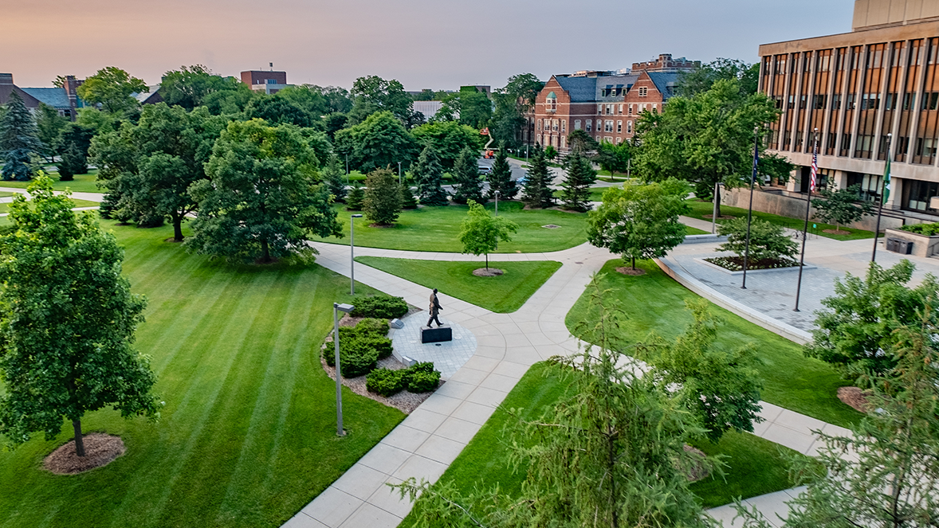
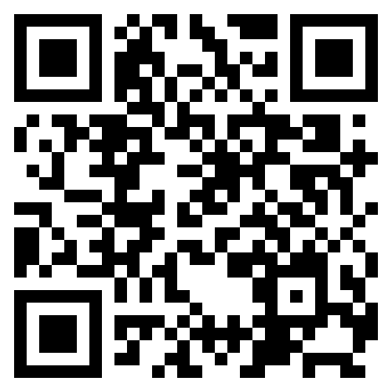



Contact FASA:
fasaffairs.msu.edu
fasaffairs@msu.edu
THANK YOU!

