Slide 1

Do you need to have a conversation?
Complaining to others
Others complaining to you
Doing extra or unnecessary work
Reassigning work
Ruminating about the problem
Getting emotional
Avoiding the person
Distracted/disengaged
This Photo by Unknown Author is licensed under CC BY-ND

Slide 2

What is it costing you?
“…the average person wasted seven days on the previous behaviors.
01
40% admitted to wasting two weeks or more.
02
estimated the cost of their silence to be $7,500 to $50,000
03
https://www.jodymichael.com/blog/when-not-to-have-a-crucial-conversation/#:~:text=The%20study%20showed%20the%20average,to%20be%20more%20than%20%2450%2C000!

Slide 3
Reasons We Avoid Crucial Conversations (Conflict)
Embarrassing for one or both parties
Don’t want to hurt feelings
Not sure its time/Not sure you have enough information
May damage relationship
They’re a good person
They’re already struggling with ______
Not my job
Shouldn’t have to/they should know
Might make it worse
Etc…….

Slide 4
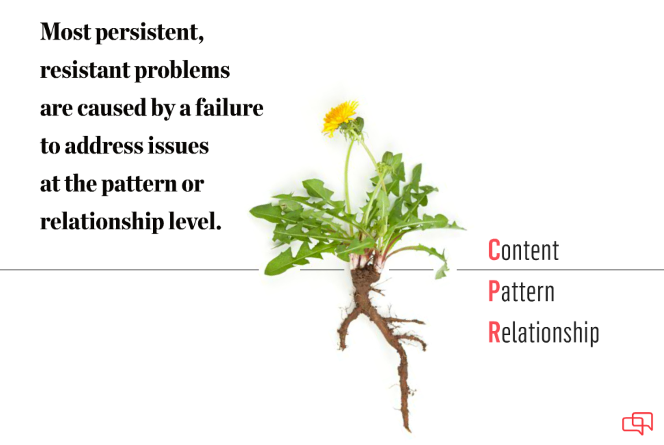
WHAT: Plan for the right conversation…
Is this a…
Single occurrence
Pattern
  Same behavior
  Different behavior, same category (e.g. lack of professionalism)
Relationship buster

Slide 5
What is a fact…really?
Separate your facts from your stories.
Stories: What you observed, versus what you think about what you observed.
FACT | STORY
You’re cut off in traffic | That person is reckless
Your colleague publicly asked you a question in your area of expertise that you couldn’t answer | They are deliberately trying to make me look bad
Your supervisor scowls and interrupts when you mention a concern about a comment they made | They are unapproachable and unwilling to change, I’m on my own

Slide 6
Tell a different story:
FACT | STORY
You’re cut off in traffic | They must be distracted. I’m glad we’re both safe and hope they’re ok.
Your colleague publicly asked you a question in your area of expertise that you couldn’t answer | They recognize this is my specialty and meant to let me share my knowledge. No harm intended
Your supervisor scowls and interrupts when you mention a concern about a comment they made | It’s possible they’re embarrassed over the comment and have already realized the mistake

Slide 7
Tell no story:
FACT | QUESTION
You’re cut off in traffic | n/a
Your colleague publicly asked you a question in your area of expertise that you couldn’t answer | When you unexpectedly asked me the question I couldn’t answer about “x”, it crossed my mind that maybe that was your intent. But that could be off-base. Would you share what you had in mind when you posed the question?
Your supervisor scowls and interrupts when you mention a concern about a comment they made | I noticed that when I mentioned “x”, your expression changed, and you looked like you may be irritated. I only wanted to talk with you privately to share the impact, and to hear your thoughts.

Slide 8
Stories, and Solutions: Six Sources
We often believe the worst about others’ intentions and motivations
We expect others to assume our good intent
We fail to consider the other reasons (sources) of behavior
 | MOTIVATION | ABILITY
PERSONAL | Do they want to engage in the behavior? | Do they have the right skills and strengths to do the right thing?
SOCIAL | Are other people encouraging and/or discouraging behaviors? | Do others provide the help, information, and resources required at particular times?
STRUCTURAL | Are systems rewarding the right behavior and discouraging ineffective ones? | Are there systems that keep people in place and on progress?

Slide 9
Stories, and Solutions: Six Sources
Example: You’re cut off in traffic
 | MOTIVATION | ABILITY
PERSONAL | They don’t care about driving safely and the risk to others | They have an injury, and then they moved to make the lane change, the muscle spasmed
SOCIAL | A passenger is telling them to hurry | Their passenger told them the lane was clear
STRUCTURAL | People are rarely pulled over for lane-change infractions | A road sign was missing, or not placed far enough back to respond in time.

Slide 10
WHY: Why are you having the conversation?
DISRUPTIVE INTENT | HELPFUL INTENT
Be right | Find the truth
Look good, save face | Learn
Win | Find a solution
Punish, blame | Produce long-term results
Control | Strengthen relationships
What do they think your intent is?
What impact could this belief have on their participation and honesty?

Slide 11

HOW:
Confidently, but with humility
Privately
Distraction free (to extent possible)
With curiosity
With emotions under control
Without pre-drawn conclusions

Slide 12
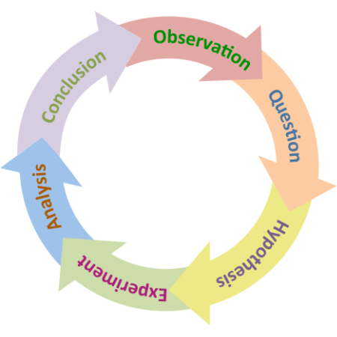
Yes, but…
I know how they are
I wasn’t born yesterday
Everyone else sees it the same way
My instincts tells me
Be a scientist and approach the conversation with curiosity instead of dread.
Turn your assumptions about the underlying cause into a working hypothesis – then gather data!

Slide 13
SAFETY:
Do they feel safe sharing their experiences, or reasons?
Would they tell you if they didn’t?
Assuming they wouldn’t, how might you know they don’t feel safe?
WHY does it matter?
If they don’t trust you, or your intentions, if they believe you think you have the answers already, or if they think the outcome is pre-determined, what reason do they have for participating? Being truthful or sharing personal information?
Incomplete information Bad decisions

Slide 14
Signs safety may be missing:
VERBAL
Understating true opinions (e.g. sarcasm, sugarcoating)
Using phrases like “some people”, instead of “I”
Changing the topic, or making jokes
Physically or verbally withdrawing
Using absolutes (e.g. never, always)
Labeling and name-calling
Monopolizing conversation
Using questions to control others (e.g. Everyone agrees with me, right?)
PHYSICAL/PHYSIOLOGICAL
Sweating profusely
Repetitive motions begin, or body freezes
Face changing color
Change in vocalization (volume, pace, etc.)
Change in eye contact
Crying
Shaking
Any significant change from “baseline”

Slide 15
Building trust:
“Trust is built in drops and lost in buckets.” – Kevin Plank
Trusting: Your ability to feel and demonstrate trust in others. You can influence this, but you may have to “unpack” a bit of your life experiences/relationships. Takes time.
Trust-worthy: Your behaviors align with your commitments/promises. And these align with positive organizational or cultural norms.
Trusted: When others perceive you to be trust-worthy. You can only influence this.

Slide 16
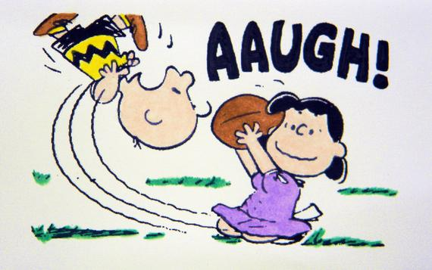
Trust and conflict:
Every interaction is a chance to build (or lose) trust. Don’t expect trust to be there when an important issue comes up if you aren’t putting in the work.
This Photo by Unknown Author is licensed under CC BY-NC

Slide 17
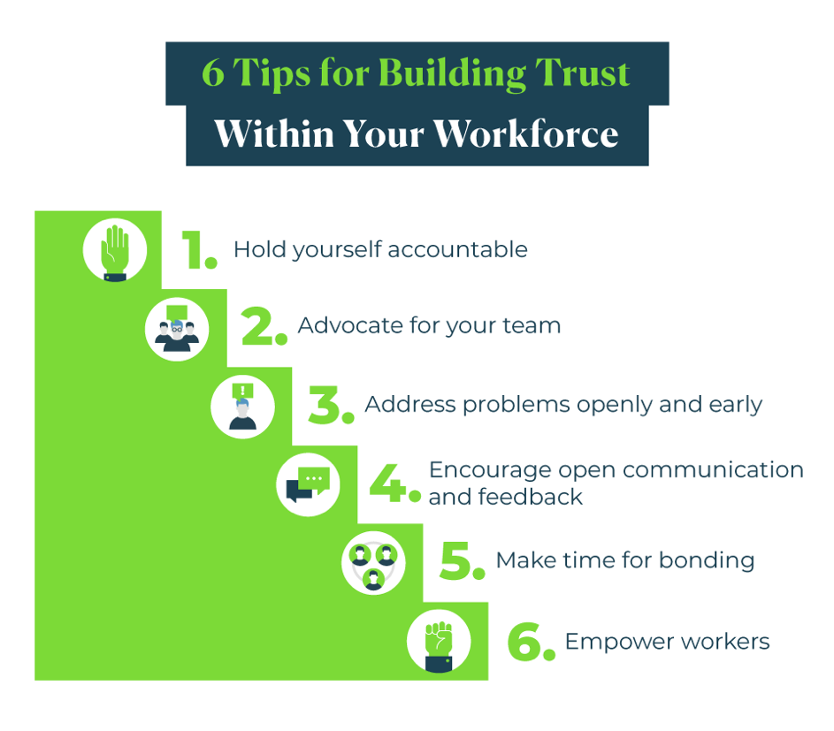
Building Trust:
https://www.upwork.com/resources/tips-for-building-trust-with-your-team

Slide 18
Trust building:
Consistent communication
Emphasize accountability
Promote transparency
Foster inclusivity
Encourage active listening
Demonstrate empathy
Celebrate success and provide constructive feedback
https://www.teamdynamics.io/blog/7-behaviors-that-build-trust-in-virtual-teams-and-hybrid-teams#:~:text=Key%20behaviors%20include%20consistent%20communication,a%20strong%20foundation%20of%20trust

Slide 19
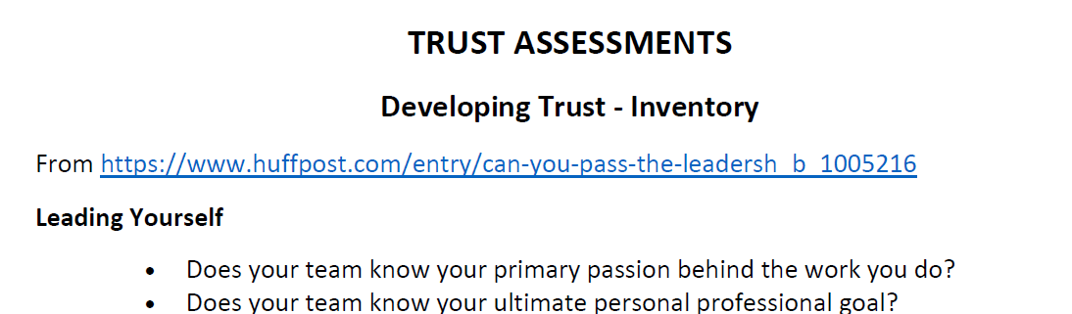
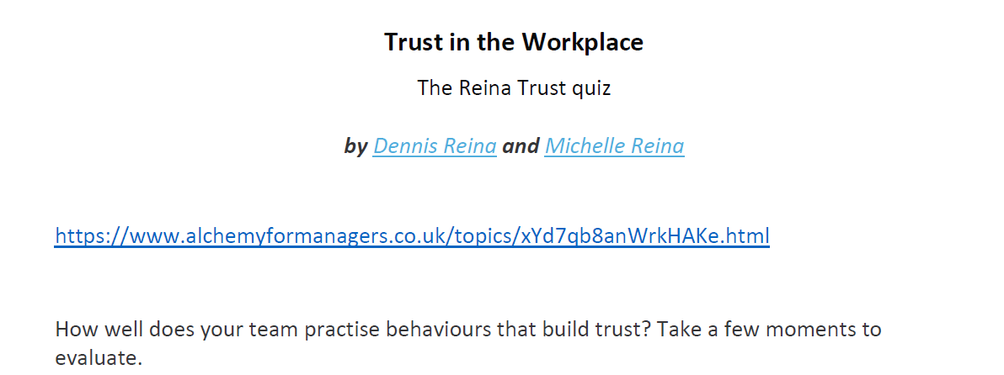
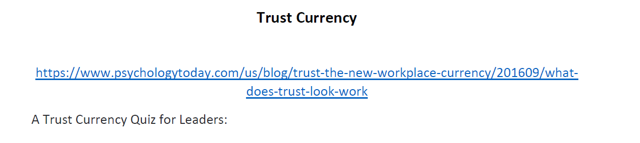

Slide 20
Watch this space:
For the 2024 schedule of professional development classes thru OPD, including:
        Crucial Conversations for Mastering Dialogue
        Crucial Conversations for Accountability
https://hr.msu.edu/professional-development/courses/index.html

Slide 21
Additional Opportunities

Slide 22
Continuing the Learning and Contacts
Climate Assessment Toolkit
Prevention, Outreach and Education Department (POE)
HR’s Organizational and Professional Development
  Conflict Management-December 7
  Crucial Conversations-December 13 and 14
  ElevateU
  Implicit Bias (2024 Dates: Feb 8th , 22nd , March 7th from 10:00a.m. – 11: 30a.m. online.)
MSU Extension
  Communicating through Conflict Certificate Course
University Ombudsperson
  Offers trainings and consultations
Faculty Grievance and Dispute Resolution Office
  Reach out with questions or for consultations
Department or College level HR Administrators
Faculty and Academic Staff Affairs and Employee Relations

