Slide 1
Setting the Tone
An Introduction to Changing Climate & Culture
Creating & Sustaining a Respectful Work Environment

Slide 2
Introduce ourselves
How is climate linked to sexual harassment?
What does Know More tell us about MSU climate?
What can we do about it?

Slide 3
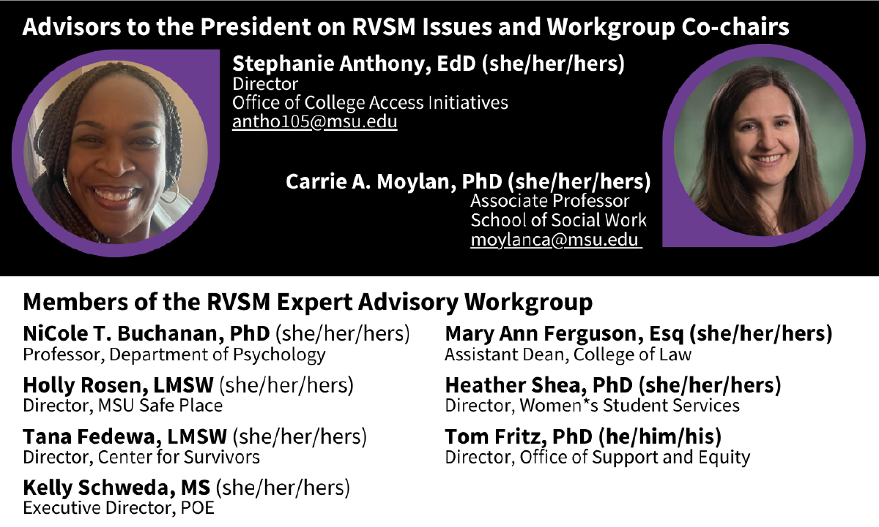
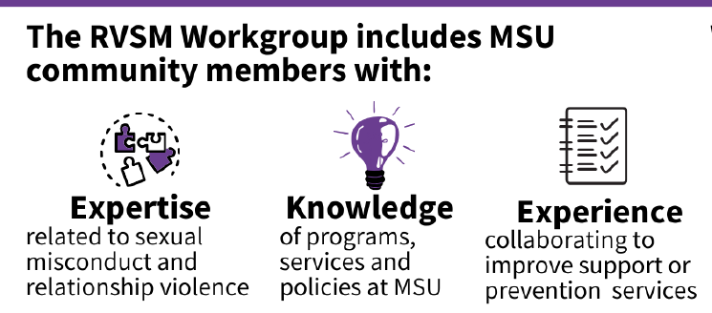
RVSM Advisors & Workgroup
Notes:
Introduce ourselves and our role as advisors and co-chairs of workgroup (brief)

Slide 4

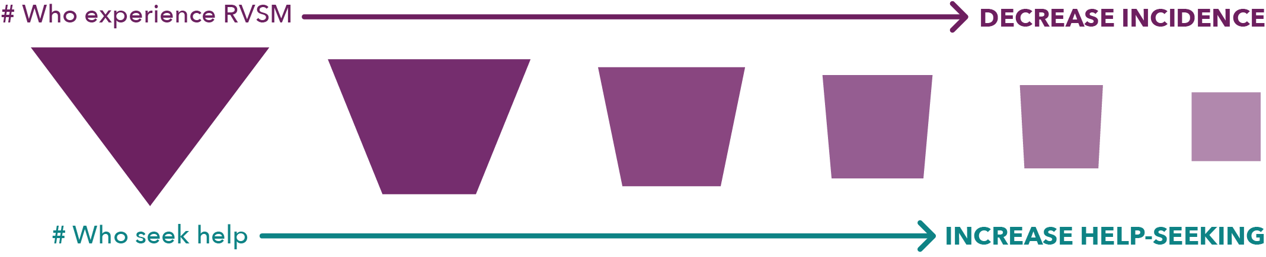
One of our goals
Change the culture and climate at MSU to:
  Reduce incidence of RVSM
  Increase help-seeking
CHANGE THE SHAPE OF OUR INSTITUTIONAL RESPONSE TO RVSM

Slide 5
Permissive Climate Sexual Harassment
Organizational climate is the STRONGEST predictor of SH
Permissive climates increase sexual harassment rates and decrease willingness to report.
Permissive climates reduce job satisfaction, while supportive climates decrease SH and retaliation rates, and increase overall psychological health and work satisfaction.
All citations drawn from: NASEM, 2018; Moylan et al, 2021
Notes:
Permissive = How risky is it for victims to report harassment
Are offenders sanctioned
Will reports be taken seriously?

Slide 6
Uncivil Workplaces Sexual Harassment
Workplace incivility is associated with
  greater tolerance for sexual harassment
  higher rates sexual harassment
  Job dissatisfaction and intention to leave
Lower intensity but higher frequency experiences (incivility, gender hostility) are just as damaging as high intensity but less frequent behaviors (sexual harassment)
All citations drawn from: NASEM, 2018; Moylan et al, 2021
Notes:
Women of color experience highest rates of incivility

Slide 7
Hierarchy and Power Sexual Harassment
Organizations that are hierarchical and have large power differences have higher rates of sexual harassment.
More male-dominated organizations have higher rates of sexual harassment.
All citations drawn from: NASEM, 2018; Moylan et al, 2021
Notes:
Less power = more vulnerable, less likely to report, fear of retaliation, etc

Slide 8
Inclusion and Belonging Sexual Harassment
LGBTQ+ students on campuses that they rated as more inclusive, experienced lower rates of sexual violence.
Schools with low levels of social connectedness have higher rates of bullying and sexual assault.
Students with greater sense of community are more likely to intervene as bystanders, report RVSM
All citations drawn from: NASEM, 2018; Moylan et al, 2021

Slide 9

Improving Climate
Permissive Climate
Uncivil
Hierarchy
Power Differences
Supportive Climate
Take SH Seriously
Foster Inclusivity
Promote Belonging
INCREASE
Reporting & Help-seeking
Job Satisfaction
Psychological Safety
Well-being
Bystander Intervention
DECREASE
Sexual Harassment
Incivility
Intent to Quit

Slide 10
So how are we addressing climate at MSU?

Slide 11


Slide 12

Campus-wide RVSM climate surveys
Students, faculty, and staff
Measure prevalence, help-seeking, climate
Reliable and valid measures
Repeat assessments to measure change
Coming in Spring 2025!

Slide 13



Slide 14
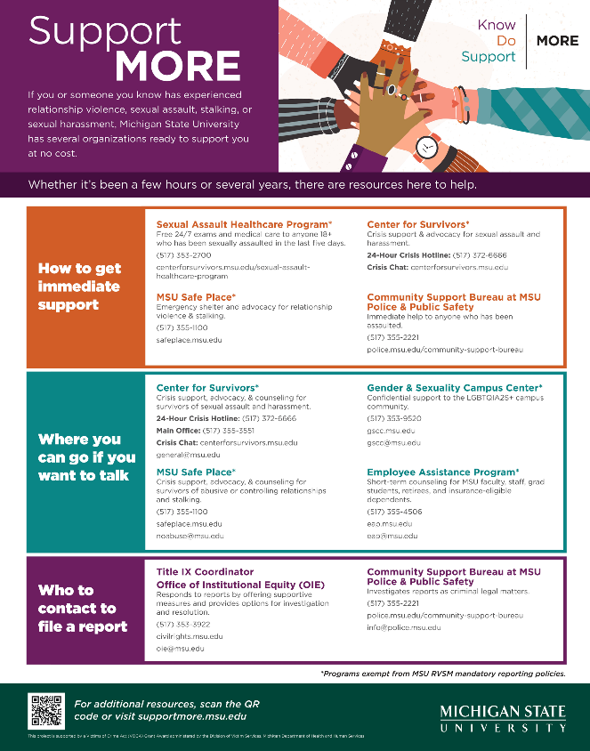
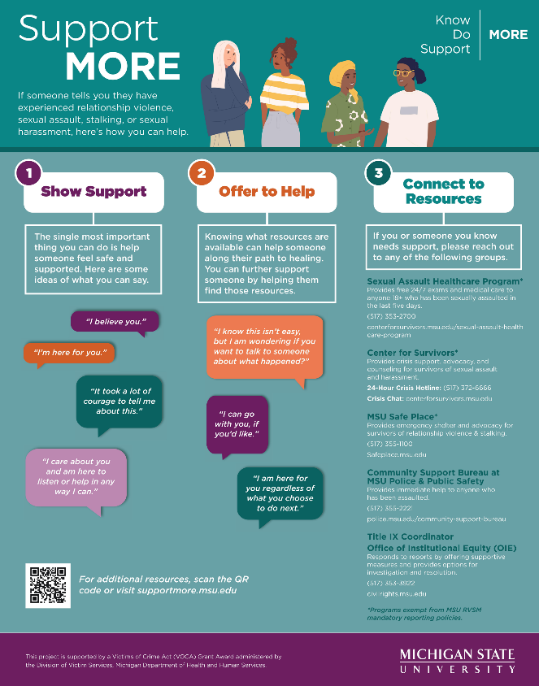



Slide 15
What does Know More tell us about climate?
Incidence & Prevalence of RVSM
RVSM Resources
Workplace Incivility
Campus Climate

Slide 16
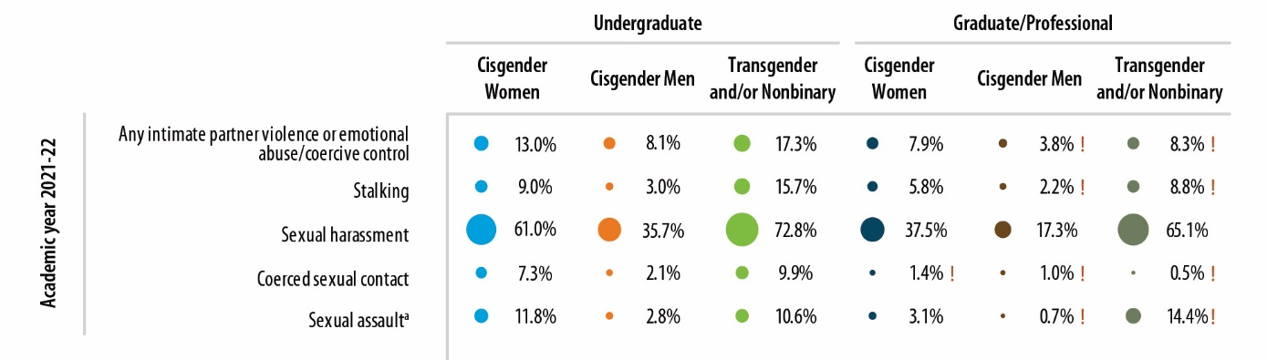
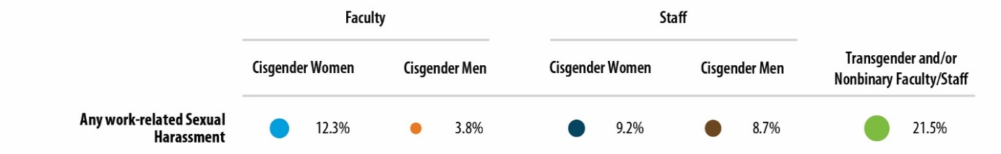
Sexual harassment

Slide 17
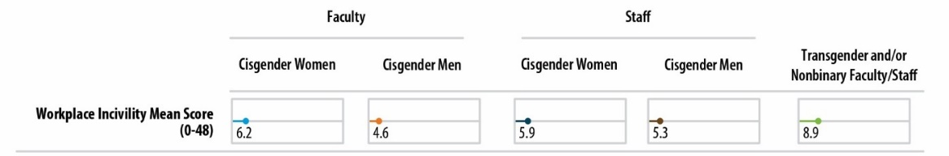
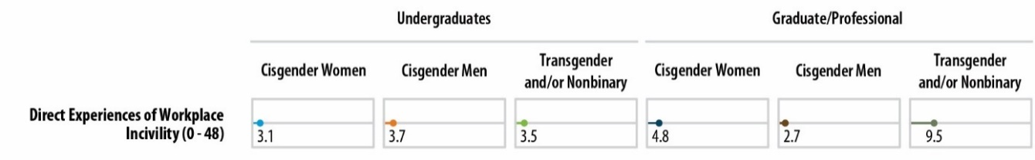
Workplace Incivility
61-75% of Faculty/Staff had experienced Workplace Incivility

Slide 18
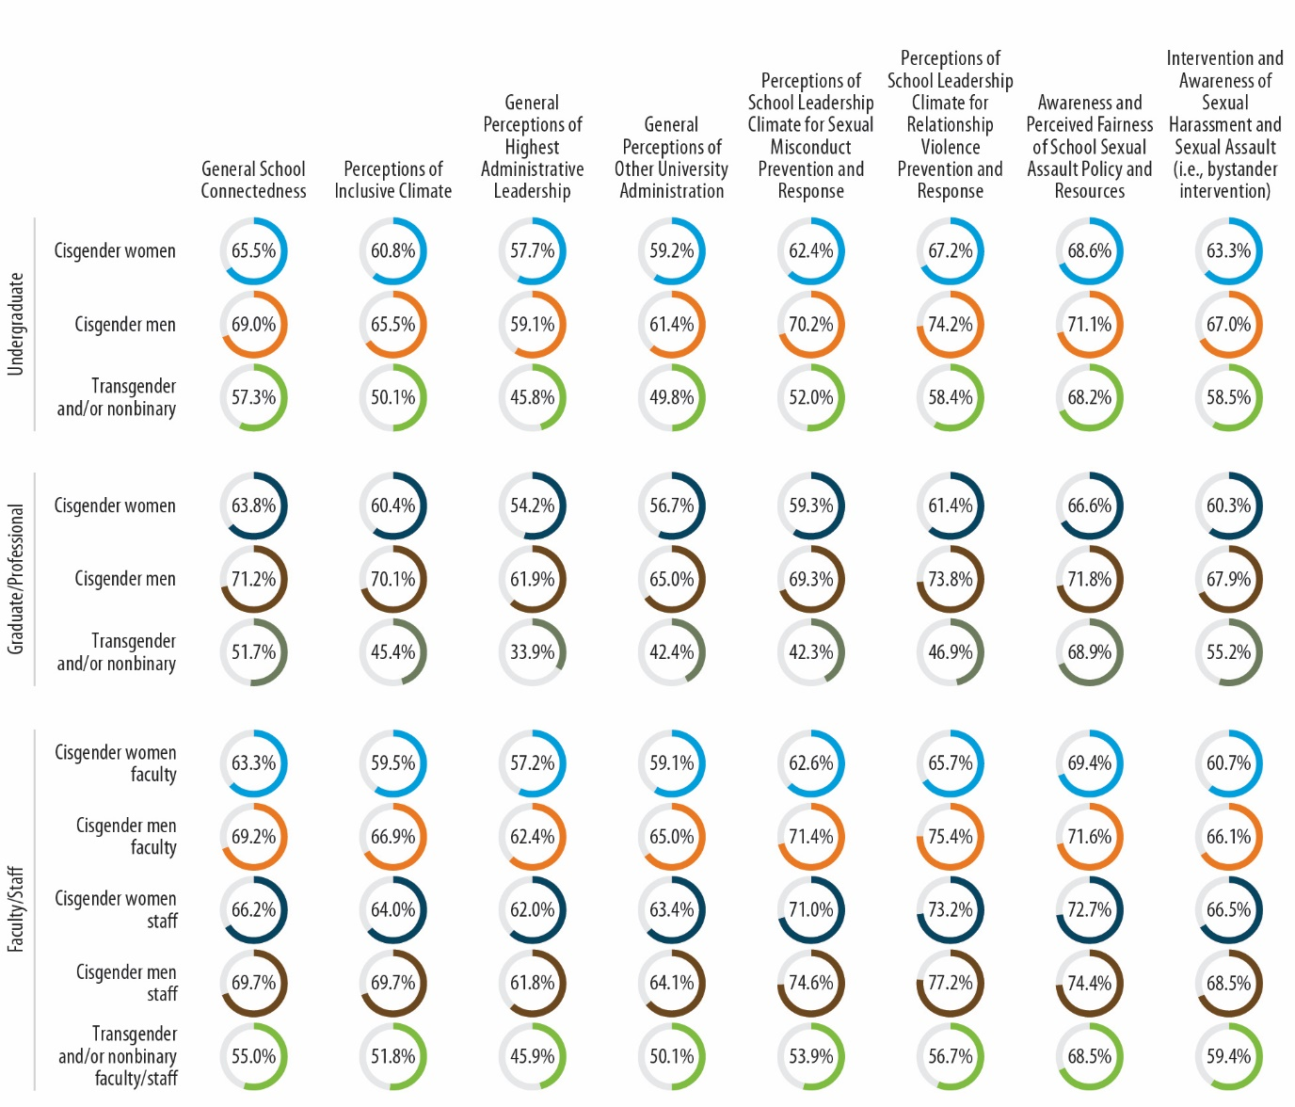
Climate
Climate scores have improved since 2019 on all but School Connectedness.

Slide 19
We each have a role in shaping climate @ MSU

