Slide 1
Management of cases Reported TO OIE
Process & Responsibilities

Slide 2
Strategic Partners
Nicole Schmidtke, Office for Civil Rights, messin41@msu.edu
Amanda Moses, Office of Employee Relations, mosesa@hr.msu.edu​
Melissa Sortman, Office Faculty and Academic Staff Affairs, sortmanm@msu.edu
​
​
​

Slide 3
WARNING
This presentation refers to an example of sexual harassment.
If you believe that you will find the discussion to be traumatizing, you may choose to not participate in the meeting or step away from the discussion.
Resources and assistance are available through the Center for
Survivors, Counseling and Psychiatric Services and the Employee
Assistance Program.

Slide 4
ACRONYMS
ADP (Anti-Discrimination Policy)
FASA (Office for Faculty and Academic Staff Affairs)
OCR (Office for Civil Rights and Title IX Education and Compliance)
OER (Office of Employee Relations)
OGC (Office of General Counsel)
OHS (Office of Health Sciences)
OIE (Office of Institutional Equity)
RO (Resolution Office)
RVSM (Relationship Violence and Sexual Misconduct and Title IX Policy)

Slide 5
Objectives
Increase understanding of the OCR/OIE/RO process and your role as an administrator
Establish the importance of working closely with FASA, OER or OHS throughout this process, so that you have the support needed
Identify possible action steps to assess and address misconduct related to reports made to OIE

Slide 6
Office for Civil Rights, & title IX education & Compliance
Prevention, Outreach, and Education Department (POE)
Office of Institutional Equity (OIE)
Support and Intake Team (SIT)
Director, RVSM Response & Investigations
Director, ADP Response & Investigations
Resolution Office (RO)
Office of the ADA Coordinator
PACE (Projects, Analytics, Compliance and Envisioning)

Slide 7
OCR Overview

Slide 8
Human resources STRUCTURE @ MSU
Provost and Exec VP
Associate Provost and Associate VP for Faculty and Academic Staff Affairs
5,700 faculty, academic staff and executive managers
Exec VP Office of Health Sciences
College of Human Medicine
College of Osteopathic Medicine
College of Nursing
Health Care Inc
Faculty, academic staff, and support staff
EVP Administration
Associate Vice President for HR
7,000+
support staff

Slide 9
What is misconduct?
Behavior that is inappropriate for the workplace, negatively impacts the work environment, does not meet legitimate expectations and/or violates University or departmental polices or procedures. It can range from minor issues to serious violations.

Slide 10
Policy Overview
Faculty & Academic Staff
Faculty Rights and Responsibilities
Code of Teaching Responsibility
Consensual Amorous or Sexual
Relationships with Students
Outside Work for Pay
Research Misconduct
University-Wide
Relationship Violence and Sexual Misconduct & Title IX Policy
Anti-Discrimination Policy
Acceptable Use Policy for MSU Information Technology
Occupational Health and Safety Rules & Regulations
Support Staff
Support Staff Rules Governing Personal
Conduct of Employees

Slide 11
Report Submitted to OIE: Initial Assessment
Notifications to Other Units
Referrals
Outreach
Closure Considerations

Slide 12
OIE Notification of Reported Behavior
Consult with FASA, OER, OHS to review
Consider whether interim action may be needed
Do not investigate
Do not retaliate
OIE Notification to Senior Admins, FASA or OER*
*FASA: If the respondent is FAS
OER: If the respondent is Support Staff

Slide 13
Hello,
​​​​​​​
My name is [[SENDER_FULL_NAME]] with the Office of Institutional Equity (OIE) at MSU. OIE responds to reports regarding possible violations of the Relationship Violence & Sexual Misconduct and Title IX Policy (RVSM and Title IX Policy) and the Anti-Discrimination Policy (ADP). You are receiving this notification based on your current listed role on campus.
OIE received a report about concerns involving Respondent Employee RESPONDENT FULL NAME, RESPONDENT TITLE, AND RESPONDENT ID NUMBER
At the present time, OIE is aware of the following information:
INSERT BULLET DESCRIPTION OF ALLEGATIONS AND OTHER RELEVANT INFORMATION AND INCLUDE ATTACHMENTS IF NECESSARY
OIE is also aware of the following reports or complaints previously made about Respondent:
INSERT BULLET POINTS LISTING OF CASE NUMBERS AND BRIEF SYNOPSIS, INCLUDING HOW THE MATTER WAS RESOLVED

Slide 14
OIE has reviewed the information and at this time has referred the matter for closure with our office due to lack of coverage, insufficient information, or non-participation by a claimant under the ADP or RVSM. We are referring the matter to you for review to take potential action as deemed necessary to address conduct that may implicate policies, protocols, or standards of conduct other than the ADP/RVSM. Please consult with Human Resources for further guidance on the available options and implementation of employment actions and notify OIE if action is taken. In the event you have additional information that may change OIE's review, please do not hesitate to contact us immediately.
Prohibition on Retaliation
Please note that MSU prohibits retaliation (including but not limited to retaliatory harassment, discrimination, intimidation, or coercion) against individuals who report conduct including discrimination or harassment, or who participate in the University's response to these reports. Any allegation of retaliation will be deemed a separate and distinct violation of policy and will be investigated independently.
The materials in this email are private and may contain confidential information. If you are not the intended recipient, be advised that any unauthorized use, disclosure, copying, distribution, or the taking of any action in reliance on the contents of this information is strictly prohibited. If you have received this email in error, please immediately notify the sender and disregard the communication.
If you have any additional questions, please do not hesitate to contact me.
Sincerely,
[[SIGNATURE]]

Slide 15
INTERIM Actions
Interim Measures = Non-disciplinary, safety measures or measures to deter conduct during an investigation under RVSM Policy or ADP.
Must talk to FASA, OER, OHS (and Title IX Coordinator) prior to any action.
Exception: Imminent Safety Concerns
Promptly notify FASA, OER, OHS (and Title IX Coordinator) if measures implemented under other policy.

Slide 16
No interim actions
If no interim actions taken, you will wait for the findings concerning the OIE investigation and/or RO finding.
Remain observant of the situation and reach out to FASA, OER, OHS if you have concerns.
You will get regular status updates from OIE and/or RO. If you have questions, reach out to OIE or RO.
You may address other workplace issues such as performance or policy violations. You should consult with OER/FASA/OHS as appropriate.

Slide 17
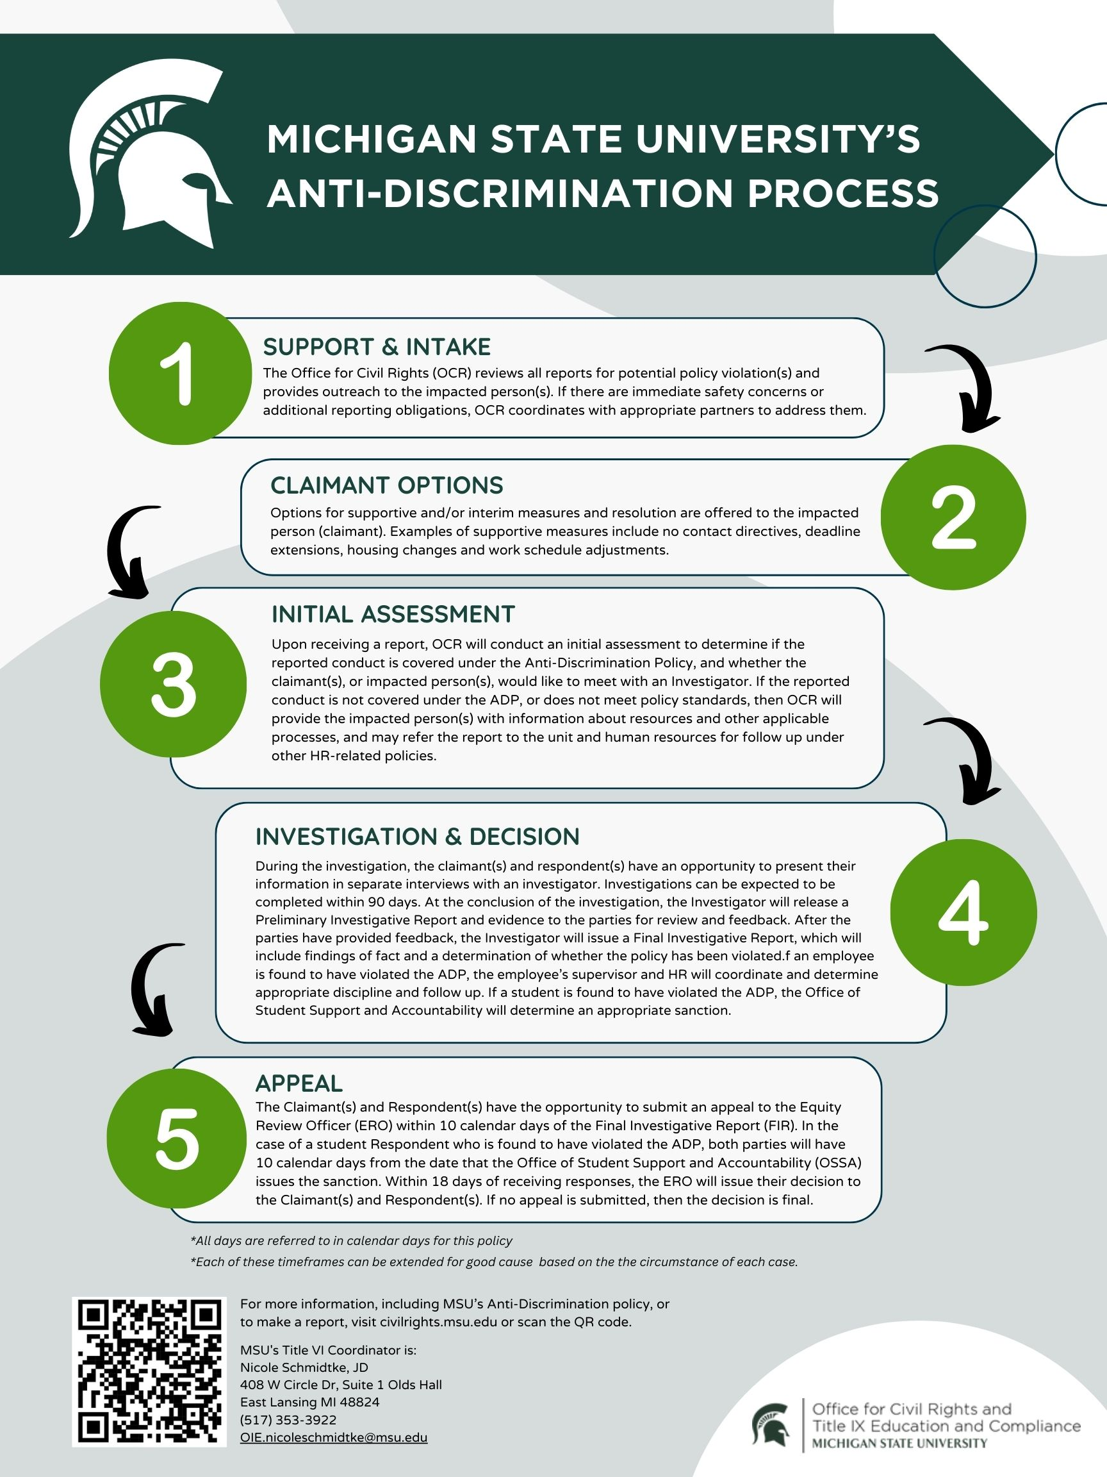

Slide 18
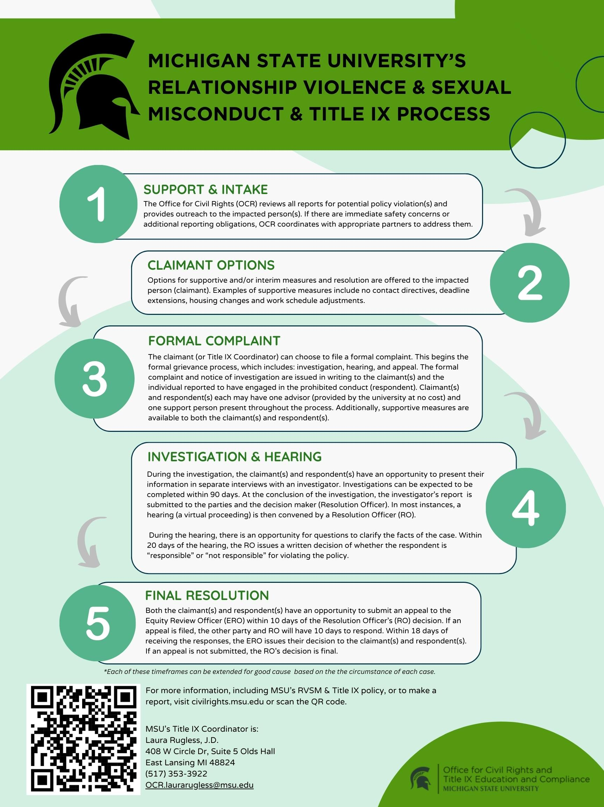

Slide 19
Case Discussion

Slide 20
Debrief Breakout Rooms
You receive a notification from OIE, what are your first steps?
What should you not do?
What are some things that you need to consider as you think about whether interim measures need to be implemented?
Who should you consult with?
What resources are available to you?
Based on what is stated in the case, do you recommend any interim measures?
If yes, what would you recommend and why? If no, why not?
Who can help you with how and what to communicate to the parties involved?
Would you do anything different if you received a notice that OIE is going to move forward with an investigation? Why or why not?

Slide 21
Situational considerations
Safety concerns
Power dynamics
Life experiences
Awareness of multiple people within the unit potentially being involved in a case, witnesses resulting in divisions and residual conflict
Reducing the ability for any retaliation
Notes:
Melissa

Slide 22
Individual Leadership Considerations

Slide 23
FINDING: Violation of RVSM or ADP Policy
Schedule
Schedule a meeting with College/Department leadership, FASA/OER, OGC, and OCR
Consider
Consider if other policies were violated and if further investigation of the issues is needed
Assess
Assess appropriate discipline or other interventions
Create
Create a plan to implement discipline and any necessary communications

Slide 24
No finding
What does "No Finding" Really Mean?
Next Steps/Considerations:
Leadership meets with FASA, OER or OHS to assess situation
Are there other behaviors or actions that are concerning?
Is further investigation needed?
Action steps to consider: professional development, re-entry, clarification of rules/policy, discipline, etc.
How do you rebuild the team?

Slide 25
What is considered in an appeal
Procedural Irregularity
New Evidence
Conflict of Interest or Bias
Arbitrary and Capricious

Slide 26
Discipline Overview for Support STaff
Consult with OER to ensure compliance with collective bargaining agreements and human resource policy.
Approval from the Director of Employee Relations is required for certain actions.
OER can assist with required notifications/reporting

Slide 27
Discipline overview for faculty & academic staff
Academic Specialist Handbook
Faculty Handbook
Fixed-Term
Tenure Stream Faculty
FRIB NCSL Handbook
Health Professional (HP) Handbook
Librarian Handbook
UNTF Contract

Slide 28
Communication Review process for employee misconduct
Communications should reflect the University’s commitment to ensure a safe and respectful working and learning environment while adhering to employee privacy rights required by law.
The University endeavors to increase transparency, promote accountability, and build trust and awareness within the University community.
Balance of transparency and confidentiality
Stakeholder communication strategy
Working with OER/FASA, OCR, OGC, Presidential Advisors, and University Communications
Considering communication in the context stage of the process and impact on stakeholders

Slide 29
Reporting
If interim actions or actions after a finding are taken, other oversight organizations may need to be notified
Clery Act – if the incident involved a Clery crime, the Clery Act Compliance Coordinator will be notified by FASA/OER
Federal Agencies (NSF/NASA/NIH/DOD/DOE/USDA)
CGA website with requirements: https://www.cga.msu.edu/PL/Portal/2190/HarassmentReportingRequirementsbyAgenc yEntityinBrief
OCR Resolution Office must be notified immediately of any disciplinary action taken
Requirements under Title IX to notify claimant

Slide 30
Real world advice
Practitioner Panel

Slide 31
QUESTIONS
Questions?

