Slide 1
Negotiating Conflict and Power Dynamics
Creating and Sustaining a Respectful Work Environment Series
November 15, 2023

Slide 2
Shannon Burton
University Ombudsperson

Slide 3
Three Dimensions of Conflict
Cognitive
Emotional
Behavioral

Slide 4
Causes of Conflict
Survival Needs
Interests
Identity Needs

Slide 5
Factors of Conflict
Communication
History
Structure
Values
Emotions

Slide 6
Contextual Considerations
Culture
Personality
Power
Data

Slide 7
Francisco Villarruel
Faculty Grievance Official

Slide 8
CONFLICT

Slide 9
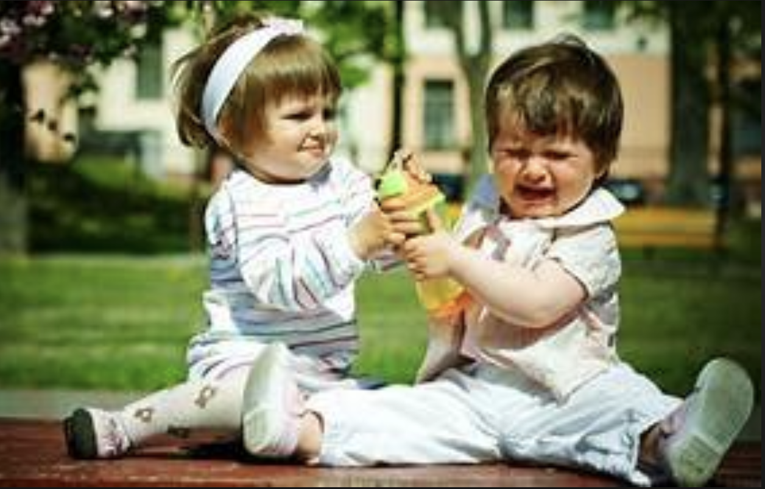
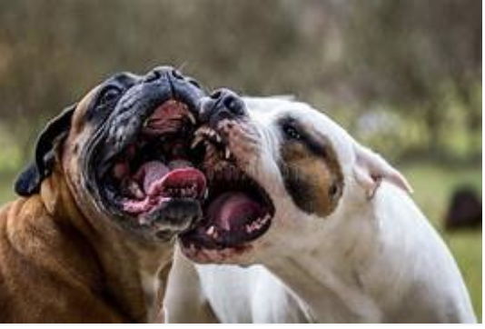
Conflict: It is part of our lived reality

Slide 10
Why do we fear conflict?
Reinforces/redefines power
‘Winner/loser’ syndrome
Impacts trust
Influences climate
Influences satisfaction
Influences identity

Slide 11
What words come to mind?
Appreciative Inquiry

Slide 12
Appreciative inquiry
What we look for we find.
What we pay attention to facilitates understanding.

Slide 13
Jade Richards
Institutional Diversity and Inclusion

Slide 14
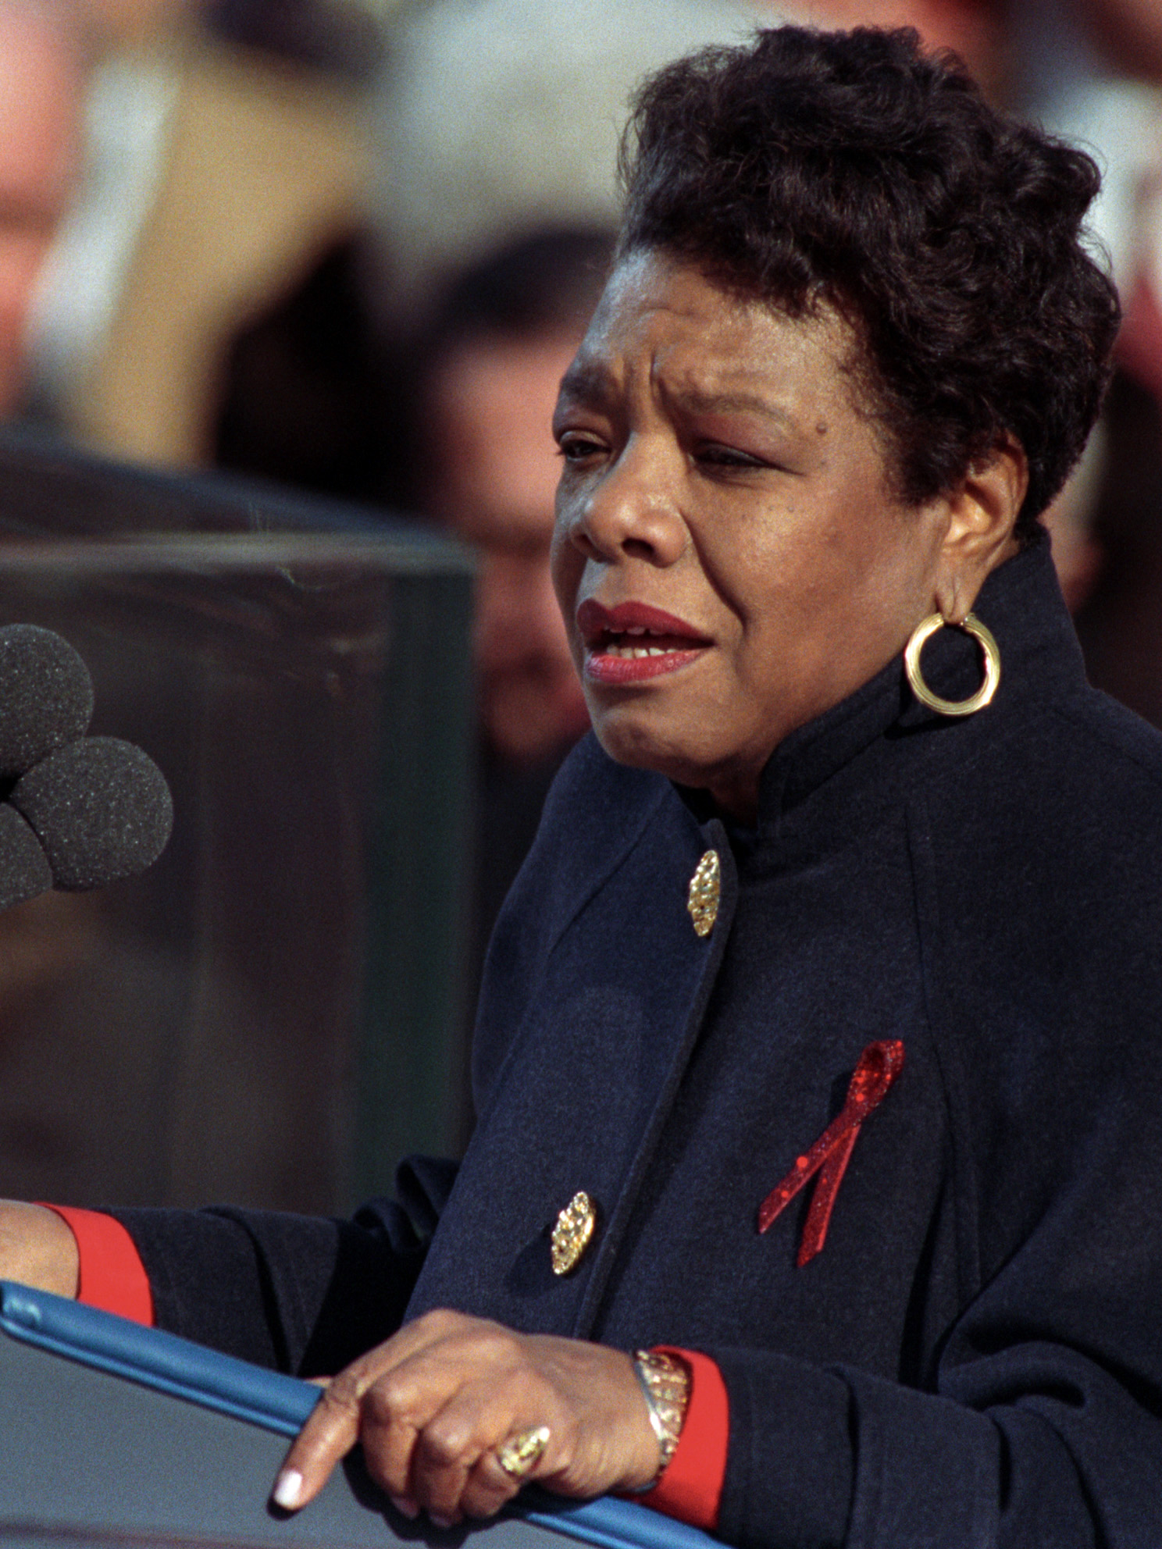
Maya Angelou
“Do the best you can until you know better. Then when you know better, do better.”

Slide 15
The Impact of Inclusion
Increased (academic) achievement
Higher self-esteem and greater confidence in creative problem-solving
Improved critical thinking and openness to intellectual challenges
Increased awareness of social problems, civic engagement, and empathy
Increased sense of belonging
Reduced prejudice across difference and increased meaningful relationships across difference
These effects are long-term and consistent across age groups

Slide 16
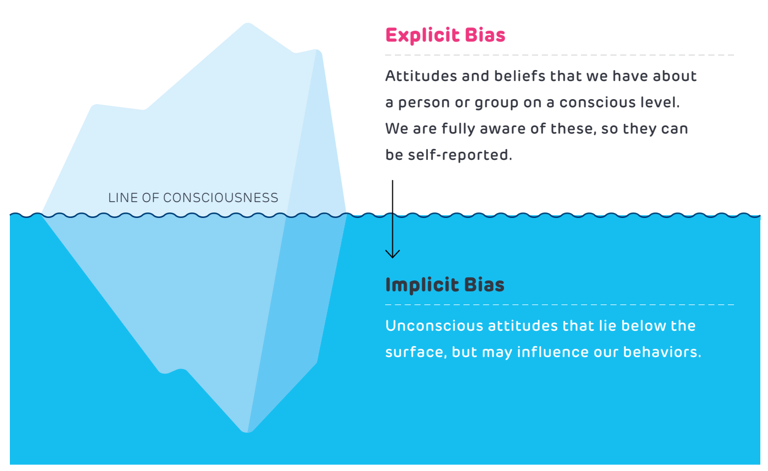
Thinking About Bias

Slide 17
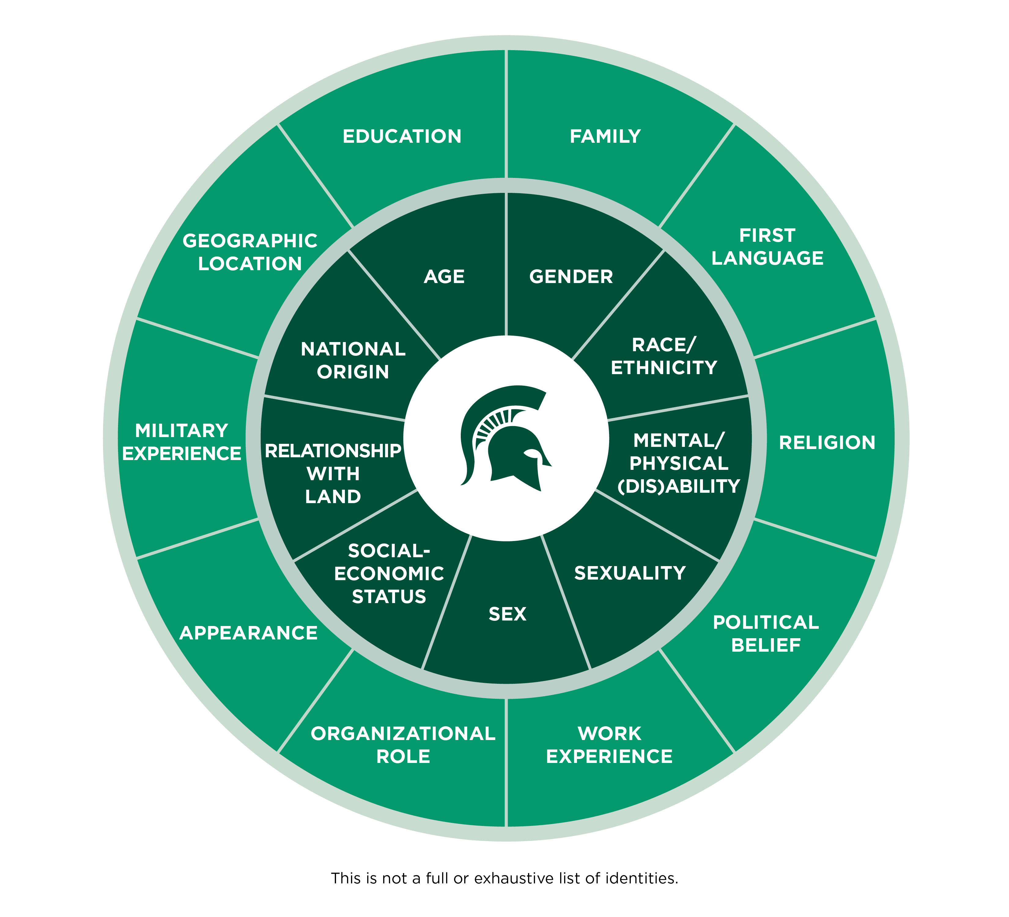
DEI Foundations Social Identities

Slide 18
Power/Positionality
Social group(s)
  People who share a range of physical, cultural or social characteristics within one of the social identity categories (Social class, Race, Gender, Religion, Education)
  We have may have a variety of social identities
    These identities may hold power and privilege in a variety of ways
  Intersectionality (Crenshaw, 1989)
      Our various identities work at different levels that can bring advantages, disadvantages, barriers, opportunities, we cannot be reduced to one part of our identity, multiple levels of oppression may combine or overlap

Slide 19
What is Oppression?
"Oppression" refers to a combination of prejudice and institutional power that creates a system that regularly and severely discriminates against some groups and benefits other groups
Oppression: a situation in which people are governed in an unfair and cruel way and prevented from having opportunities and freedom
https://nmaahc.si.edu/
https://dictionary.cambridge.org/
Notes:
Share out slide:
A person of the non-dominant group can experience oppression in the form of limitations, disadvantages, or disapproval. They may even suffer abuse from individuals, institutions, or cultural practices. "Oppression" refers to a combination of prejudice and institutional power that creates a system that regularly and severely discriminates against some groups and benefits other groups.
Oppression: a situation in which people are governed in an unfair and cruel way and prevented from having opportunities and freedom
https://nmaahc.si.edu/learn/talking-about-race/topics/social-identities-and-systems-oppression
https://dictionary.cambridge.org/us/dictionary/english/oppression

Slide 20
Phobias and -isms
Phobias
-isms
an extreme or irrational fear of or aversion to something
Some examples:
  Fatphobia
  Islamophobia
  Transphobia
  Xenophobia
an oppressive and discriminatory action or belief
Some examples:
  Ableism
  Ageism
  Anti-Semitism
  Colorism
  Elitism
  Heterosexism
  Racism

Slide 21
Intent Vs. Impact
Intent
What you think or feel
What you thought you were doing
What you aimed to achieve through an action
Impact
How your actions make other people feel
How your action was perceived by others
How a person/people/community receive your action

Slide 22
A Scenario...
Things to consider:
What happened?
What are the dynamics?
How are people feeling?
What are you feeling?
What is coming up for you?
https://mediaspace.msu.edu/media/Toxic+Workplace/1_957mkywe

Slide 23
A Scenario Debrief
Things to consider:
What happened?
What are the dynamics?
How are people feeling?
What are you feeling?
What is coming up for you?

Slide 24
Kathie Elliott
Organization and Professional Development
Human Resources

Slide 25

Do you need to have a conversation?
Complaining to others
Others complaining to you
Doing extra or unnecessary work
Reassigning work
Ruminating about the problem
Getting emotional
Avoiding the person
Distracted/disengaged
This Photo by Unknown Author is licensed under CC BY-ND

Slide 26

What is it costing you?
“…the average person wasted seven days on the previous behaviors.
01
40% admitted to wasting two weeks or more.
02
estimated the cost of their silence to be $7,500 to $50,000
03
https://www.jodymichael.com/blog/when-not-to-have-a-crucial-conversation/#:~:text=The%20study%20showed%20the%20average,to%20be%20more%20than%20%2450%2C000!

Slide 27
Reasons We Avoid Crucial Conversations (Conflict)
Embarrassing for one or both parties
Don’t want to hurt feelings
Not sure its time/Not sure you have enough information
May damage relationship
They’re a good person
They’re already struggling with ______
Not my job
Shouldn’t have to/they should know
Might make it worse
Etc…….

Slide 28
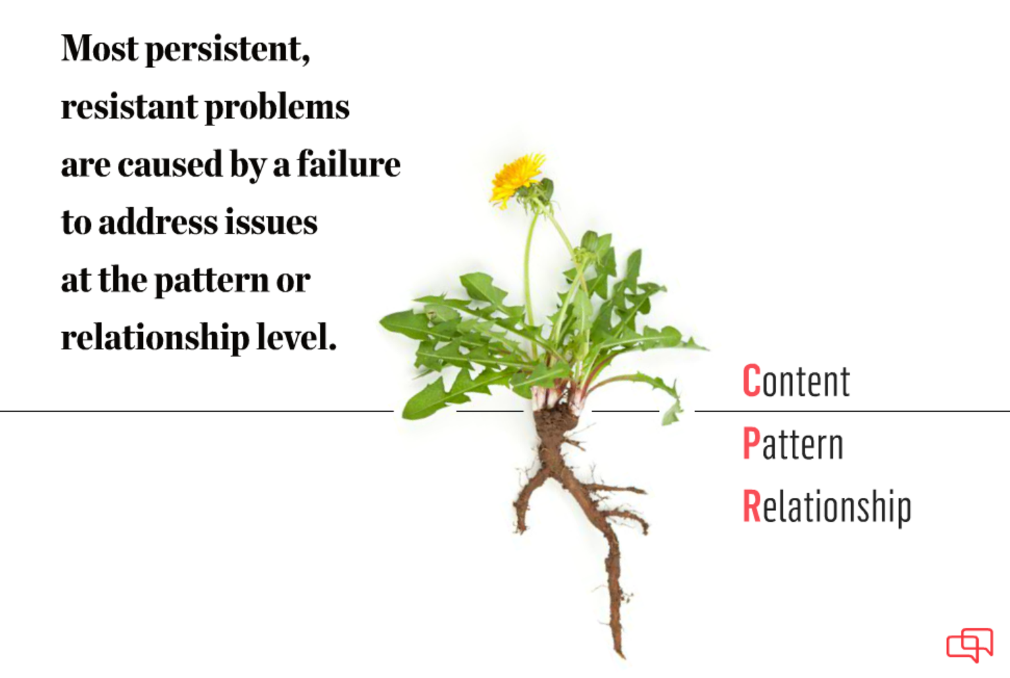
WHAT: Plan for the right conversation…
Is this a…
Single occurrence
Pattern
  Same behavior
  Different behavior, same category (e.g. lack of professionalism)
Relationship buster

Slide 29
What is a fact…really?
Separate your facts from your stories.
Stories: What you observed, versus what you think about what you observed.
FACT | STORY
You’re cut off in traffic | That person is reckless
Your colleague publicly asked you a question in your area of expertise that you couldn’t answer | They are deliberately trying to make me look bad
Your supervisor scowls and interrupts when you mention a concern about a comment they made | They are unapproachable and unwilling to change, I’m on my own

Slide 30
Tell a different story:
FACT | STORY
You’re cut off in traffic | They must be distracted. I’m glad we’re both safe and hope they’re ok.
Your colleague publicly asked you a question in your area of expertise that you couldn’t answer | They recognize this is my specialty and meant to let me share my knowledge. No harm intended
Your supervisor scowls and interrupts when you mention a concern about a comment they made | It’s possible they’re embarrassed over the comment and have already realized the mistake

Slide 31
Tell no story:
FACT | QUESTION
You’re cut off in traffic | n/a
Your colleague publicly asked you a question in your area of expertise that you couldn’t answer | When you unexpectedly asked me the question I couldn’t answer about “x”, it crossed my mind that maybe that was your intent. But that could be off-base. Would you share what you had in mind when you posed the question?
Your supervisor scowls and interrupts when you mention a concern about a comment they made | I noticed that when I mentioned “x”, your expression changed, and you looked like you may be irritated. I only wanted to talk with you privately to share the impact, and to hear your thoughts.

Slide 32
Stories, and Solutions: Six Sources
We often believe the worst about others’ intentions and motivations
We expect others to assume our good intent
We fail to consider the other reasons (sources) of behavior
 | MOTIVATION | ABILITY
PERSONAL | Do they want to engage in the behavior? | Do they have the right skills and strengths to do the right thing?
SOCIAL | Are other people encouraging and/or discouraging behaviors? | Do others provide the help, information, and resources required at particular times?
STRUCTURAL | Are systems rewarding the right behavior and discouraging ineffective ones? | Are there systems that keep people in place and on progress?

Slide 33
Stories, and Solutions: Six Sources
Example: You’re cut off in traffic
 | MOTIVATION | ABILITY
PERSONAL | They don’t care about driving safely and the risk to others | They have an injury, and then they moved to make the lane change, the muscle spasmed
SOCIAL | A passenger is telling them to hurry | Their passenger told them the lane was clear
STRUCTURAL | People are rarely pulled over for lane-change infractions | A road sign was missing, or not placed far enough back to respond in time.

Slide 34
WHY: Why are you having the conversation?
DISRUPTIVE INTENT | HELPFUL INTENT
Be right | Find the truth
Look good, save face | Learn
Win | Find a solution
Punish, blame | Produce long-term results
Control | Strengthen relationships
What do they think your intent is?
What impact could this belief have on their participation and honesty?

Slide 35

HOW:
Confidently, but with humility
Privately
Distraction free (to extent possible)
With curiosity
With emotions under control
Without pre-drawn conclusions

Slide 36
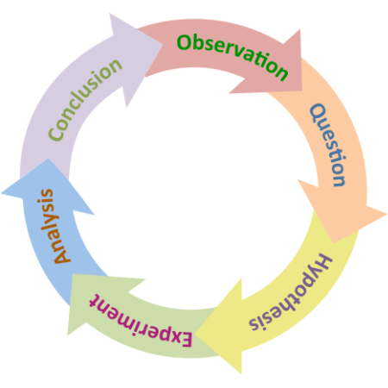
Yes, but…
I know how they are
I wasn’t born yesterday
Everyone else sees it the same way
My instincts tells me
Be a scientist and approach the conversation with curiosity instead of dread.
Turn your assumptions about the underlying cause into a working hypothesis – then gather data!

Slide 37
SAFETY:
Do they feel safe sharing their experiences, or reasons?
Would they tell you if they didn’t?
Assuming they wouldn’t, how might you know they don’t feel safe?
WHY does it matter?
If they don’t trust you, or your intentions, if they believe you think you have the answers already, or if they think the outcome is pre-determined, what reason do they have for participating? Being truthful or sharing personal information?
Incomplete information Bad decisions

Slide 38
Signs safety may be missing:
VERBAL
Understating true opinions (e.g. sarcasm, sugarcoating)
Using phrases like “some people”, instead of “I”
Changing the topic, or making jokes
Physically or verbally withdrawing
Using absolutes (e.g. never, always)
Labeling and name-calling
Monopolizing conversation
Using questions to control others (e.g. Everyone agrees with me, right?)
PHYSICAL/PHYSIOLOGICAL
Sweating profusely
Repetitive motions begin, or body freezes
Face changing color
Change in vocalization (volume, pace, etc.)
Change in eye contact
Crying
Shaking
Any significant change from “baseline”

Slide 39
Building trust:
“Trust is built in drops and lost in buckets.” – Kevin Plank
Trusting: Your ability to feel and demonstrate trust in others. You can influence this, but you may have to “unpack” a bit of your life experiences/relationships. Takes time.
Trust-worthy: Your behaviors align with your commitments/promises. And these align with positive organizational or cultural norms.
Trusted: When others perceive you to be trust-worthy. You can only influence this.

Slide 40
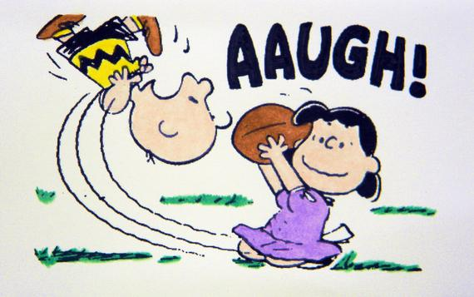
Trust and conflict:
Every interaction is a chance to build (or lose) trust. Don’t expect trust to be there when an important issue comes up if you aren’t putting in the work.
This Photo by Unknown Author is licensed under CC BY-NC

Slide 41
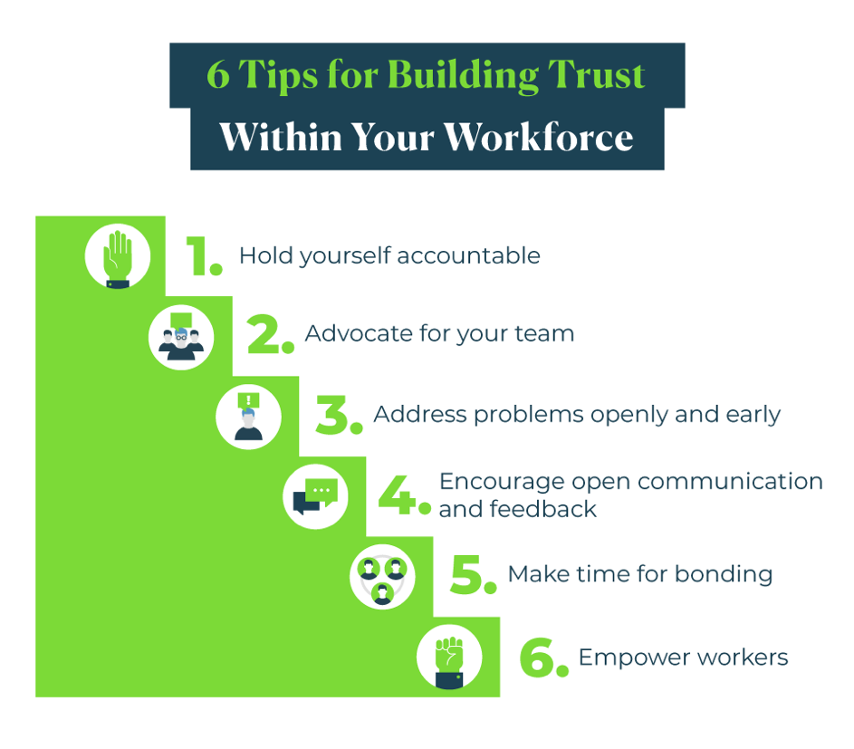
Building Trust:
https://www.upwork.com/resources/tips-for-building-trust-with-your-team

Slide 42
Trust building:
Consistent communication
Emphasize accountability
Promote transparency
Foster inclusivity
Encourage active listening
Demonstrate empathy
Celebrate success and provide constructive feedback
https://www.teamdynamics.io/blog/7-behaviors-that-build-trust-in-virtual-teams-and-hybrid-teams#:~:text=Key%20behaviors%20include%20consistent%20communication,a%20strong%20foundation%20of%20trust

Slide 43
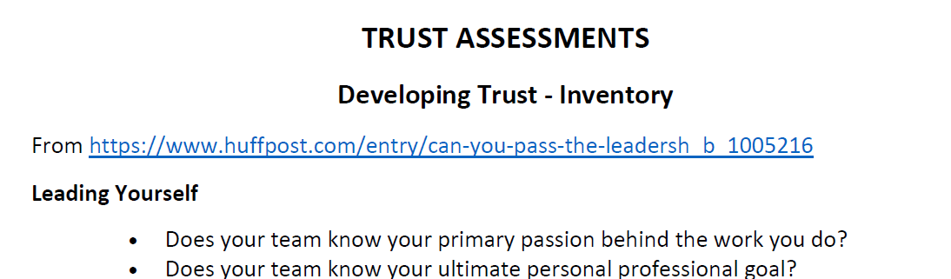
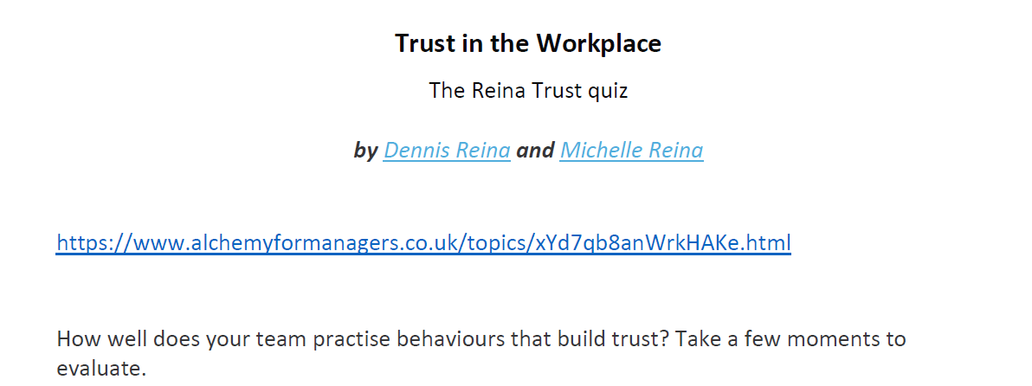
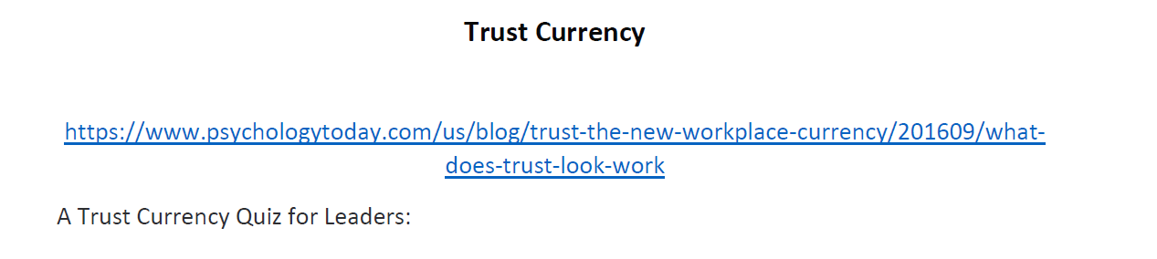

Slide 44
Watch this space:
For the 2024 schedule of professional development classes thru OPD, including:
        Crucial Conversations for Mastering Dialogue
        Crucial Conversations for Accountability
https://hr.msu.edu/professional-development/courses/index.html

Slide 45
Additional Opportunities

Slide 46
Continuing the Learning and Contacts
Climate Assessment Toolkit
Prevention, Outreach and Education Department (POE)
HR’s Organizational and Professional Development
  Conflict Management-December 7
  Crucial Conversations-December 13 and 14
  ElevateU
  Implicit Bias (2024 Dates: Feb 8th , 22nd , March 7th from 10:00a.m. – 11: 30a.m. online.)
MSU Extension
  Communicating through Conflict Certificate Course
University Ombudsperson
  Offers trainings and consultations
Faculty Grievance and Dispute Resolution Office
  Reach out with questions or for consultations
Department or College level HR Administrators
Faculty and Academic Staff Affairs and Employee Relations

