Slide 2
TIMELINE

Slide 3
YEAR 1
Fall 2020 | Plan development
Spring 2021 | Plan release
YEAR 2
Fall 2021 | Campus engagement for feedback on the plan
Spring 2022 | Know More @MSU RVSM Climate Survey #2 administered Annual RVSM Strategic Plan updates posted on dashboard
YEAR 3
Fall 2022 | [Know More #2 report to be released]
Spring 2023 | Know More #2 report released Know More #2 campus listening sessions Annual RVSM Strategic Plan updates posted on dashboard

Slide 4
YEAR 4
Fall 2023 | Campus engagement for feedback on the plan [Know More #3 planned—but will delay]
Spring | Annual RVSM Strategic Plan updates posted on dashboard
YEAR 5
Fall | Know More @MSU RVSM Climate Survey #3 administered Annual RVSM Strategic Plan updates posted on dashboard
Spring | Know More #3 report released Annual RVSM Strategic Plan updates posted on dashboard Future planning

Slide 5
OVERVIEW OF THE
RVSM STRATEGIC PLAN

Slide 6
How We Created the RVSM Strategic Plan
OUR PLANNING FRAMEWORK
FRAMEWORK STRENGTHS
VALUES
Empirically-driven, value-based process
Guide for creating operational strategic plans
Prior use with diverse communities & cultures
Prior use with RVSM initiatives
PRINCIPLES
AIMS
INITIATIVES
METRICS

Slide 7
Our Guiding Values
VALUES
COLLABORATION
EQUITY
EXCELLENCE
INTEGRITY
RESPECT
PRINCIPLES
We value COLLABORATION
and will develop partnerships within MSU and with the communities we serve to develop programs, policies,
and training for RVSM services and prevention
We will advance
EQUITY
eliminating barriers to access and success,
challenging discrimination and bias and addressing past and present inequalities as we develop programs, policies, and training for RVSM services and prevention
We strive for EXCELLENCE
and hold ourselves to the highest standards of practice to improve our institutional response to RVSM programs, policies and training
We will act with INTEGRITY
to hold ourselves
accountable to the
highest levels of honesty, trustworthiness and dependability in our responses to RVSM
We will cultivate RESPECT
to create and sustain a culture of safety that strives to prevent violence in all its forms and values the dignity of all people
AIMS
INITIATIVES
METRICS

Slide 8
Our Guiding Principles
VALUES
PRINCIPLES
INTERSECTIONAL
TRAUMA-INFORMED
AIMS
We recognize people experience power, privilege and marginalization differently based on the unique intersection of their identities.
We recognize social oppressions create climates that allow violence to occur, and that violence increases disparities in the health and well-being of survivors.
We acknowledge intersectional oppressions differentially impact institutional responses and resources provided to survivors based on their identity.
We commit to intentional action to rectify the disparities that result from these dynamics.
We will prevent the re-traumatization of survivors by taking universal precautions in our interactions, recognizing the strengths inherent in survivors, and providing appropriate supports so all members of our community can reach their full potential.
We will implement training, policies, and procedures that acknowledge the prevalence of traumatic experiences and understand the long-term,
systemic impacts such events can have on a
person’s functioning and well-being.
INITIATIVES
METRICS

Slide 9
Our Aims
VALUES
PRINCIPLES
AIMS
CHANGE THE SHAPE OF OUR INSTITUTIONAL RESPONSE TO RVSM
INITIATIVES
METRICS

Slide 10
Our Aims
VALUES
PRINCIPLES
AIMS
CHANGE THE SHAPE OF OUR INSTITUTIONAL RESPONSE TO RVSM
INITIATIVES
METRICS

Slide 11
Our Aims
VALUES
PRINCIPLES
AIMS
CHANGE THE SHAPE OF OUR INSTITUTIONAL RESPONSE TO RVSM
INITIATIVES
METRICS

Slide 12
Our Aims
VALUES
PRINCIPLES
AIMS
CHANGE THE SHAPE OF OUR INSTITUTIONAL RESPONSE TO RVSM
INITIATIVES
METRICS

Slide 13
Our Aims
VALUES
PRINCIPLES
AIMS
CHANGE THE SHAPE OF OUR INSTITUTIONAL RESPONSE TO RVSM
INITIATIVES
METRICS

Slide 14
Our Aims
VALUES
PRINCIPLES
AIMS
CHANGE THE SHAPE OF OUR INSTITUTIONAL RESPONSE TO RVSM
INITIATIVES
METRICS

Slide 15
Our Aims
VALUES
PRINCIPLES
AIMS
CHANGE THE SHAPE
INCREASE HELP-SEEKING
CHANGE THE SHAPE
DECREASE INCIDENCE
INITIATIVES
METRICS

Slide 16
Our Initiatives
VALUES
PRINCIPLES
AIMS
INITIATIVES
EXPANDING
TRAUMA-INFORMED SERVICES
ASSESSING
RESOURCES FOR RESPONDENTS
METRICS
BUILDING
TRAUMA-INFORMED CULTURE
STRENGTHENING
PREVENTION PROGRAMMING
STRENGTHENING
RVSM SANCTIONS & DISCIPLINE
CREATING
RESPECTFUL WORK ENVIRONMENTS
PROMOTING ACCOUNTABILITY

Slide 17
COLLABORATION
EQUITY
EXCELLENCE
INTEGRITY
RESPECT
INTERSECTIONAL & TRAUMA-INFORMED
CHANGE THE SHAPE
INCREASE HELP-SEEKING
CHANGE THE SHAPE
DECREASE INCIDENCE
EXPANDING
TRAUMA-INFORMED SERVICES
ASSESSING
RESOURCES FOR RESPONDENTS
METRICS
SURVIVORS
RESPONDENTS
BUILDING
TRAUMA-INFORMED CULTURE
STRENGTHENING
PREVENTION PROGRAMMING
HELPERS
STRENGTHENING
RVSM SANCTIONS & DISCIPLINE
CREATING
RESPECTFUL
WORK ENVIRONMENTS
CAMPUS
COMMUNITY
STRENGTHENING
RVSM SANCTIONS & DISCIPLINE
[Office of the Provost
LEADERS
PROMOTING
ACCOUNTABILITY

Slide 18
UPDATES

Slide 19
EXPANDING
TRAUMA-INFORMED SERVICES
SEXUAL ASSAULT
HEALTHCARE PROGRAM
$1,817,023
MDHHS Grant
OPENED NOVEMBER 2020
1.1
STRENGTHENING
RVSM SANCTIONS & DISCIPLINE
[Office of the Provost

Slide 21
EXPANDING
TRAUMA-INFORMED SERVICES
SEXUAL ASSAULT
HEALTHCARE PROGRAM
$1,817,023
MDHHS Grant
OPENED NOVEMBER 2020
1.1
24/7 SEXUAL ASSAULT
ADVOCACY RESPONSE
Current
operational budget
Began Fall 2022
EXPANDING Fall 2023
1.5
STRENGTHENING
RVSM SANCTIONS & DISCIPLINE
[Office of the Provost

Slide 22
BUILDING
TRAUMA-INFORMED CULTURE
2.1
CULTURE OF SUPPORT CAMPAIGN
$475,000
MDHHS Grant
LAUNCHED SPRING 2022
2.3

Slide 23
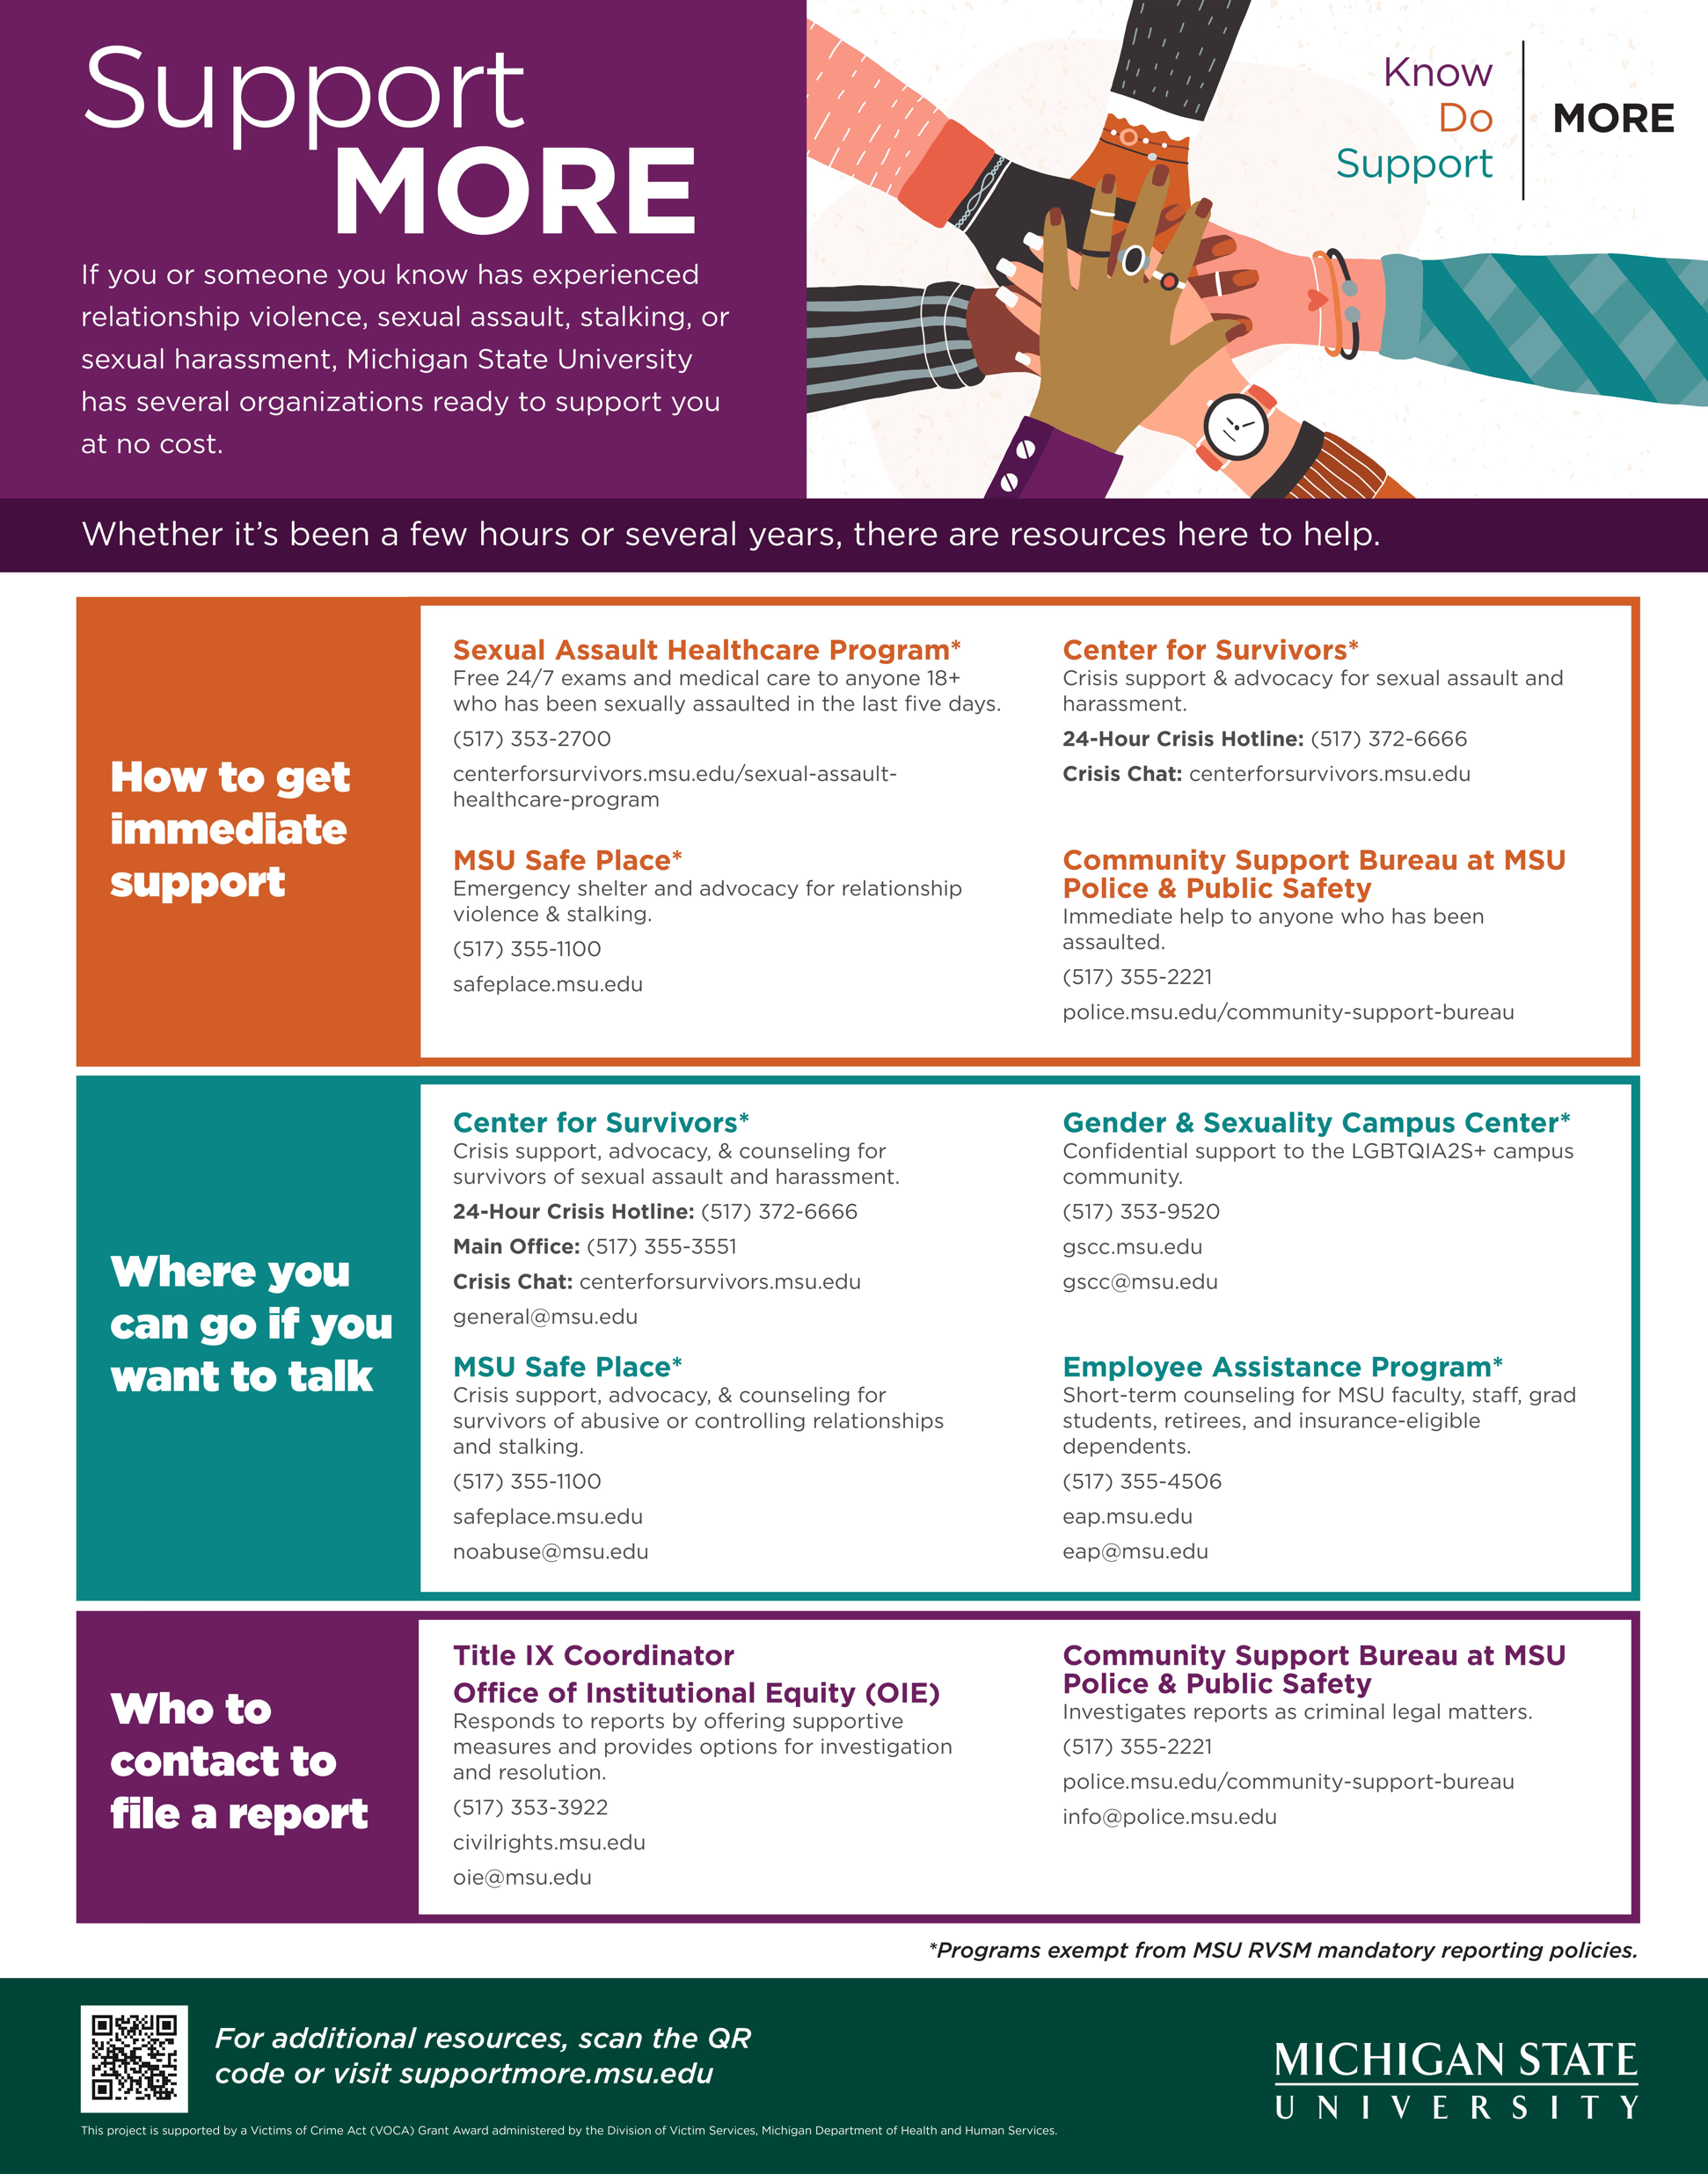
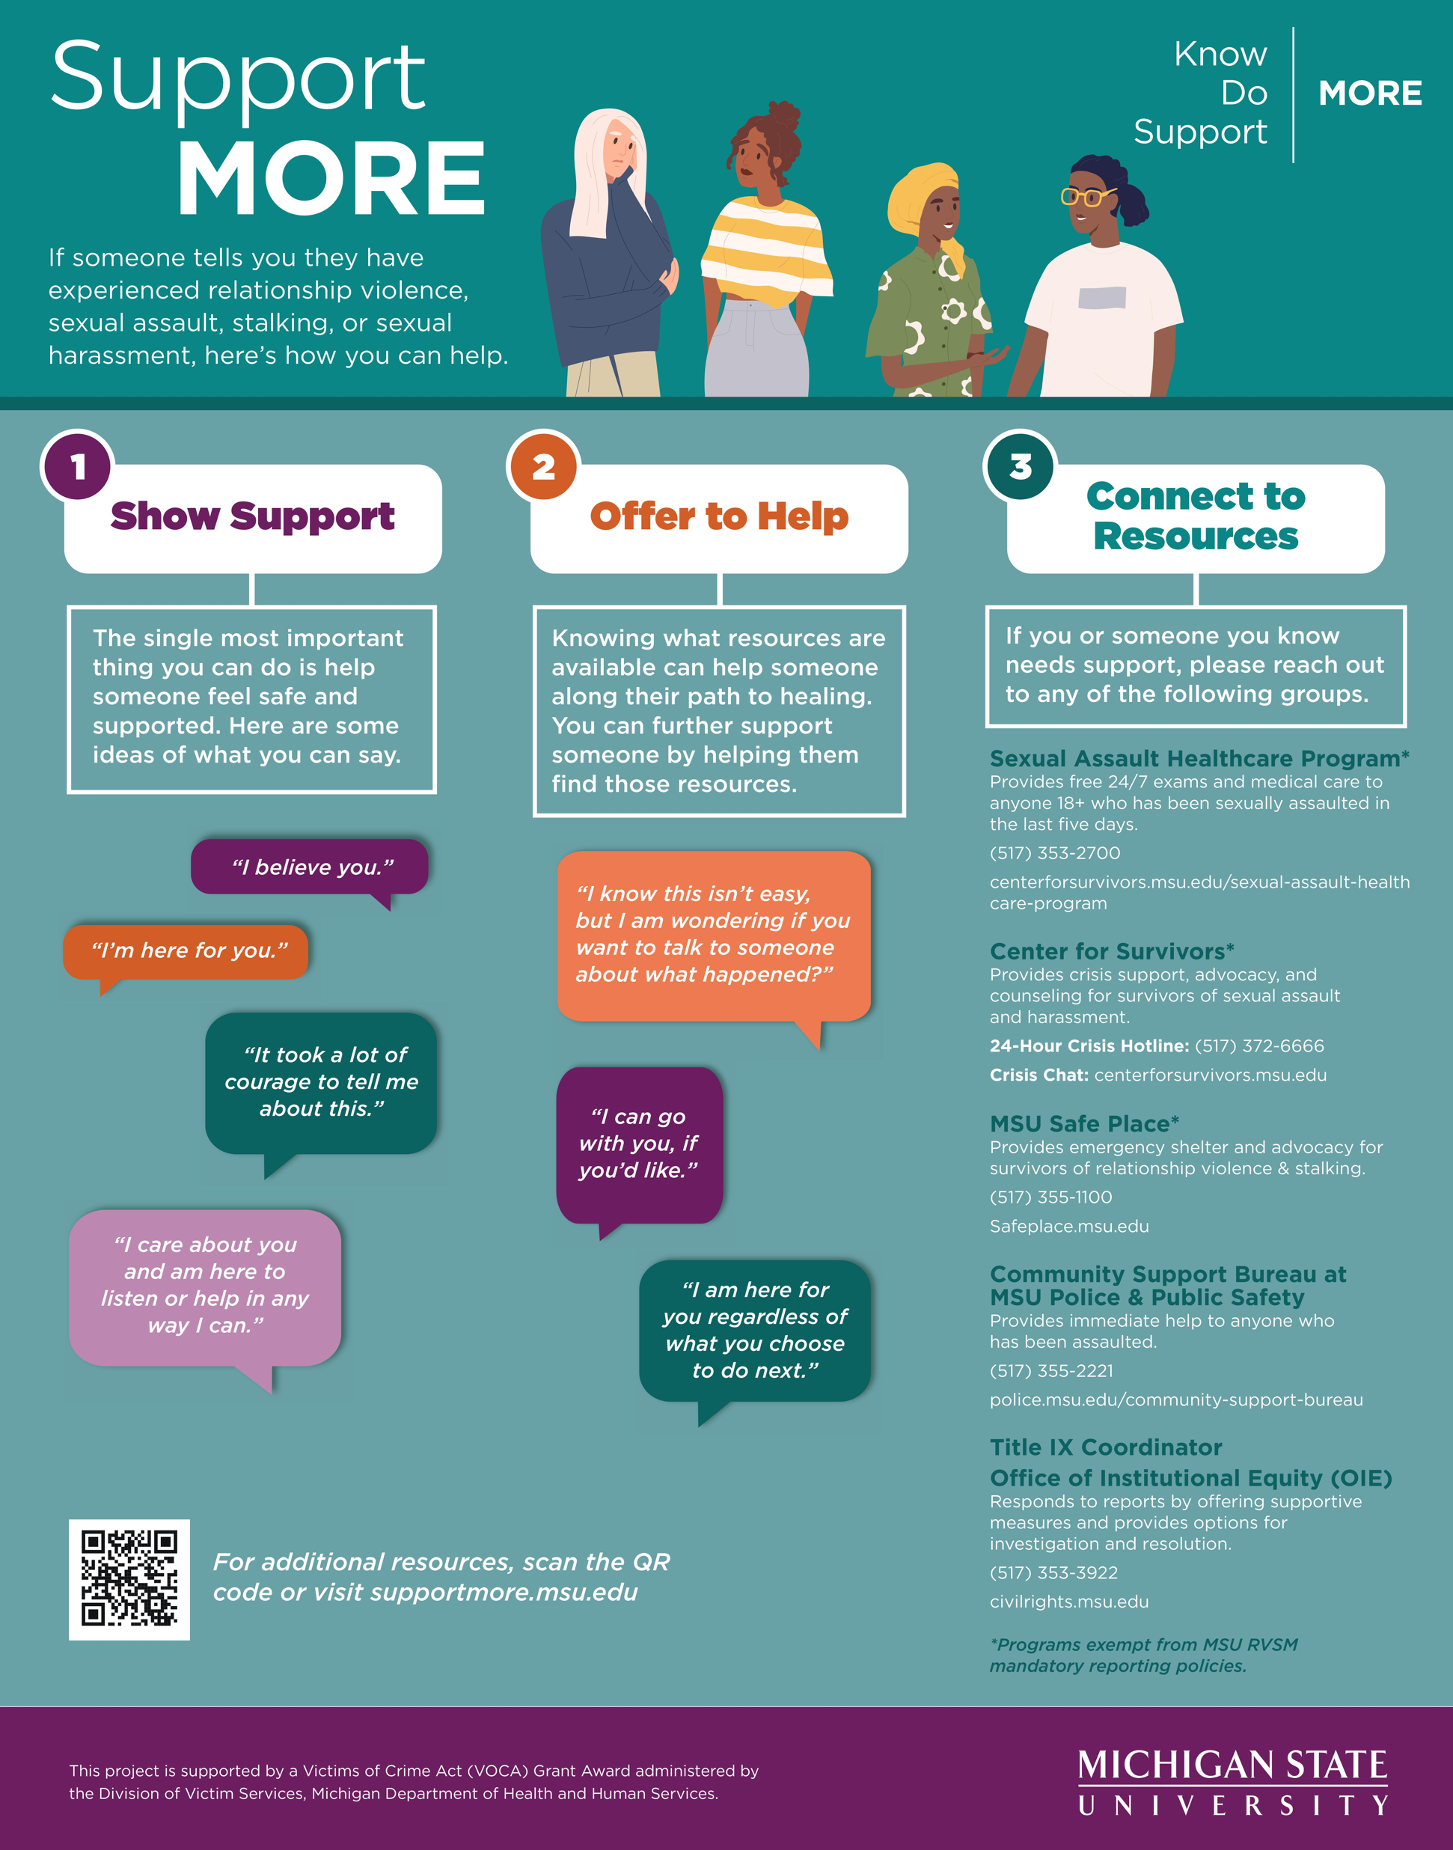

Slide 25
STRENGTHENING
RVSM SANCTIONS & DISCIPLINE
Current
operational budget
LEADERS
STRENGTHENING
RVSM SANCTIONS & DISCIPLINE
RVSM SANCTIONS &
DISCIPLINE INITIATIVE
(Office of the Provost)
3.1
COMPLETED SPRING 2022
3.2

Slide 26
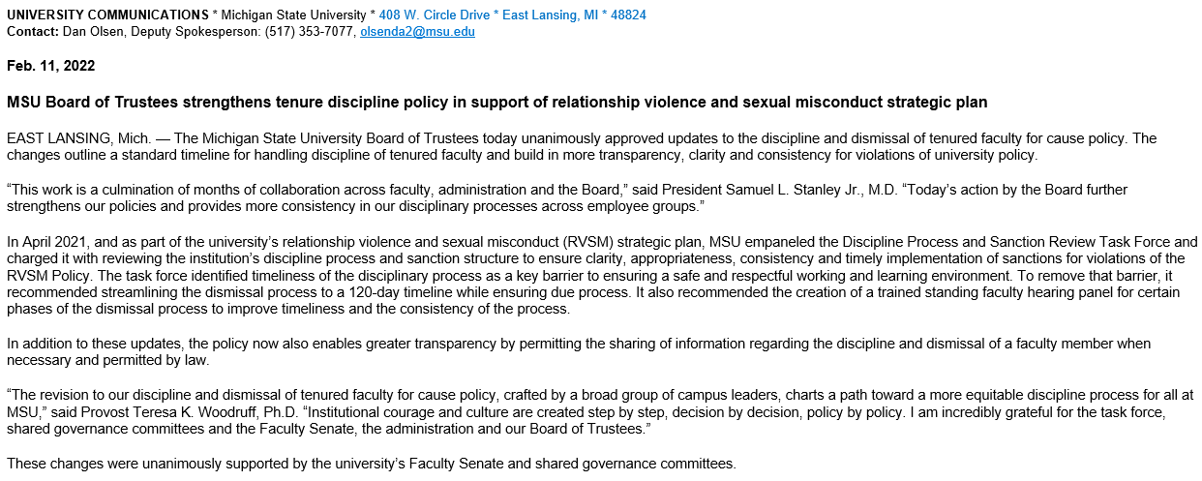

Slide 27
EXPANDING
TRAUMA-INFORMED SERVICES
RESPONDENTS
ASSESSING
RESOURCES FOR RESPONDENTS
RESPONDENT
PROGRAMMING TASK FORCE
Current
operational budget
4.1
DELAYED
Begin Fall 2023
4.1
RESPONDENT ADVISORS
Current
operational budget
STARTED SPRING 2020
4.2
STRENGTHENING
RVSM SANCTIONS & DISCIPLINE
[Office of the Provost

Slide 28
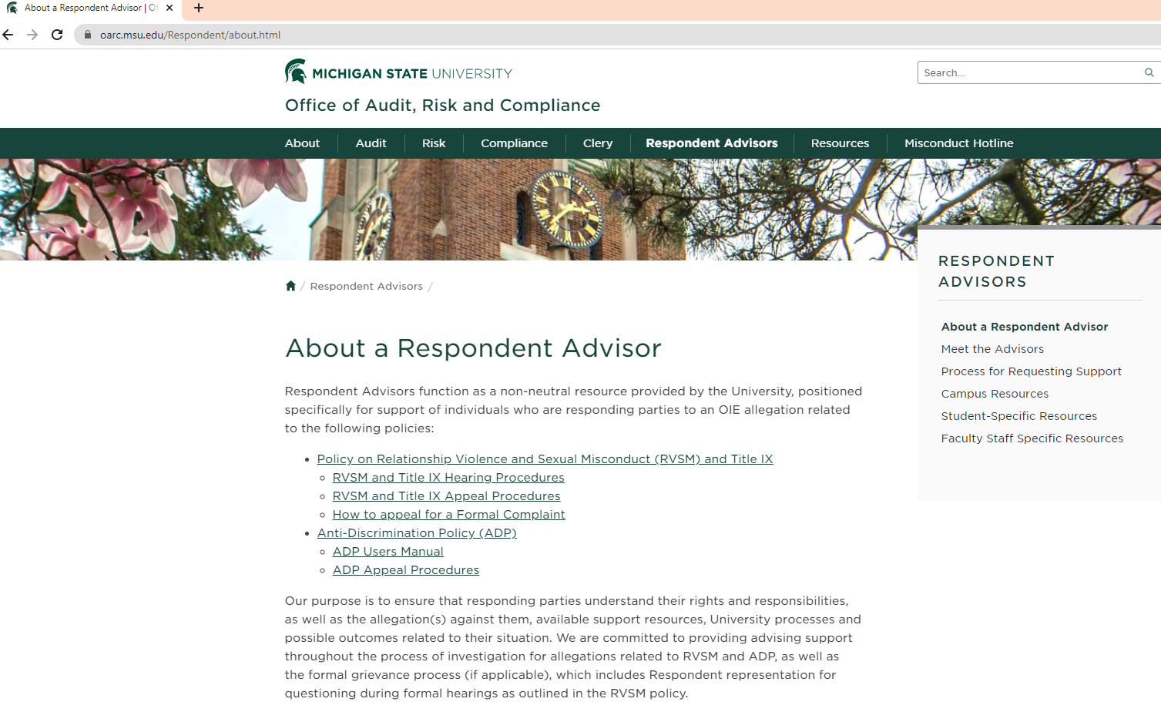

Slide 29
STRENGTHENING
PREVENTION PROGRAMMING
EXPANDING
TRAUMA-INFORMED SERVICES
RESPONDENTS
ASSESSING
RESOURCES FOR RESPONDENTS
STUDENT VOICE FOR PREVENTION INITIATIVE
Current
operational budget
LAUNCHED SPRING 2022
5.1
5.2
STRENGTHENING
RVSM SANCTIONS & DISCIPLINE
[Office of the Provost

Slide 30
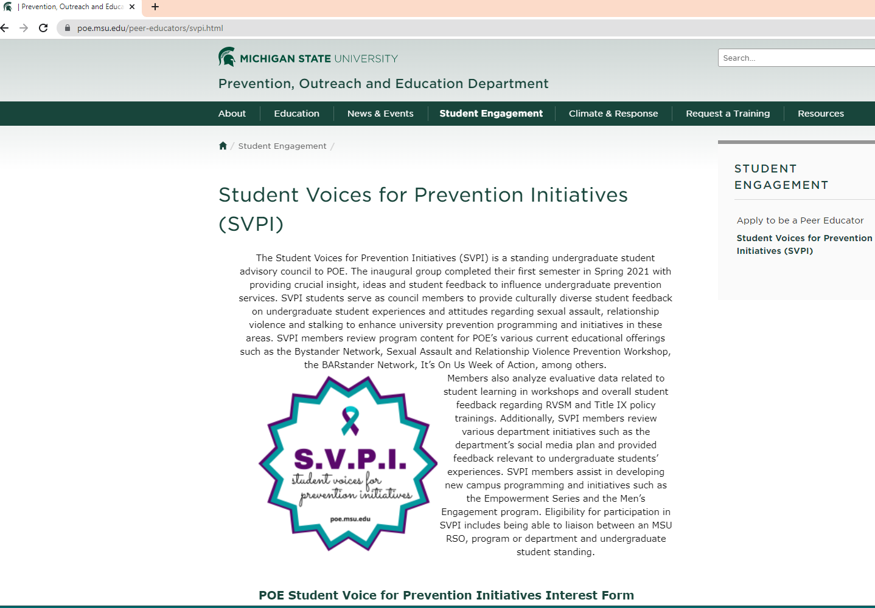
STRENGTHENING
RVSM SANCTIONS & DISCIPLINE
[Office of the Provost

Slide 31
CREATING
RESPECTFUL
WORK ENVIRONMENTS
STRENGTHENING
PREVENTION PROGRAMMING
EXPANDING
TRAUMA-INFORMED SERVICES
RESPONDENTS
ASSESSING
RESOURCES FOR RESPONDENTS
RESPECTFUL WORK ENVIRONMENT
TRAINING SERIES
Current
operational budget
6.2
LAUNCHED FALL 2021
6.3
6.1

Slide 32
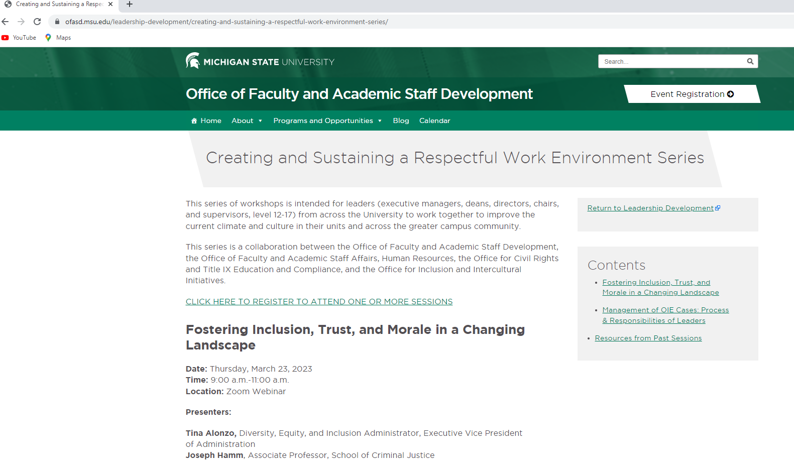
RESPONDENTS

Slide 33
PROMOTING
ACCOUNTABILITY
RVSM DATA
DASHBOARD
STRENGTHENING
PREVENTION PROGRAMMING
EXPANDING
TRAUMA-INFORMED SERVICES
RESPONDENTS
ASSESSING
RESOURCES FOR RESPONDENTS
Current
operational budget
7.1
LAUNCHED SPRING 2022
STRENGTHENING
RVSM SANCTIONS & DISCIPLINE
[Office of the Provost

Slide 34
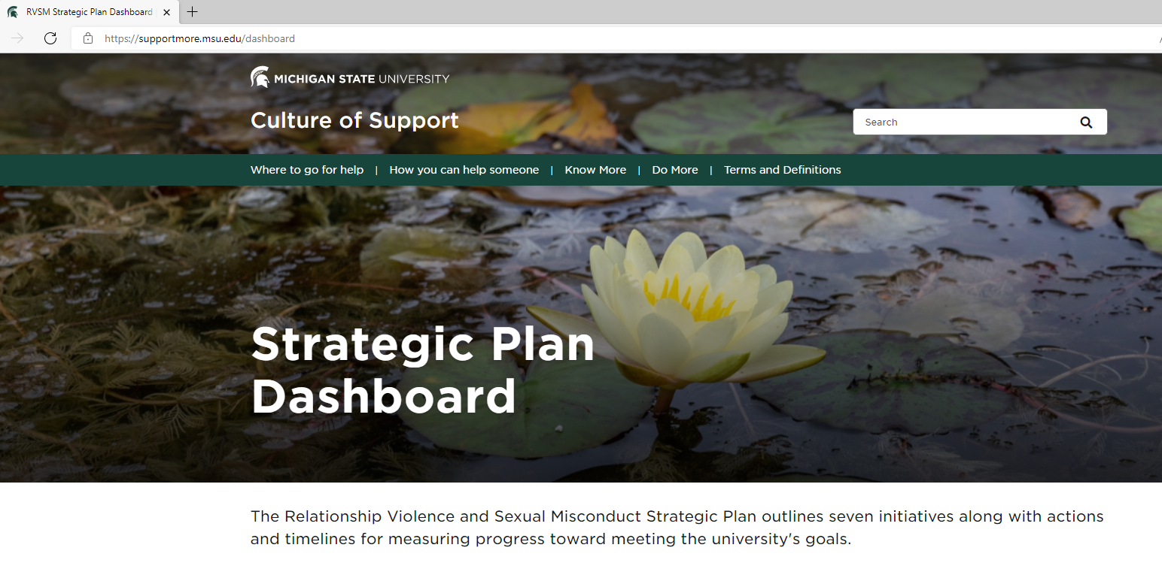
RESPONDENTS
STRENGTHENING
RVSM SANCTIONS & DISCIPLINE
[Office of the Provost

Slide 35
CHANGE THE SHAPE OF OUR INSTITUTIONAL RESPONSE TO RVSM
YES
NOT YET

Slide 38
QUESTIONS?

