Slide 1
Advancing Diversity, Equity and Inclusion at MSU
Jabbar R. Bennett, PhD
Vice President and Chief Diversity Officer
Professor of Medicine
College of Human Medicine
Conversation on MSU’s Strategic Plans
Tuesday, April 4, 2023

Slide 2
Institutional Diversity, Equity and Inclusion (DEI) Strategic Priorities
University Strategic Planning Committee
Diversity, Equity and Inclusion Steering Committee
Task Force on Racial Equity
Relationship Violence and Sexual Misconduct Expert Advisory Workgroup
Short-Term Work Group on Names and Pronouns
Phase Two – Implementation Planning
(2021 – 2023)

Slide 3
University Strategic Planning Implementation Steering Committee (SPISC)
Goal
To ensure communication, encourage coordination and enable collaboration among executive sponsors and subcommittees
Convenor
Bill Beekman
Leadership
Strategic Theme | Executive Sponsor(s)
Student Success | Vennie Gore, Thomas Jeitschko
Staff and Faculty Success | Melissa Woo, Thomas Jeitschko
Innovation for Global Impact | Norm Beauchamp, Doug Gage, Thomas Jeitschko
Sustainable Health | Norm Beauchamp
Stewardship and Sustainability | Lisa Frace, Melissa Woo
Diversity, Equity and Inclusion | Jabbar R. Bennett
Other Members
Dan Bollman, Becki Campbell, Terry Frazier, Thomas Glasmacher, Mike Stokes,
Heather Swain, Dave Weatherspoon, Mike Zeig

Slide 4
DEI Strategic Theme Subcommittee, Strategic Planning Implementation Steering Committee (cont’d)
Executive Sponsor/Convenor
Jabbar R. Bennett, Vice President and Chief Diversity Officer
Members
Ann Austin, Interim Assoc. Provost/Assoc. Vice President, Faculty and Academic Staff Affairs
Norm Beauchamp, Executive Vice President, Health Sciences
Dan Bollman, Vice President, Infrastructure Planning and Facilities
Christina Brogdon, Vice President and Chief Human Resources Officer
Kwesi C. Brookins, Associate Provost, University Outreach and Engagement
Lisa Frace, Senior Vice President, Chief Financial Officer and Treasurer
Doug Gage, Vice President, Research and Innovation
Vennie Gore, Senior Vice President, Student Life and Engagement
Emily Guerrant, Vice President and University Spokesperson
Sarah Harebo, Acting Associate Vice President, Office for Civil Rights and Title IX
Thomas Jeitschko, Interim Provost and Executive Vice President for Academic Affairs
Marlon Lynch, Vice President, Public Safety and Chief of Police
Kim Tobin, Vice President, University Advancement
Estrella Torrez, Assoc. Prof., Residential College in the Arts and Humanities
Quentin Tyler, Assoc. Dean, College of Ag. & Natural Resources/Director, MSU Extension
Kathy Wilbur, Senior Vice President, Government Relations
Melissa Woo, Executive Vice President, and Chief Information Officer
Source: https://inclusion.msu.edu/news/vpcdo-dei-strategic-update.html

Slide 5
DEI Strategic Theme Subcommittee, Strategic Planning Implementation Steering Committee
Purpose
To help support the implementation and success of key institutional diversity, equity and inclusion strategic priorities
Objectives
To assist in implementation planning efforts
  Provide overall feedback on approach to implementation
  Review and give input on “Stakeholder” and “Influencer” lists
  Prioritize recommendations
  Evaluate and expand proposed metrics
  Explore individual and unit-based accountability measures
To manage execution of efforts within their oversight
  Create “Action Planning Teams” consisting of faculty, staff, students and others
To provide regular updates on progress made and challenges faced
Source: https://inclusion.msu.edu/news/vpcdo-dei-strategic-update.html

Slide 6
Institutional DEI Strategic Priorities Implementation Planning – Action Planning Teams
12+ Action Planning Teams With Broad Representation
Department of Police and
Public Safety
Human Resources
Information Technology
Infrastructure Planning and Facilities
MSU Extension
Office for Civil Rights/Title IX
Office of Health Sciences
Office of Research and Innovation
Office of the Provost
Student Life and Engagement
University Advancement
University Communications

Slide 7
DEI Strategic Theme Subcommittee, Strategic Planning Implementation Steering Committee Goals and Objectives
Goal | Become a national leader in increasing diversity, promoting inclusion, ensuring equity and eliminating disparities on our campus and beyond | Alignment with DEI Report and Plan Strategic Goal(s) | Prioritized Action Items (~200)
Objective 1 | Recruit and support the success of a more diverse student body: Recruit, retain and graduate a diverse student body and eliminate disparities in MSU’s graduation rates | Strategic Goal One: Increase Diversity Strategic Goal Two: Ensure Equity Strategic Goal Three: Promote Inclusion | 17*
Objective 2 | Dramatically increase MSU faculty who make significant contributions to advancing social justice and ethics, ensuring equity, addressing disparities and empowering communities through scholarship and engaged research | Strategic Goal One: Increase Diversity Strategic Goal Two: Ensure Equity Strategic Goal Four: Enhance Outreach and Engagement | 19*
Objective 3 | Recruit, retain and expand career development for staff from diverse backgrounds | Strategic Goal One: Increase Diversity Strategic Goal Two: Ensure Equity Strategic Goal Three: Promote Inclusion | 23*
Objective 4 | Provide a world-class academic environment that integrates DEI in teaching, research and service | Strategic Goal Two: Ensure Equity Strategic Goal Three: Promote Inclusion | 10*
Objective 5 | Increase proactive engagement with historically underrepresented and underserved communities based on partnerships informed by shared goals and mutual learning | Strategic Goal Two: Ensure Equity Strategic Goal Three: Promote Inclusion Strategic Goal Four: Enhance Outreach and Engagement | 20*
*Ranked as #1 priority

Slide 8
Institutional DEI Strategic Priorities Implementation Planning
Action | Tentative Timeline
Socialize Proposed Implementation Approach Among Sponsors, Stakeholders, Influencers and Community | Fall 2021 – Spring 2022
Engage Sponsors Provide Overall Feedback Review Stakeholder and Influencer Lists Review Metrics Explore Accountability | Spring 2022
Engage Stakeholders, Influencers and Community Provide Overall Feedback | Spring 2022
Communicate Next Steps | Spring 2022
Convene Sponsors Discuss Feasibility and Prioritization of Proposed Recommendations and Actions Review and Endorse Metrics Establish Accountability Determine Funding Request Process Explore Dashboard Creation | Spring – Summer 2022
Provide Regular Updates Board of Trustees | Spring 2022 – Ongoing
Explore Implementation | Fall 2022 – Ongoing
Monitor and Assess Progress Performance Review | Spring 2023 – Ongoing
Provide Regular Updates Board of Trustees Public Dashboard | Spring 2023 – Ongoing
Explore Approach to Funding New Initiatives | Spring 2024 – Ongoing
Source: https://inclusion.msu.edu/news/vpcdo-dei-strategic-update.html

Slide 9
Progress Update – General
Source: https://inclusion.msu.edu/news/spotlight-dei-implemented-actions.html

Slide 10

Progress Update – General (cont’d 2 of 6)
Annual Report Highlights
Report documents first year of institutional DEI strategic priority implementation efforts with 50% of ~ 270 action items being complete or in progress
$38M committed to construct the 34,000 square foot multicultural center, with groundbreaking set for April 21
$48.1M was spent with diverse vendors, a historical record, making up 4.55% of total vendor expenditures
Served 3,478 students with permanent disabilities and 451 employees, both an increase from the previous year
Six-year graduation rate hit a second record year at 82%, tying the previous year
Graduate rates among student of color remained the same or increased
Faculty and academic staff of color saw a slight increase of 1.5% (comprising 29.2% of total)
Support staff of color increased to 18.6%, an increase of 7.2%
Released March 20, 2023
Source: https://inclusion.msu.edu/about/data-information/index.html

Slide 11
Progress Update – General (cont’d 3 of 6)
Short Term Work Group on Names and Pronouns/Name, Gender, Pronoun Systems Integration

Slide 12
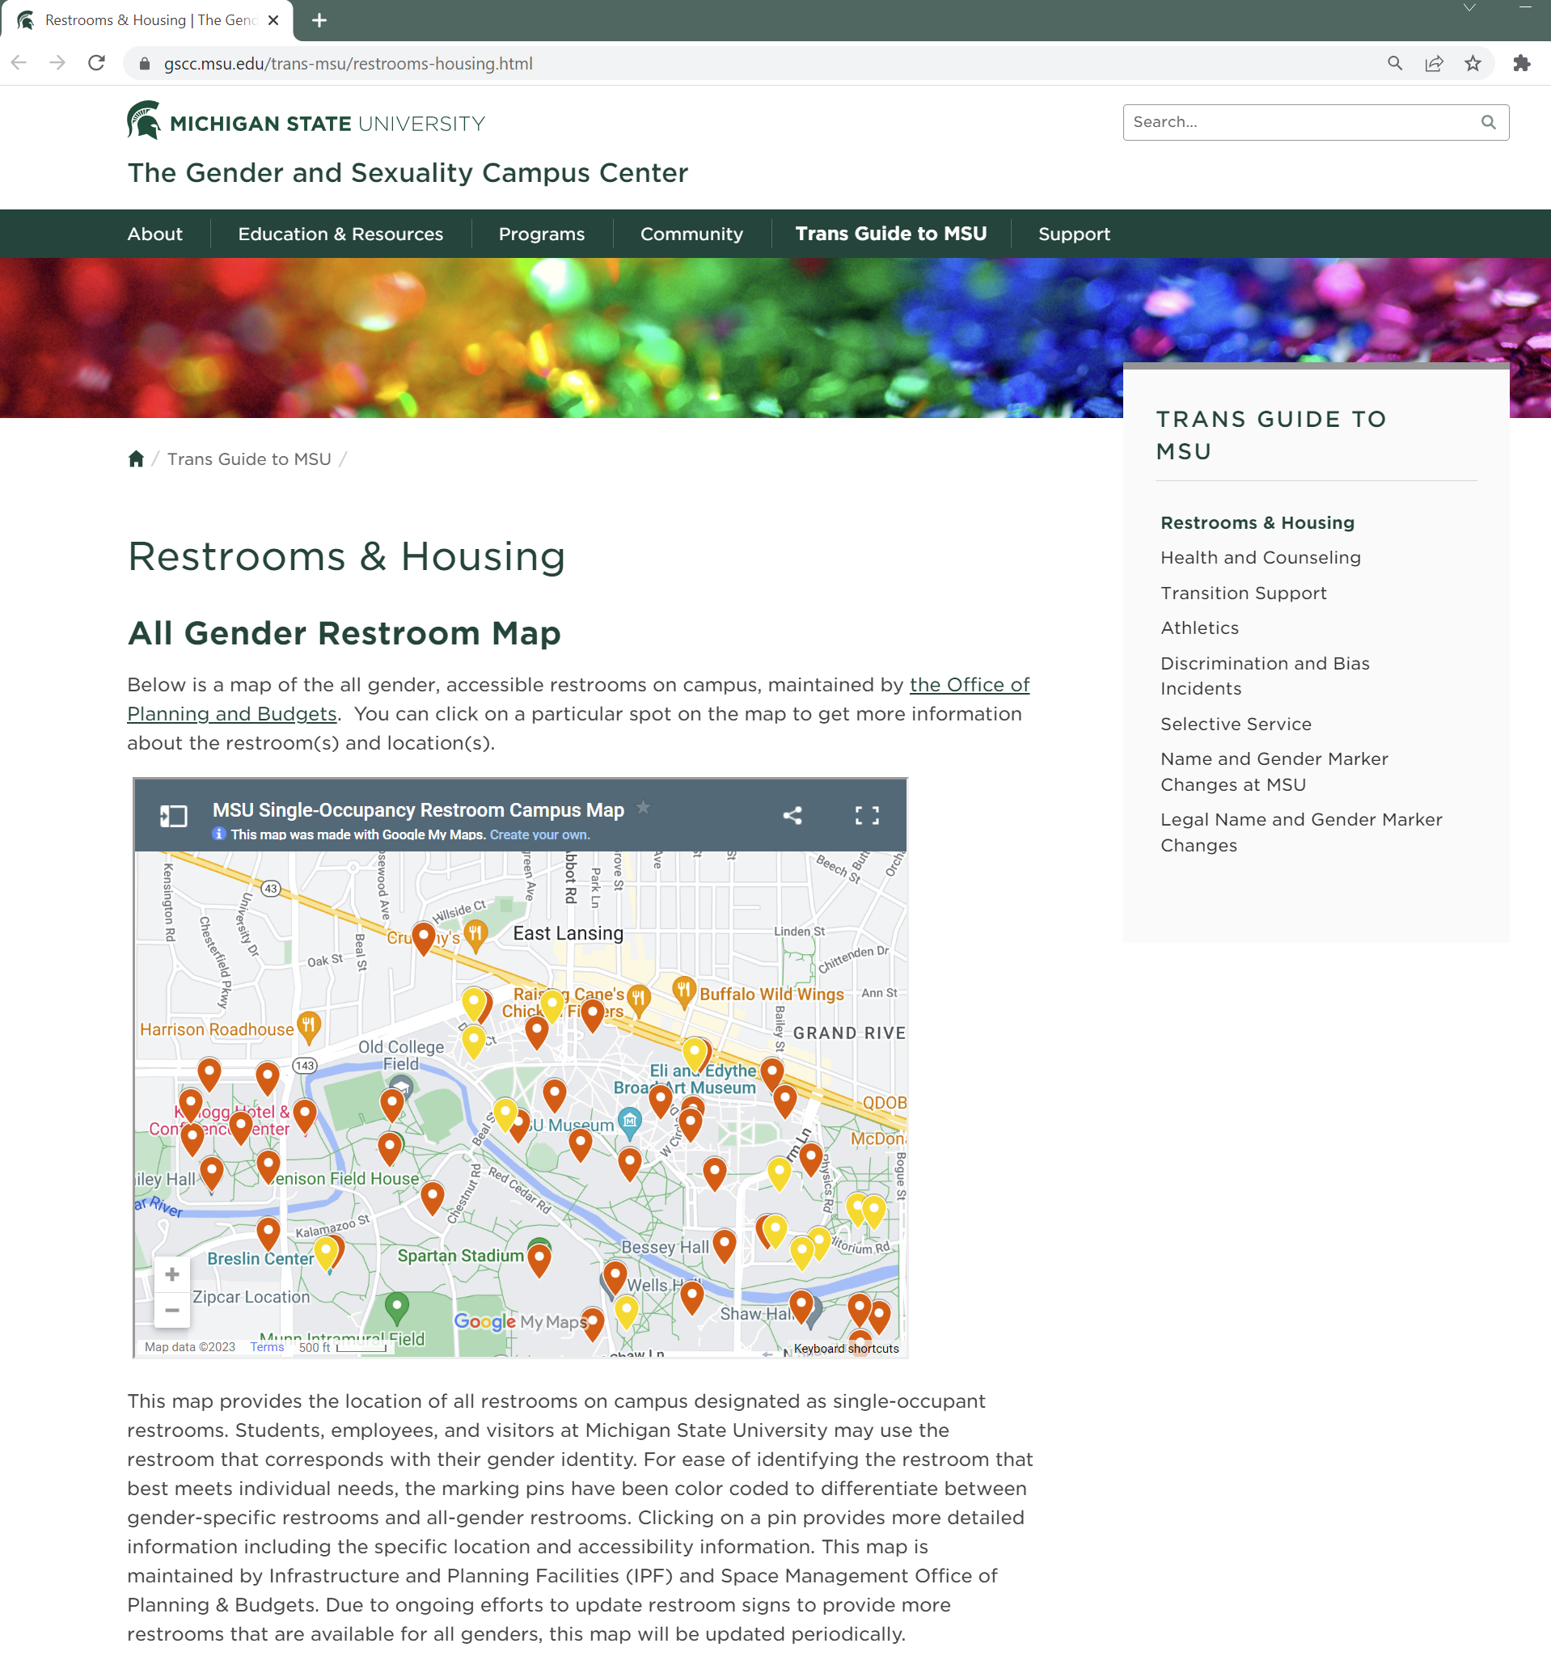
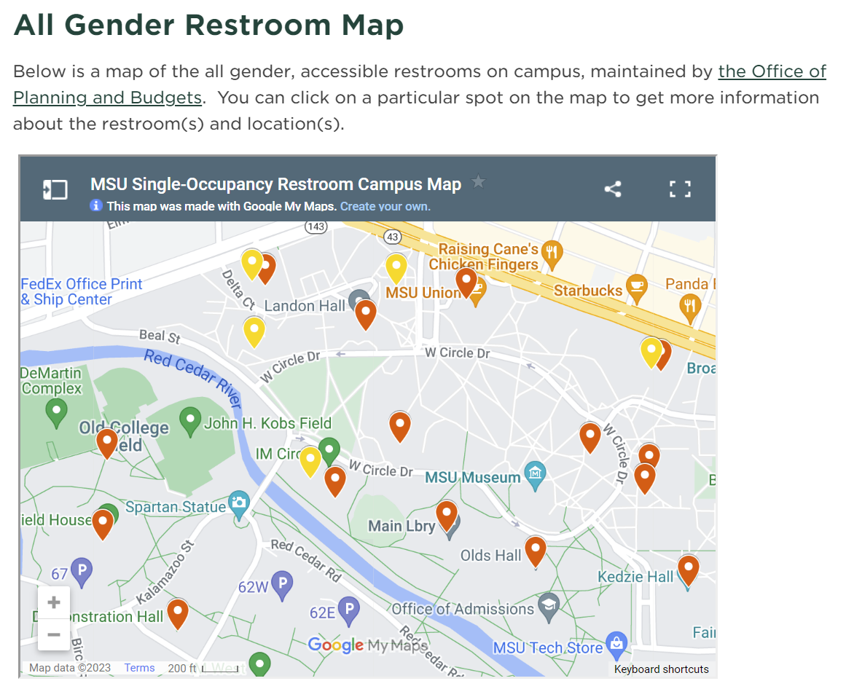
Progress Update – General (cont’d 4 of 6)
All Gender Restroom Locator Map
Source: https://ispm.msu.edu/locations/single-occupancy-restrooms

Slide 13
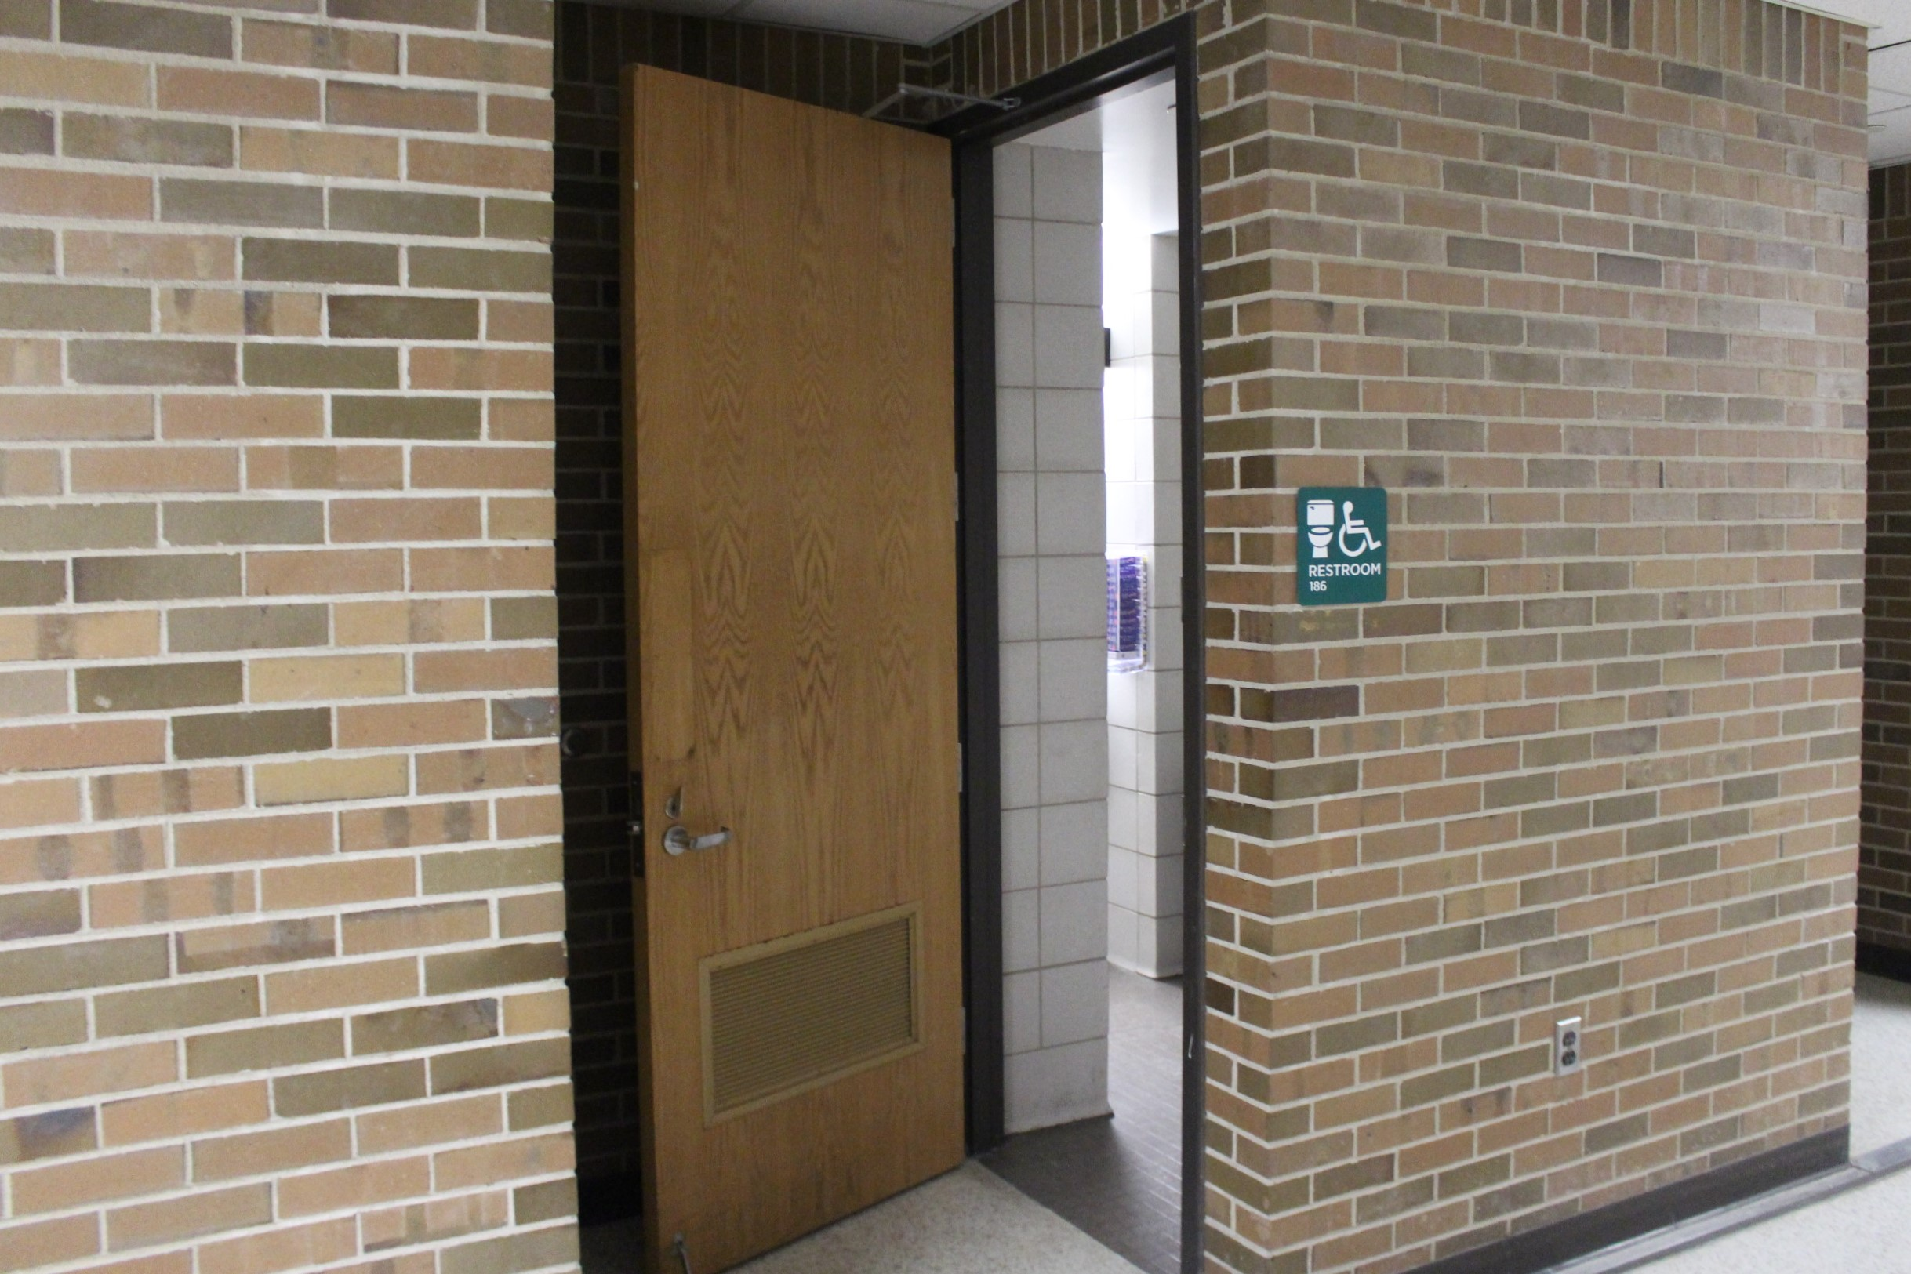
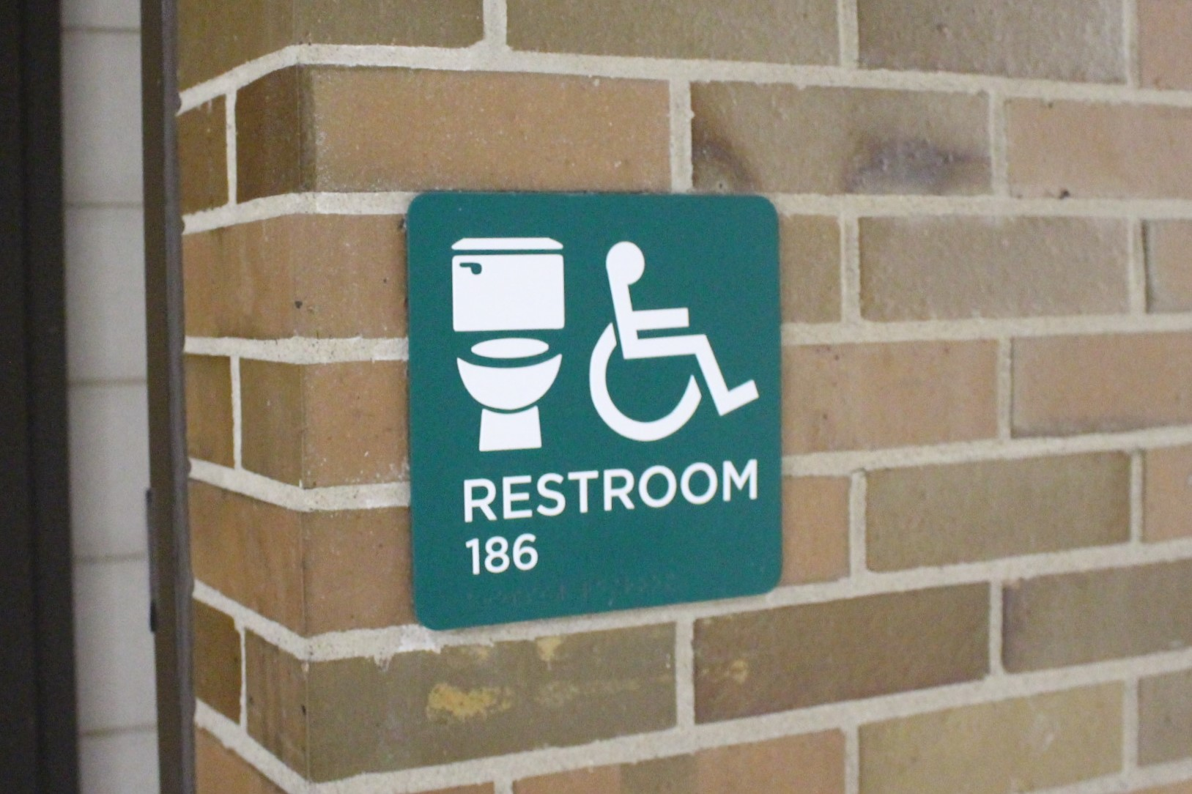
Progress Update – General (cont’d 5 of 6)
All Gender Restroom Design Study
Source: https://inclusion.msu.edu/news/all-gender-restroom-design-study.html

Slide 14
Progress Update – General (cont’d 6 of 6)
Other Select Initiatives
IT Tool Accessibility
Mitigating Bias in Hiring eLearning
MSU CARES Volunteer Program
Supplier Diversity Program

Slide 15


Progress Update – Staff and Faculty Success
University Observed Days Off, Effective Academic Year 2022 – 2023
2
Personal Observance Days Added
Annual Winter Break
(1 week from December – January)
MLK Jr. Day is a Full University Holiday

Slide 16
Progress Update – Staff and Faculty Success (cont’d 2 of 3)

Slide 17
Progress Update – Staff and Faculty Success (cont’d 3 of 3)
Expansion of Eligibility of 403(b) Base Retirement Program
  Starting January 1, 2023, every benefit eligible current employee and new hire became immediately eligible to enroll in the 403(b) Base Retirement Program with voluntary participation
Bereavement Leave Policy for Faculty/Academic Staff
  Endorsed by Faculty Senate January 24, 2023
Acknowledgement of Diversity, Equity and Inclusion (DEI) in Reappointment, Promotion and Tenure (RPT)
Academic Search Committee Training
  Required, online training program expected to go live in 2023
Academic Specialists Handbook Policy Review
  Working Group made recommendations in AY21 – 22 impacting professional development, the continuing appointment system, and promotion

Slide 18
Progress Update – Student Success
Five Pillars of Success Identified by Students During the Feasibility Study:
Advocacy and Activism, Community, Education, Healing, Intersectionality

Slide 19
2022 – 2023 Top Priorities
Finalize Metrics, Accountability Structures and Funding Mechanisms for Institutional DEI Strategic Priorities
Launch Work Group on Race and Ethnicity in Student Data
Conduct Anti-Discrimination Policy (ADP) Review
Establish DEI Corporate Executive Council

Slide 20
Our Shared Responsibility
The Office for Institutional Diversity and Inclusion will provide a template for and oversight of university-wide DEI Strategic Plan-related initiatives and partner with units to develop and align local DEI action plans
Administration
University President, and Vice President and Chief Diversity Officer will share regular updates with Board of Trustees
Major Academic and Administrative Units
Leaders will discuss and report local efforts during annual budget request and performance review processes
Employees
Contributions toward advancing diversity, equity and inclusion will be considered during annual performance review discussions
Accountability and Transparency
DEI plans and annual progress updates will be made public for all major academic and administrative units

