Slide 1
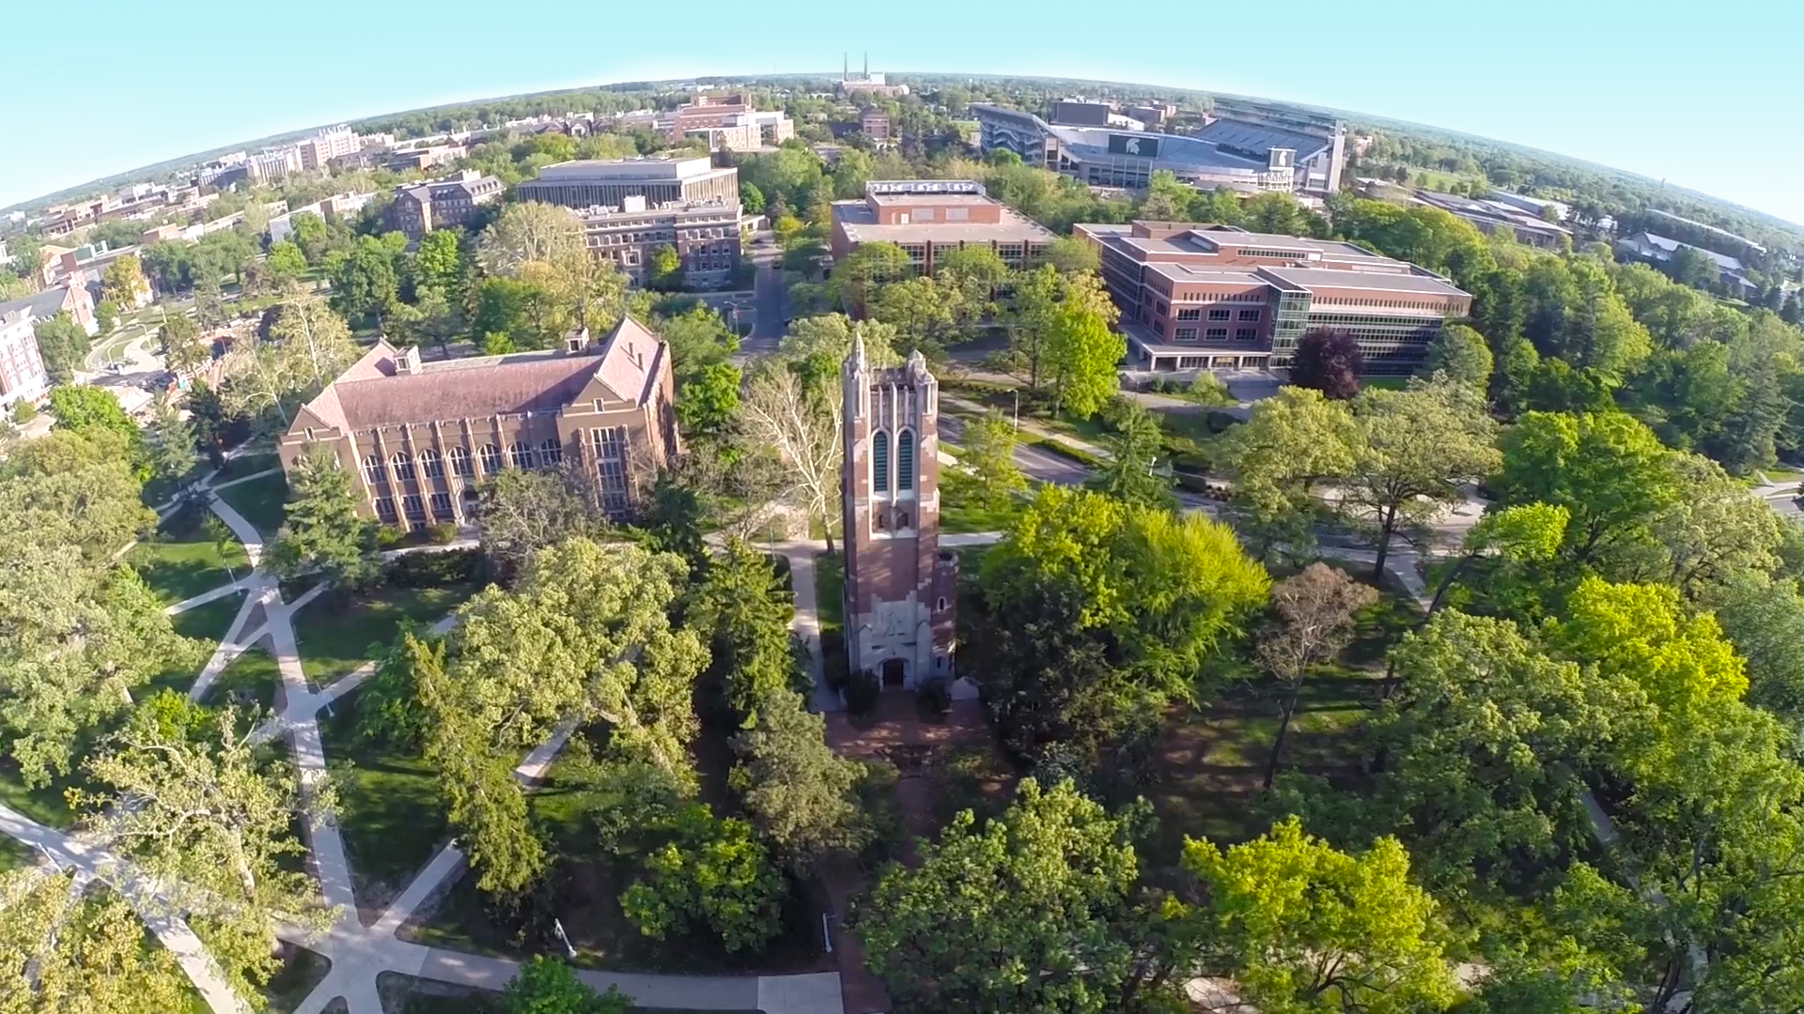

Strategic Plan
PRESIDENTIAL STRATEGIC INITIATIVES

Slide 2
Conversation on the MSU Strategic Planning Process
Academic Advancement Network
March 19, 2021
Agenda
Strategic Plan update presentation
Small group discussions, breakout rooms
Large group discussion and Q&A

Slide 3
WHY Are We Creating a Strategic Plan?
“Through effective strategic planning, we can build on our strong foundation. We also have the opportunity to strengthen our commitments to live our shared values every day around diversity, equity, and inclusion and to lead by example in being a safe, welcoming, and respectful campus.”
President Samuel L. Stanley Jr., M.D.
in charge letter to Strategic Planning Steering Committee

Slide 4
WHO Is Creating The Strategic Plan
Steering Committee Co-chairs
Vennie Gore and Joseph Salem Jr.
Steering Committee Members
Brianna Aiello
Merri Jo Bales
Norman Beauchamp
John Beck
Debra Bittner
Rebecca Campbell
Maggie Chen-Hernandez
Sheila Contreras
Pero Dagbovie
Prabu David
Megan Donahue
Doug Gage
Jeff Grabill
Jennifer Gruber
Sanjay Gupta
Thomas Jeitschko
Jennifer Johnson
Leo Kempel
Wanda Lipscomb
Ruben Martinez
Joan Rose
Anna Maria Santiago
Heather Swain
Francisco Villarruel
Michael Zeig
Focused Inquiry Groups
  Values subcommittee, led by Jennifer Johnson
  Optimal size and scope of MSU, led by Anna Maria Santiago
  Online learning, led by Jeff Grabill
  Institutional resources, led by Thomas Jeitschko

Slide 5
HOW Are We Creating the Strategic Plan?
OUR PROCESS
Mission |  | What is our purpose? Why do we exist?
Phase 1
Values |  | Core beliefs and guiding principles that inform and shape our daily activities, behavior and interactions across the university and align with our vision and mission
Environmental Scans |  | Where are we now? Trends that may impact success
Engagement
Focused Inquiry Reports |  | Key trends: MSU implications and possible responses
Phase 2
Vision |  | Where do we want to go?
TIME
Strategic Directions |  | Broad themes, areas of emphasis
Goals/Actions/Scenarios |  | How will we get there?
Phase 3
Metrics |  | How will we know?
Implementation |  | Who must do what?
Evaluation |  | How are we doing?

Slide 6


Major Accomplishments (1 of 2)
We Conducted . . .
MSU Leadership Retreat
  MARCH 2020:
  100+ trustees, leaders, faculty, staff and students attended
  Agenda included internal and external trends via speaker and table topic discussions
  SWOT analysis
Environmental Scan
Various Speakers
  SPRING – FALL 2020:
  12 topics presented by university leaders and content experts including:
    higher education trends; budget and resource models; diversity, equity and inclusion; research; student success; enrollment; graduate education; benchmarks; human resources; international engagement; and MSU Extension

Slide 7


Major Accomplishments (2 of 2)
We Conducted . . .
Four Focused Inquiry Groups
  SUMMER – FALL 2020:
  Values
  Optimal scope and scale of MSU
  Online learning
  Institutional resources
  Extensive inquiry with final reports, next steps and recommendations
Engagement Sessions
Various Audiences
  NOVEMBER 2020:
  28 sessions, 755 participants
  120 students
  220 faculty
  350 staff
  65 alumni
  Data collected, analyzed thematically and summarized in report

Slide 8
Key Findings: STRENGTHS
Commitment to student success
Renowned international programs and study abroad
High-ranking academic programs: Top 100 global university and AAU member; 9 academic programs ranked No. 1 and 36 programs in top 25
Research growth from $500M and rank 36 (2012) to $715M and rank 32 (2019); Global Impact Initiative yielded 87 hires and $45M in sponsored research funding
Facility for Rare Isotope Beams (FRIB)
Institutional size and scope
Strong partnerships continue to expand scale, impact and funding (i.e., Doug Meijer Medical Innovation Building, Henry Ford Health Systems, Apple)
Community engagement through MSU Extension, WKAR and more
Large, loyal alumni base

Slide 9
Key Findings: WEAKNESSES
Campus climate
Lack of institutional trust
Lack of cohesive approach to DEI
No Nobel winners and few National Academy winners
High out-of-state tuition relative to peers
Graduate education: Thin administrative support vs. peers; affects research excellence
Challenges securing NIH funding (lack of university hospital)
Lack of alignment –values, funding, policies
Resource constraints limit important strategic investments
Size and scope intersecting with silos risks missing opportunities, operational efficiencies
Aging physical infrastructure
Relatively smaller endowment compared to peers due to later entry to large-scale fundraising

Slide 10
Key Findings: OPPORTUNITIES
Public-private partnerships supporting facilities and infrastructure
Forging new partnerships to spur innovation and growth
Targeting research agenda to address societal issues: climate, water, food, social justice
Expanding educational access via online platforms
Diversifying portfolio of educational opportunities to span a 60-year learning continuum
Student success and talent attraction to contribute to economic growth
Fundraising success for endowed chairs points to future potential for faculty support
Leveraging data systems and analytics to better support student success
Enhanced faculty and staff talent pool due to robust digital tools and evolving perspectives on work

Slide 11
Key Findings: THREATS
Difficulty addressing financial challenges posed by pandemic and other fiscal stressors (rising health care and insurance costs, costs to grow research infrastructure, etc.)
Declining state support
Decline in college-age population in Midwest
Geopolitical instability: Limiting talent, international students, study abroad and scholarship opportunities
Cyber security threats; increased targeting of higher education
Rapidly changing nature of work and economy (automation-, data- and technology-driven)
Public perceptions – questioning value vs. benefit, costs of college, debt loads
Political polarization playing out on university campuses
Increasingly competitive environment to attract top faculty and students

Slide 12
Key Findings: SWOT Analysis
STRENGTHS
Commitment to student success
Renowned international programs and study abroad
High-ranking academic programs: Top 100 global university and AAU member;
9 academic programs ranked No. 1 and 36 programs in top 25
Research growth from $500M and rank 36 (2012) to $715M and rank 32 (2019); Global Impact Initiative yielded 87 hires and $45M in sponsored research funding
Facility for Rare Isotope Beams (FRIB)
Institutional size and scope
Strong partnerships continue to expand scale, impact and funding (i.e., Doug Meijer Medical Innovation Building, Henry Ford Health Systems, Apple)
Community engagement through MSU Extension, WKAR and more
Large, loyal alumni base
WEAKNESSES
Campus climate
Lack of institutional trust
Lack of cohesive approach to DEI
No Nobel winners and few National Academy winners
High out-of-state tuition relative to peers
Graduate education: Thin administrative support vs. peers; affects research excellence
Challenges securing NIH funding (lack of university hospital)
Lack of alignment –values, funding, policies
Resource constraints limit important strategic investments
Size and scope intersecting with silos risks missing opportunities, operational efficiencies
Aging physical infrastructure
Relatively smaller endowment compared to peers due to later entry to large-scale fundraising
OPPORTUNITIES
Public-private partnerships supporting facilities and infrastructure
Forging new partnerships to spur innovation and growth
Targeting research agenda to address societal issues: climate, water, food, social justice
Expanding educational access via online platforms
Diversifying portfolio of educational opportunities to span a 60-year learning continuum
Student success and talent attraction to contribute to economic growth
Fundraising success for endowed chairs points to future potential for faculty support
Leveraging data systems and analytics to better support student success
Enhanced faculty and staff talent pool due to robust digital tools and evolving perspectives on work
THREATS
Difficulty addressing financial challenges posed by pandemic and other fiscal stressors (rising health care and insurance costs, costs to grow research infrastructure, etc.)
Declining state support
Decline in college-age population in Midwest
Geopolitical instability: Limiting talent, international students, study abroad and scholarship opportunities
Cyber security threats; increased targeting of higher education
Rapidly changing nature of work and economy (automation-, data- and technology-driven)
Public perceptions – questioning value vs. benefit, costs of college, debt loads
Political polarization playing out on university campuses
Increasingly competitive environment to attract top faculty and students

Slide 13
Affirming MISSION, Articulating VISION
MSU MISSION STATEMENT, approved in 2008
Michigan State University will be a leader in responding to the grand challenges and opportunities of our time
by creating a diverse, welcoming and safe community where people with multiple perspectives and expertise thrive
to offer collaborative, interdisciplinary and multi-stakeholder solutions.
Michigan State University, a member of the Association of American Universities and one of the top 100 research universities in the world, was founded in 1855. We are an inclusive, academic community known for our traditionally strong academic disciplines and professional programs, and our liberal arts foundation. Our cross- and interdisciplinary enterprises connect the sciences, humanities, and professions in practical, sustainable, and innovative ways to address society’s rapidly changing needs.
As a public, research-intensive, land-grant university funded in part by the state of Michigan, our mission is to advance knowledge and transform lives by:
providing outstanding undergraduate, graduate, and professional education to promising, qualified students in order to prepare them to contribute fully to society as globally engaged citizen leaders
conducting research of the highest caliber that seeks to answer questions and create solutions in order to expand human understanding and make a positive difference, both locally and globally
advancing outreach, engagement, and economic development activities that are innovative, research-driven, and lead to a better quality of life
for individuals and communities, at home and around the world
Vision Elements: Working Version for Review

Slide 14

Strategic Themes (1 of 7)
Land-Grant University for the 21st Century
As the nation’s premier land-grant institution, Michigan State University will align its resources to address
society’s evolving 21st century needs through strategic initiatives in the following areas:
Diversity, Equity and Inclusion
Innovation for Global Impact
Staff and Faculty Success
Stewardship and Sustainability
Student Success
Sustainable Health
(presented alphabetically))

Slide 15
Strategic Themes (2 of 7)
Diversity, Equity and Inclusion
The points below are not intended to be final or all-inclusive
As a 21st century land-grant university, we must focus on eliminating inequalities and increasing economic opportunities for increasingly diverse communities. Ways to focus our efforts include:
  Developing a comprehensive approach to increase the diversity of our faculty, staff and students
  Eliminating inequity of access and rewards
  Ensuring inclusion of diverse voices and ideas to enhance our work addressing institutional and societal challenges
  Creating a safe and inclusive campus community based on recommendations from the DEI Steering Committee
  Including anti-racism and diverse voices in the curriculum

Slide 16
Strategic Themes (3 of 7)
Innovation for Global Impact
The points below are not intended to be final or all-inclusive
As a partner in communities spanning Michigan and the globe, we bring a richly interdisciplinary and engaged approach to the grand, global challenges of our time. Offering more than technical solutions, we will:
  Focus discovery and innovation on complex challenges in ways that leverage our collaborative and interactive approach to partnership
  Approach partnerships from an asset-based perspective that understands and uses the gifts present in communities and is grounded in co-learning and co-creation of knowledge
  Accelerate innovation for positive social change, requiring us to reach new levels of alignment across the university’s multiple missions and providing new opportunities for students, staff and faculty
  Continuing to build an ecosystem to support research and discovery, knowledge creation and innovation to improve lives, benefit communities and enhance society
  Focus student experiences on creating responsible and engaged global citizens

Slide 17
Strategic Themes (4 of 7)
Staff and Faculty Success
The points below are not intended to be final or all-inclusive
Recognizing our success depends on the success of faculty and staff, we will:
  Develop a strategy to attract, retain and promote the work of a diverse and expert faculty and staff
  Enhance career and leadership development for staff and faculty
  Provide education, training and development necessary to meet evolving institutional and societal needs and expectations
  Continue to improve communication and transparency at all levels of the university to improve campus climate

Slide 18
Strategic Themes (5 of 7)
Stewardship and Sustainability
The points below are not intended to be final or all-inclusive
To achieve our vision, we will be good stewards of resources and pursue initiatives in a manner that ensures sustainability and long-term success.
  Our size and scope are great strengths, but we recognize our scale contributes to operational silos; we will work to reduce barriers to operational efficiency
  We will leverage our collective institutional resources to support cross-institutional initiatives that advance our strategic priorities and amplify our impact, while respecting programmatic needs
  MSU’s fiscal, physical, technological and human resources will be applied in a clear and transparent manner, and we will align incentives with desired outcomes

Slide 19
Strategic Themes (6 of 7)
Student Success
The points below are not intended to be final or all-inclusive
Educating the next generation is at the core of the 21st century land-grant mission. We will:
  Pursue a comprehensive strategy to ensure the success of students during their academic careers and beyond as lifelong learners, leaders, problem solvers and engaged citizens
  Enhance academic support services and create an ecosystem where the whole student thrives and is transformed, with attention to mental health, wellness and cultural experiences
  Create curricular and co-curricular opportunities for enhanced cross-disciplinary research and educational experiences for students
  Continue working to shorten students’ time to degree and to close gaps in graduation rates for students from all backgrounds
  Continue refining a multifaceted strategy to reduce financial barriers to students’ success
  Increase access to an MSU education for underserved populations through partnerships with peer institutions and an online education strategy that complements the residential experience

Slide 20
Strategic Themes (7 of 7)
Sustainable Health
The points below are not intended to be final or all-inclusive
We are committed to improving quality of life for people everywhere by addressing health and the systems that affect health. From delivering cutting-edge clinical care to investing in public health initiatives to advancing basic and translational biomedical research, we will:
  Continue to partner with communities to eliminate health disparities, co-develop solutions and advance healing and hope
  Use a comprehensive approach to health, leveraging expertise and research activity in areas such as agriculture, the environment and the social and behavioral sciences
  Pay special attention to the physical and mental health of our students, faculty and staff.

Slide 21



Major Work to Come
Articulate Goals & Metrics
for Strategic Themes
  MARCH – APRIL 2021
Documentation
of Process
  NOVEMBER 2020 – JUNE 2021
Recommendations for Implementation
  JANUARY – JUNE 2021
Present Final Report to
Board of Trustees
  JUNE 2021

Slide 22
Breakout Discussions
Format
6 strategic themes X 3 small groups devoted to each = 18 breakout rooms
Discussion points to consider
Discuss university-level goals that when successfully met will mark significant achievement in this theme.
Discuss additional recommendations for points to consider in articulating the strategic theme.

Slide 23
Group Discussion
Please remember to submit Qualtrics forms from breakout rooms! Thank you.
Please submit questions in the Zoom Chat
Questions will be collated and asked aloud to Joe and Vennie, as time permits

Slide 24
Thank you!
Web: https://president.msu.edu/initiatives/strategic-plan/index.html
Email: MSU2030@msu.edu

