Slide 1
Imagining the Future of Academic Work: New Lenses and New Frames
Shirley M. Malcom, Ph.D.

Slide 2
“Never Let a Good Crisis go to waste” ….Winston Churchill (and likely a bunch of other folks)

Slide 3
New Lenses and New Frames Lessons from COVID-- Beyond 20/20 Vision

Slide 4
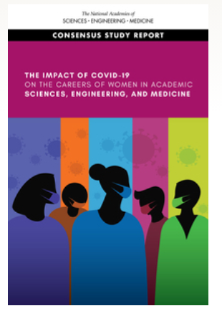
NASEM Committee Investigating the Potential Impact of COVID-19 on the Careers of Women in Academic Science, Engineering, and Medicine
Whether ongoing interventions help or harm women in academic research
If these interventions impact women and men differently;
What unique challenges are women in academic research facing in light of COVID-19
How these elements may impact the research careers of women in SEM.
Notes:
These are the goals and priorities of SEA Change.
We have adapted the Equality Charters Process to operate within the context of the US. Importantly, that includes consideration of federal and state legal parameters. Unlike the two separate equality charters in the UK, we knew that we must consider the intersectionality of identities from the start.

Slide 5
COVID Impacts
Loss of “boundary control,” blurring of spaces between personal and professional
Increased workload
Loss of productivity and decreased work efficiency
Increased stressors and effects on personal well being
“Life”– Childcare, eldercare and sandwiched care
Ambivalent institutional responses
Notes:
These are the goals and priorities of SEA Change.
We have adapted the Equality Charters Process to operate within the context of the US. Importantly, that includes consideration of federal and state legal parameters. Unlike the two separate equality charters in the UK, we knew that we must consider the intersectionality of identities from the start.

Slide 6
Effects of the COVID-19 Pandemic on Work Effectiveness of Women in Academic STEMM

Slide 7
Challenges and Copin Strategies of Women in Academic STEMM Related to Childcare Demands due to the COVID-19 Pandemic

Slide 8
NASEM Committee Investigating the Potential Impact of COVID-19 on the Careers of Women in Academic Science, Engineering, and Medicine (cont.)
Will we be able to retain the progress made in women’s representation in STEMM, including in leadership roles?
What will be the impacts of “the confluence of social stressors,” especially as systemic racism adds to these for Women of Color?
How will the institution respond to loss of productivity that may be appear disproportionately among women and among some fields?
How will institutional responses be monitored to ensure equitable impacts, such as for tenure track and non-tenure track faculty?
What impacts on collaboration and networking necessary for career success?
What impacts on mental health and well being?
Notes:
These are the goals and priorities of SEA Change.
We have adapted the Equality Charters Process to operate within the context of the US. Importantly, that includes consideration of federal and state legal parameters. Unlike the two separate equality charters in the UK, we knew that we must consider the intersectionality of identities from the start.

Slide 9
What We Need
Clarity: What is expected? How will my work be assessed? Do the same “understandings” apply?
Fairness: Since each of us experienced this period differently can we expect that this will be considered in going forward? In whatever re-imagining takes place?
Opportunity: Will there be space for experimentation, invention and innovation in all our roles?
Notes:
These are the goals and priorities of SEA Change.
We have adapted the Equality Charters Process to operate within the context of the US. Importantly, that includes consideration of federal and state legal parameters. Unlike the two separate equality charters in the UK, we knew that we must consider the intersectionality of identities from the start.

Slide 10
New Lenses and New Frames Our Reckoning on Race

Slide 11
What We Learned
Different groups experience societal challenges in different ways, revealing incredible inequities
Unequal treatment is a problem beyond issues in the larger society, such as in housing, employment and policing; it also includes education at all levels
Our scholarship has a diversity problem, especially as it relates to race/ethnicity
Notes:
These are the goals and priorities of SEA Change.
We have adapted the Equality Charters Process to operate within the context of the US. Importantly, that includes consideration of federal and state legal parameters. Unlike the two separate equality charters in the UK, we knew that we must consider the intersectionality of identities from the start.

Slide 12
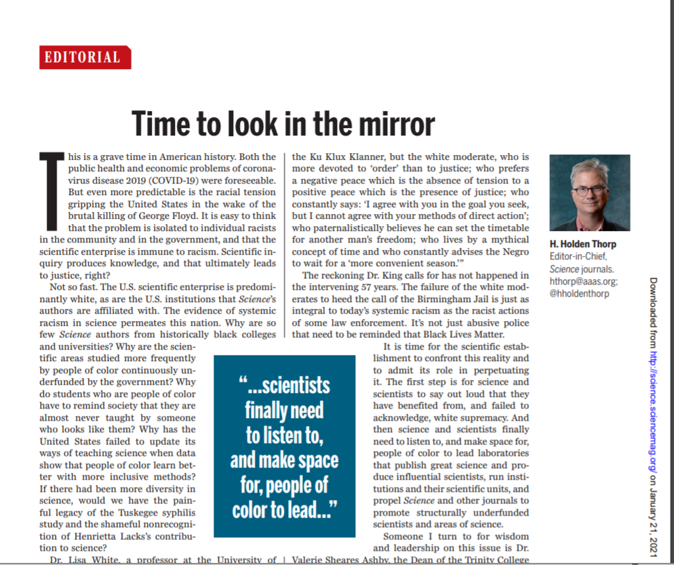
New Lenses and New Frames Our Reckoning on Race (cont.)

Slide 13
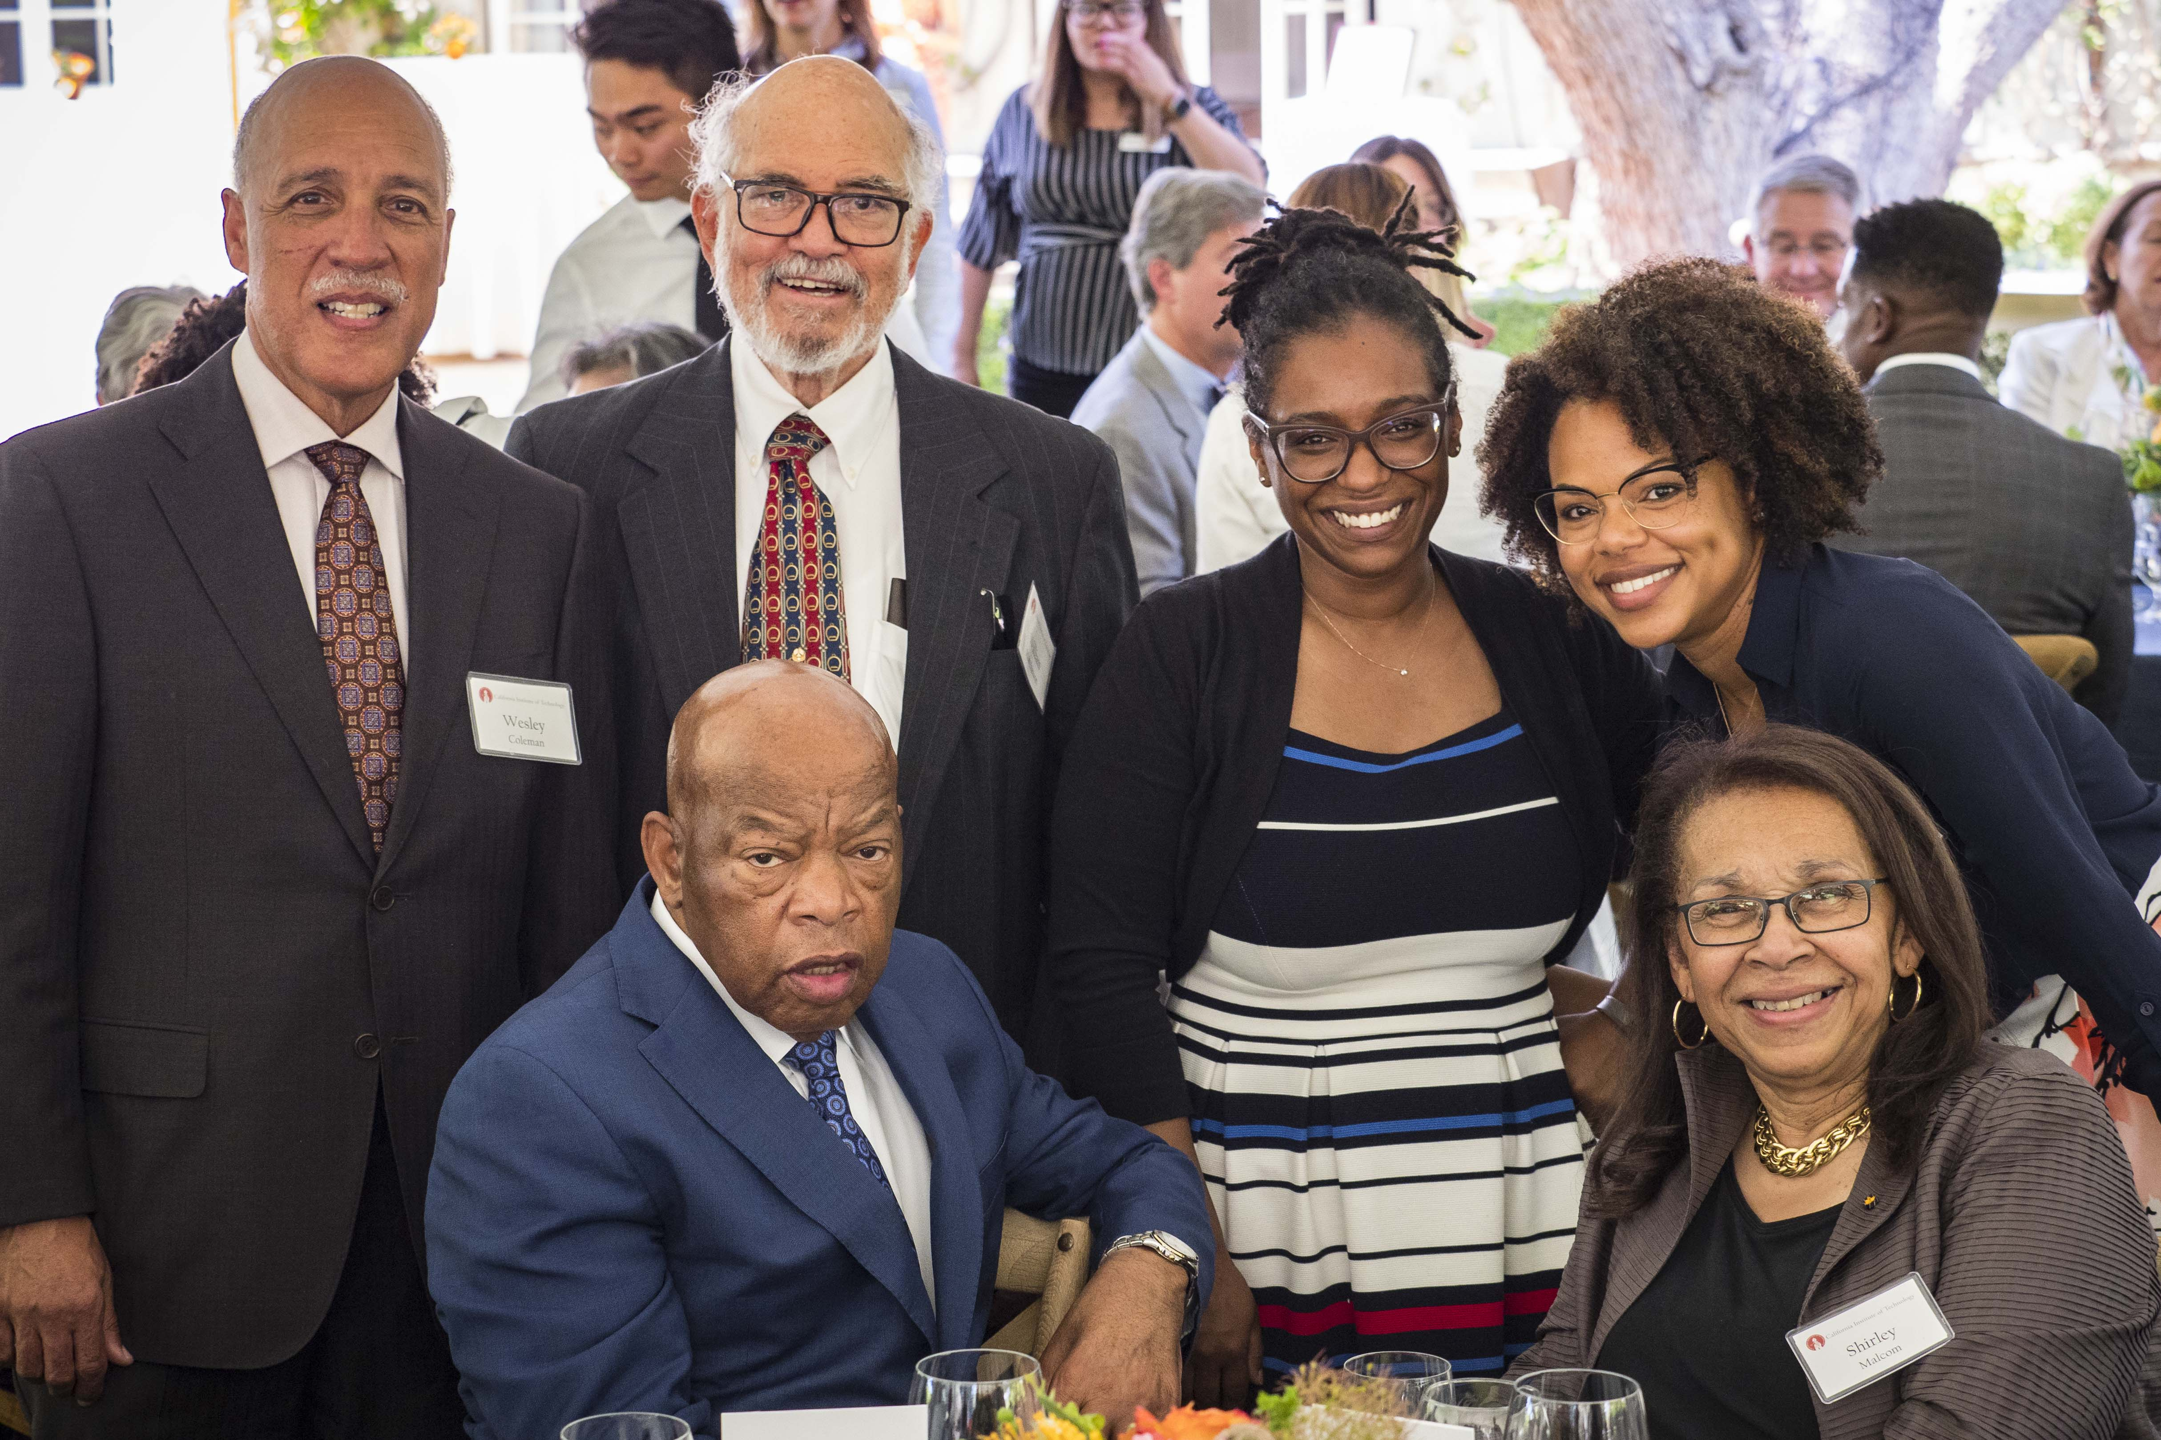
New Lenses and New Frames
Those of us in science have responsibilities to the larger society
We need to get in “good trouble”
We must call out injustice

Slide 14
What We Learned (cont.)
Our STEMM fields do not reflect the diversity of society, and the voices and lenses of marginalized groups are not included as well as they should be in shaping science, technology, engineering and medicine
Racism is real, including within our higher education institutions and many of our fields
We want to respond to DEI, but we are not sure how
We want to respond to DEI but not if it means changing our institutions
But we can only move ahead by re-imagining our institutions, our fields and our own work
Notes:
These are the goals and priorities of SEA Change.
We have adapted the Equality Charters Process to operate within the context of the US. Importantly, that includes consideration of federal and state legal parameters. Unlike the two separate equality charters in the UK, we knew that we must consider the intersectionality of identities from the start.

Slide 15
The System as the Problem
From Science Advances, October 9, 2019
Factors include: Is the proposal scored? What score it receives? Choice of topics?
The system? Research agenda; reviewers; priorities; values of field, agency and reviewers about what is meritorious
Choice of topic? Whose choices?
Notes:
These are the goals and priorities of SEA Change.
We have adapted the Equality Charters Process to operate within the context of the US. Importantly, that includes consideration of federal and state legal parameters. Unlike the two separate equality charters in the UK, we knew that we must consider the intersectionality of identities from the start.

Slide 16
First, imagine “The University we need.” The Future of Academic work will flow from that!

Slide 17
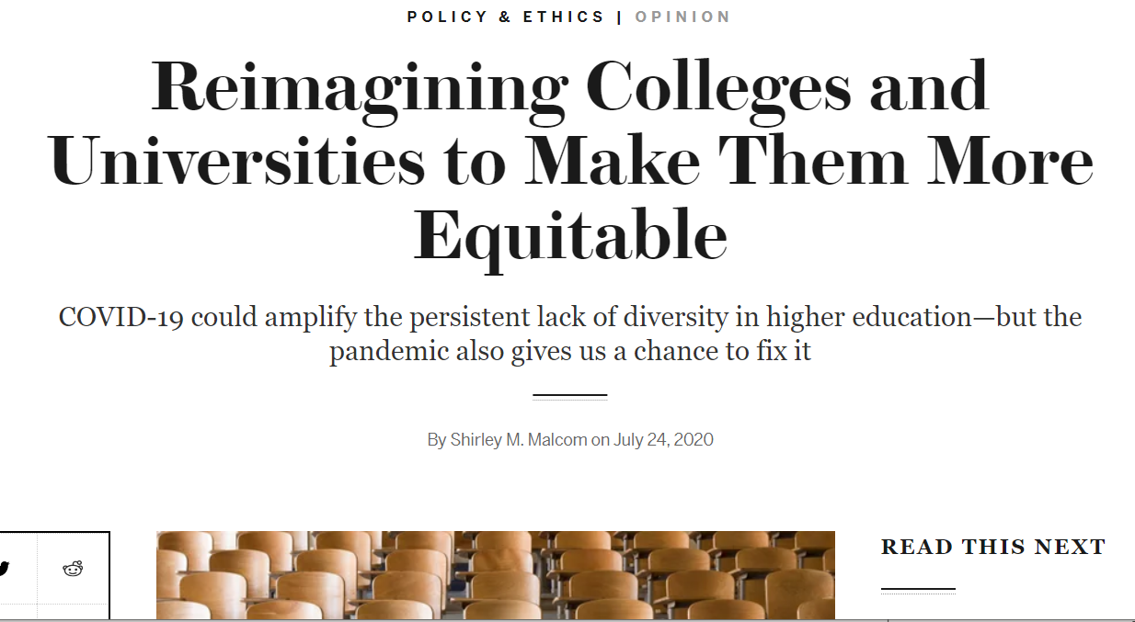
Reimagining Colleges and Universities to Make Them More Equitable

Slide 18
……When our colleges and Universities inform, Affirm, support and enable justice and sustainability

Slide 19
The Institution Our Society Needs
Support overall economic development
Overcome food and housing insecurity
Enable healthy populations and reduce disparities
Address climate change
Educate this and future generations
Promote justice and social mobility
And, and , and ……..
Notes:
These are the goals and priorities of SEA Change.
We have adapted the Equality Charters Process to operate within the context of the US. Importantly, that includes consideration of federal and state legal parameters. Unlike the two separate equality charters in the UK, we knew that we must consider the intersectionality of identities from the start.

Slide 20
Enlarging Our Vision of Academic Work: Teaching
How? Who? What? Who defines? Who measures value, quality? How evaluated? (as an individual, as a department/unit, institution-wide)
Who is a student? Do we include colleagues from other fields, community, elected officials, business leaders?
What innovations will be retained? Based on what criteria?
Notes:
These are the goals and priorities of SEA Change.
We have adapted the Equality Charters Process to operate within the context of the US. Importantly, that includes consideration of federal and state legal parameters. Unlike the two separate equality charters in the UK, we knew that we must consider the intersectionality of identities from the start.

Slide 21
Enlarging Our Vision of Academic Work: Research
Serving the public need, whether through fundamental, applied research, or translational research
Obtaining support for research--how to decide what it is important to do. What will be supported, what is needed?
How is the value of research assessed? Grants, publications, presentations? What other outputs: people, patents, businesses? What permeability with NGOs, community, companies, other fields?
New structures to address big problems? What does that mean for academic work?
Notes:
These are the goals and priorities of SEA Change.
We have adapted the Equality Charters Process to operate within the context of the US. Importantly, that includes consideration of federal and state legal parameters. Unlike the two separate equality charters in the UK, we knew that we must consider the intersectionality of identities from the start.

Slide 22
Enlarging Our Vision of Academic Work: Service
What counts as service?
Service to whom? How defined, measured and valued? Within the institution? Within the field? Within the state, region, nation and internationally?
What priority at individual, unit and institution levels?
What role for academic citizenship?
Notes:
These are the goals and priorities of SEA Change.
We have adapted the Equality Charters Process to operate within the context of the US. Importantly, that includes consideration of federal and state legal parameters. Unlike the two separate equality charters in the UK, we knew that we must consider the intersectionality of identities from the start.

Slide 23
Other Work That Is Needed
Mentoring
Community outreach
Diversity, equity, inclusion, justice
Public scholarship
Constructing a counternarrative– “Shirley’s Law”
Building a more “permeable” institution—a “Future’s Focused Strategy”
Notes:
These are the goals and priorities of SEA Change.
We have adapted the Equality Charters Process to operate within the context of the US. Importantly, that includes consideration of federal and state legal parameters. Unlike the two separate equality charters in the UK, we knew that we must consider the intersectionality of identities from the start.

Slide 24
Systemic Change work must be top-down and bottom-up….academic work is central to both!

Slide 25
AAAS SEA CHANGE AWARDS
Notes:
The SEA Change Awards are the component that most people are familiar with.
Systemic transformation requires a simultaneous top-down, bottom-up approach. Institutional Awards will help set up the foundation needed to advance individual departments; the advancement of multiple departments will then help catalyze continuous improvement at the institutional level.
The Institutional Bronze Awards process has been in pilot since 2017. 2020 will be the last year of the pilot before the Awards process fully launches. Institutions submitting applications for Institutional Awards in 2020 will be a part of Awards Pilot cohort 2. DEADLINE October 30.
It will be several years before the Departmental Awards are up and running. Currently. SEA Change plans on partnering with coalitions of disciplinary society partners to develop and administer discipline-specific departmental awards. The Physics & Astronomy working group intends to pilot Departmental Awards in fall of 2020.

