Slide 1
Leadership Institute Working with Support Staff March 12, 2021

Slide 2
Key Contacts
Work with your unit H.R. Administrator first.
OFFICE OF EMPLOYEE RELATIONS
• Rick Fanning, Director, rickfanning@hr.msu.edu
• Andrew Jarvis, Human Resources Manager, ANDREWJA@hr.msu.edu
• Lilyan Talia, Human Resources Analyst, talialil@hr.msu.edu

Slide 3
Employee Relations’ Role
Establish and maintain relations with leadership of 10 bargaining units representing MSU employees
Negotiate collective bargaining agreements
Assist and counsel supervisors and administrators on contract interpretation, performance management/setting expectations, and issuing discipline

Slide 4
Myth 1:
Union contracts limit my ability to manage!

Slide 5
Management’s Rights
Management’s Rights clause allows one to determine:
The work to be performed, the method of performing the work and standards, the location and schedule;
The number of people needed to perform the work;
To lay off for lack of work, lack of funds;
To reprimand, suspend and discharge for just cause; etc.
Except as where abridged by contract, law or past practice.

Slide 6
Constraints to Management Rights
Collective Bargaining Agreements
Mandatory Subjects of Bargaining
MSU policies and procedures
(Some) Past practices
Federal, state and local laws/ordinances
Alphabet Soup - PERA, FOIA, RCPD, FMLA, FLSA

Slide 7
Typical Contract Provisions
Recognition | Union Security
Union Dues | Seniority Provisions
Grievance Procedure | Management’s Rights
Employee Rights | Filling Vacancies
Overtime | Supervisor Working
Job Classifications | Layoffs and Recall
Discipline and Discharge | Leaves of Absence

Slide 8
Contract Ambiguities
May, shall, could, will, may not, must
Patent ambiguities
Terms are open to various interpretation
Ex. “reasonable”, or “short durations”
Contact ER for practice and guidance
Latent ambiguities
Language seems clear until applied
Ex. Preference is “based on seniority”
Contact ER for practice and guidance
Contract vs. Law vs. Policy vs. Past Practice

Slide 9
Lists in Labor Relations
By definition limit the scope of the applicable provision
If there is a list without qualification, case law presumes items not on the list were intentionally left out
Management’s Rights
Retain all rights not otherwise abridged
Job Descriptions
All other duties as assigned
Bereavement Leave
Specific relationships listed in each contract
Disciplines

Slide 10
Myth 2
A bypass employee is someone else’s poor performer.

Slide 11
Contracts allow management to determine the size and makeup of units and to layoff employees when necessary. Union contracts speak to whom is laid off when work is eliminated or reorganized.
Job classifications are based on work performed.
Layoff is never to be used to take the place of performance management.

Slide 12
Myth 3
It takes five years to fire an employee!
This Photo by Unknown Author is licensed under CC BY

Slide 13
Performance Management
Coaching – document with a note to yourself that you place in your supervisory file
Counseling – similar to coaching but follow up with written document to the employee
Discipline/Discharge – either progressive or summary and written on specific form; triggers right to union representation (Weingarten Rights)
If it’s not documented, it didn’t happen!

Slide 14
Weingarten Rights
When Employees have a right to Union representation:
When a supervisor believes discipline may result from an investigatory meeting
When an employee reasonably believes discipline may result from an investigatory meeting
- Supervisor can declare the meeting will be non-disciplinary
When Employees do not have a right to Union representation (but supervisor may allow it):
Evaluations
Counseling Sessions
Informal discussions

Slide 15
Policy Guidance
Support Staff Rules Governing Personal Conduct of Employees Policy: https://www.hr.msu.edu/policies-procedures/support-staff/support-staff-policies-procedures/personal_conduct.html
Disciplinary Action Policy: https://www.hr.msu.edu/policies-procedures/support-staff/support-staff-policies-procedures/discipline.html

Slide 16
Myth 4:
A Performance Improvement Plan (PIP) is an amnesty period.

Slide 17
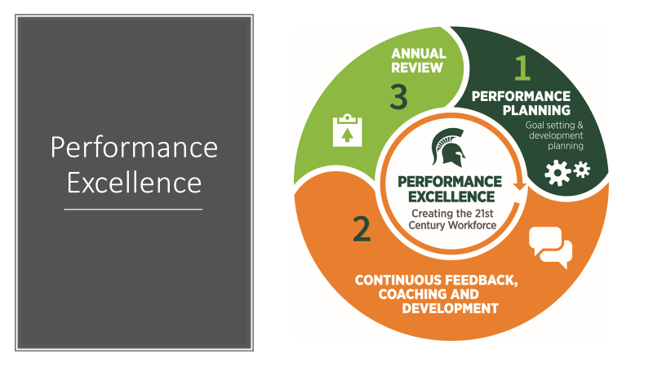

Slide 18
“How will we align our skills, incentives, and resources to create a plan to achieve our collective vision?”
https://president.msu.edu/initiatives/strategic-plan/planning-process/key-questions.html

Slide 19
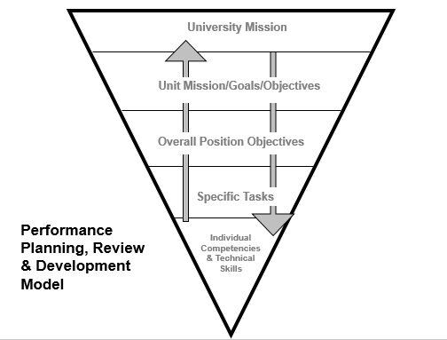
Notes:
Look at University priorities and initiatives, departmental or college plans and goals, unit priorities and then the individual position and how it fits in. It is our role to not only consider how these pieces tie together, but to help our employees make that connection as well.
How can you make connections for your staff in terms of how what they are working on is connected to unit, department or university priorities?

Slide 20
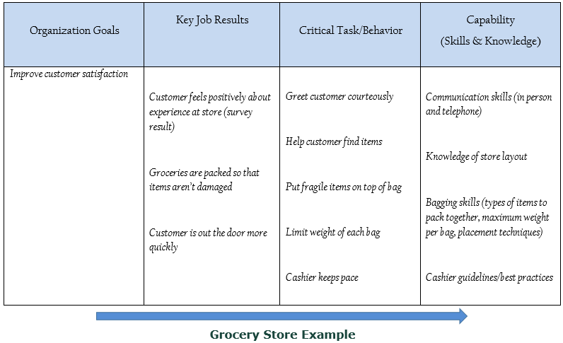
Professional Development Impact Map
Notes:
This organization has a goal to improve the overall customer satisfaction survey score by 5 points in the calendar year 2021.

Slide 21
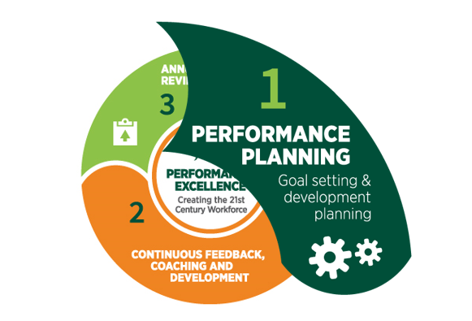

Slide 22
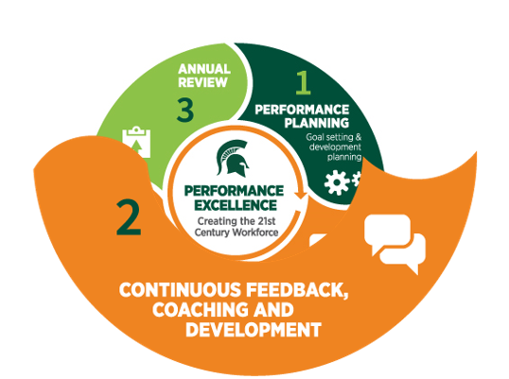

Slide 23
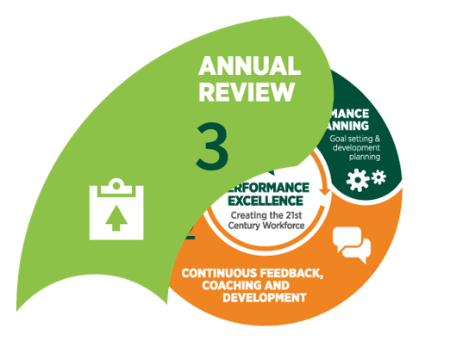

Slide 24
Performance Management Tips for Pandemic and Remote Work
Keep with it! Do not postpone coaching, feedback, 1/1, performance reviews. Work changes, expectations and goals may need to be adjusted.
Establish short term, define criteria for success and re-evaluate and reiterate often. Task based.
Don’t ignore performance issues or delay accountability conversations.
Notes:
Instinct is to postpone coaching, feedback, reviews. Opposite is true. Even more important to connect with employees. Revisit goals, establish new definitions of success.
Managers should keep the focus on the future -- identifying opportunities, quickly communicating changes and preparing for potential pivots.
Additionally, taking a performance goal-based approach to performance measurement that focuses on clearly defined expectations and standards (e.g., SMART goals, KPIs) allows for a more flexible or task-based approach where metrics don't exist or can be deceiving. This is especially important for teams new to working from home. It is critical for those teams to focus on clearly defined outcomes and performance indicators (e.g., metrics, goals, deliverables). Don't mistake activity and participation -- such as emails, meetings, hours on a timesheet -- for high-quality, productive performance outcomes.

Slide 25
Questions?

Slide 26
HR Contact Information
Solutions Center
517-353-4434 or (800) 353-353-4434
solutionscenter@hr.msu.edu
Need an answer to an HR question? Call this number to get the answers you need.
Organization and Professional Development
517-355-0183
prodev@hr.msu.edu
Want suggestions to build your own development plan? Looking for guidance in addressing skill gaps with your team? Call OPD to get on the right track.
Presenter: Christy Turner turner.c@hr.msu.edu

