Slide 1
RVSM CLIMATE SURVEY
SUMMARY OF FINDINGS

Slide 2
Relationship Violence & Sexual Misconduct (RVSM) Expert Advisory Workgroup
with
RTI International
Office of President
Office of the Provost
Office for Civil Rights & Title IX
Office for Inclusion & Intercultural Initiatives
Office of the Registrar
AHR & HR
MSU Communications
ASMSU & COGS
Faculty Senate
WACSS
ADA Coordinator
LBGT Resource Center
Health Promotion
Council of Research Deans
Office of Survey Research

Slide 3
WHY
A RVSM CAMPUS CLIMATE SURVEY?

Slide 4
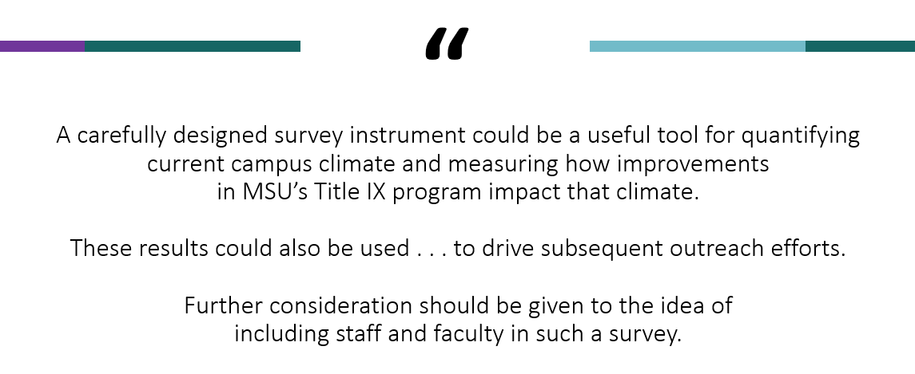
A carefully designed survey instrument could be a useful tool for quantifying current campus climate and measuring how improvements in MSU’s Title IX program impact that climate.
These results could be used to drive subsequent outreach efforts.
Further consideration should be given to the idea of including staff and faculty in such a survey.

Slide 5
TIMELINE
March 2018
April 2018
May 2018
June 2018 – February 2019
External Report Issued
RVSM Workgroup Tasked
Outside Vendor Selected
Development & Stakeholder Feedback

Slide 6
TIMELINE
March 2018
April 2018
May 2018
June 2018 – February 2019
External Report Issued
RVSM Workgroup Tasked
Outside Vendor Selected
Development & Stakeholder Feedback
March – May 2019
June – October 2019
November 2019
Survey Administration
Vendor Report Preparation
REPORT PUBLIC RELEASE

Slide 7
TIMELINE
March 2018
April 2018
May 2018
June 2018 – February 2019
External Report Issued
RVSM Workgroup Tasked
Outside Vendor Selected
Development & Stakeholder Feedback
March – May 2019
June – October 2019
November 2019
Survey Administration
Vendor Report Preparation
REPORT PUBLIC RELEASE
December 2019– March 2020
April 2020 – Present
Open Forum Discussions & Unit-Level Presentations
RVSM, DEI, University Strategic Planning

Slide 8
1
REVIEW SURVEY CONTENT
2
SUMMARIZE SURVEY METHODS
3
HIGHLIGHT KEY FINDINGS
4
DESCRIBE NEXT STEPS

Slide 9
1
SURVEY CONTENT

Slide 10
1
SURVEY CONTENT
Incidence & Prevalence of RVSM
RVSM Resources
Campus Climate
Campus Climate
(Connectedness, Leadership, RVSM Climate)
Workplace Incivility
Workplace Incivility
Workplace Incivility

Slide 11
2
METHODS
IRB review by RTI and MSU (RTI is IRB of record)
Surveys sent to entire population via online platform (anonymous)
Students: 9,479 participated (14 – 27% response rate)
Faculty & Staff: 5,594 participated (22 – 42% response rate)

Slide 12
3
FINDINGS

Slide 13
3
FINDINGS
Incidence & Prevalence of RVSM
RVSM Resources
Campus Climate
Campus Climate
(Connectedness, Leadership, RVSM Climate)
Workplace Incivility
Workplace Incivility
Workplace Incivility

Slide 14
3
FINDINGS
Incidence & Prevalence of RVSM

Slide 15
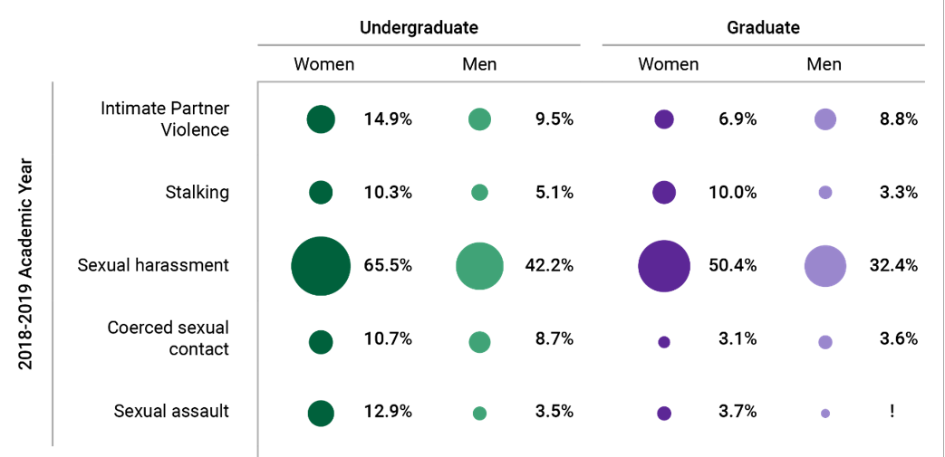
3
FINDINGS
Pages ES-2, 10
Incidence & Prevalence of RVSM

Slide 16
3
FINDINGS
Pages 13-20
Incidence & Prevalence of RVSM
REPORT PROVIDES BREAKDOWNS BY
Year in School Athletics
Race/Ethnicity Greek Life
Sexual Orientation International
Gender Identity Disability

Slide 17
3
FINDINGS
Incidence & Prevalence of RVSM

Slide 18
3
FINDINGS
Pages ES-4, 47
Incidence & Prevalence of RVSM
STUDENT
Any Work-Related
Sexual Assault
(unreliable estimates ( < .5%)

Slide 19
3
FINDINGS
Pages 49-50
Incidence & Prevalence of RVSM
STUDENT
REPORT PROVIDES BREAKDOWNS BY
Years of Service Sexual Orientation
Rank Gender Identity
Race/Ethnicity Disability
Any Work-Related
Sexual Assault
(unreliable estimates ( < .5%)

Slide 20
3
FINDINGS
RVSM Resources

Slide 21
3
FINDINGS
RVSM Resources
 | Students | Faculty-Staff
Reported to MSU Office | 20% | 3 - 17%
Service Helpfulness | 83 - 87% | (oops, forgot to include)
Know What Services Are Available | 76 - 88% | 82 - 90%
Received RVSM Training | 75 - 94% | 57 - 94%
Note: table compiles & summarizes text throughout report

Slide 22
3
FINDINGS
Pages 34, 35, 57, 60
RVSM Resources
 | Students | Faculty-Staff
Reported to MSU Office | 20% | 3 - 17%
Service Helpfulness | 83 - 87% | (oops, forgot to include)
Know What Services Are Available | 76 - 88% | 82 - 90%
Received RVSM Training | 75 - 94% | 57 - 94%
Note: table compiles & summarizes text throughout report

Slide 23
3
FINDINGS
Pages 57,60
RVSM Resources
 | Students | Faculty-Staff
Reported to MSU Office | 20% | 3 - 17%
Service Helpfulness | 83 - 87% | (accidentally omitted)
Know What Services Are Available | 76 - 88% | 82 - 90%
Received RVSM Training | 75 - 94% | 57 - 94%
Note: table compiles & summarizes text throughout report

Slide 24
3
FINDINGS
Campus Climate

Slide 25
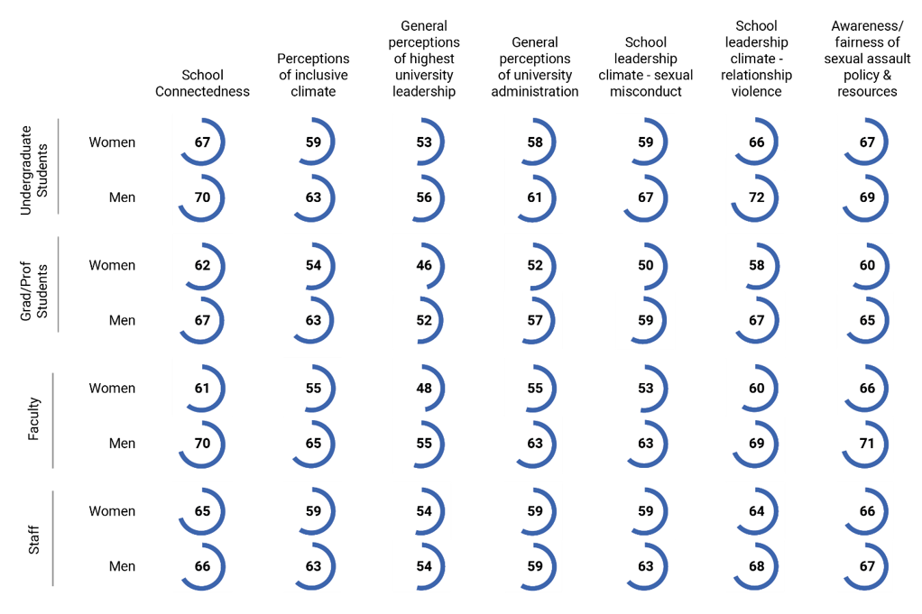
3
FINDINGS
Pages ES-5, 56
Campus Climate

Slide 26
3
FINDINGS
Workplace Incivility

Slide 27
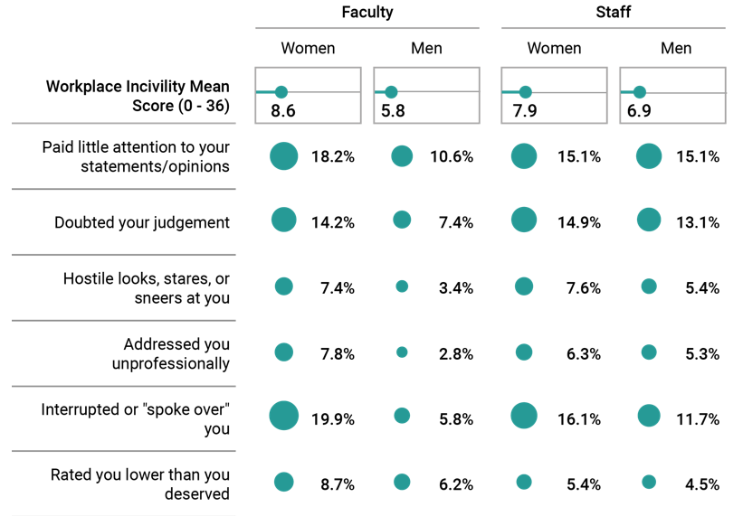
3
FINDINGS
Page 43
Workplace Incivility

Slide 28
4
NEXT STEPS

Slide 29
4
NEXT STEPS
Released Full Report on Office for Civil Rights & Title IX Website
Press Release & Email Announcement from President Stanley
Campus Open Forum Discussions & Unit-Level Presentations
RVSM Strategic Plan & Sharing Data With University & DEI Planning Groups
Planning for future surveys to track changes & progress

Slide 30
QUESTIONS

