Slide 1
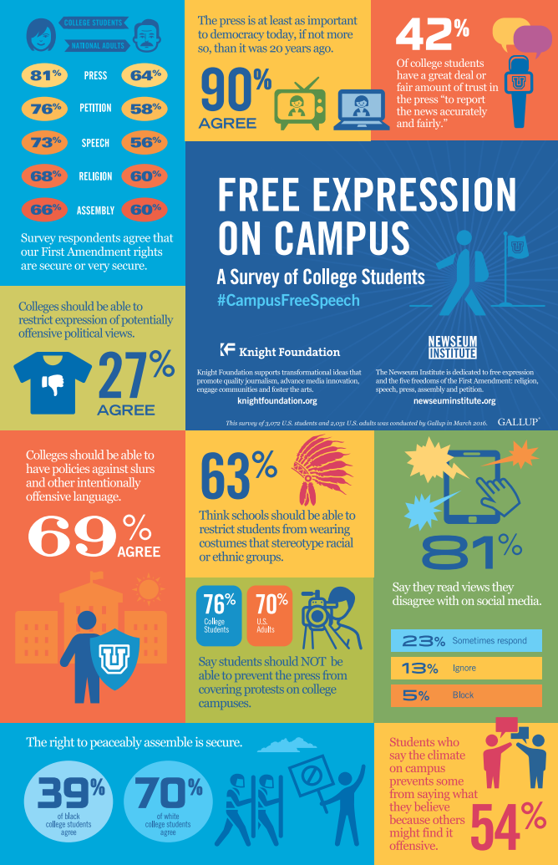
Free Speech on Campus
October 30, 2020
Kristine Bowman
Professor of Education Policy & Law
Tanya Jachimiak
Associate Vice President
This Photo by Unknown Author is licensed under CC BY-NC

Slide 2
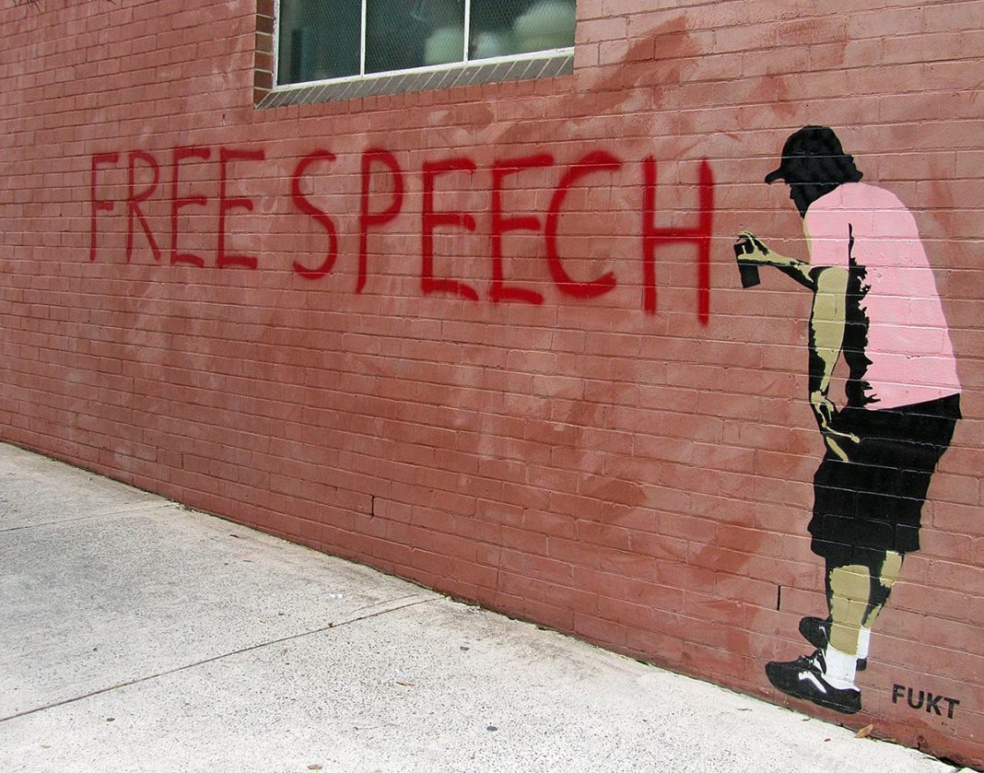
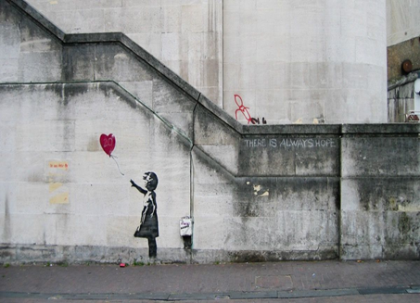
Overview
Learn
Free speech fundamentals
Hate speech
Act
Speak out
When speech becomes harassing conduct
Get Support
Resources at MSU
Q&A is open throughout
Your questions will help planning for the follow-up session
This Photo by Unknown Author is licensed under CC BY-SA

Slide 3
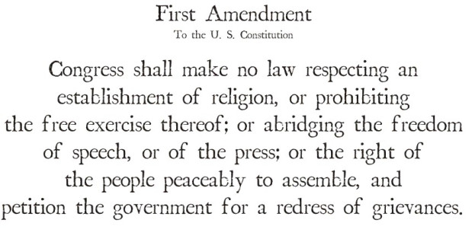
Free speech fundamentals
This Photo by Unknown Author is licensed under CC BY-NC-ND

Slide 4
Free speech fundamentals
Why we have it
Applies in public situations, not private
Student vs employee contexts
Global context—the free speech continuum
The United States position
This Photo by Unknown Author is licensed under CC BY-SA

Slide 5
Free speech fundamentals
Some protected speech can be restricted
Time, place and manner
Events, including outside speakers
The default assumption is that speech is protected
However, some speech is not protected
Unprotected speech includes:
Fighting words
True threats
Destruction of property
Defamation (libel and slander)
Fraud
Incitement to imminent lawless action
Solicitation to commit crimes
Blackmail
Perjury
Obscenity
Child pornography

Slide 6
Hate speech
Not a legal concept
Hate speech may be protected speech
The idea of “hate speech” recognizes that some speech is motivated by bias and can cause great harm
Code of conduct speech restrictions can harm groups they were intended to protect
This Photo by Unknown Author is licensed under CC BY-NC-ND

Slide 7
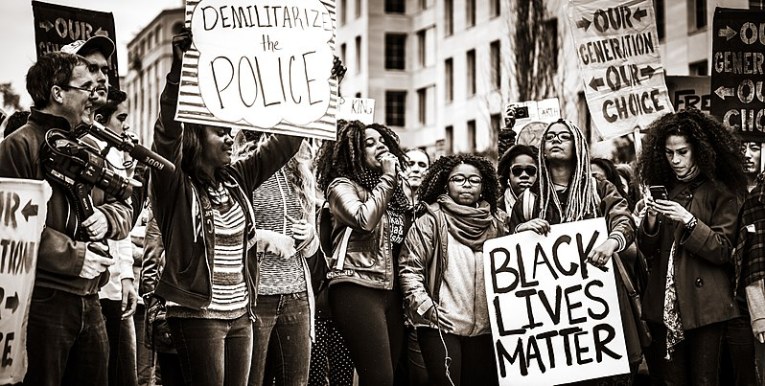
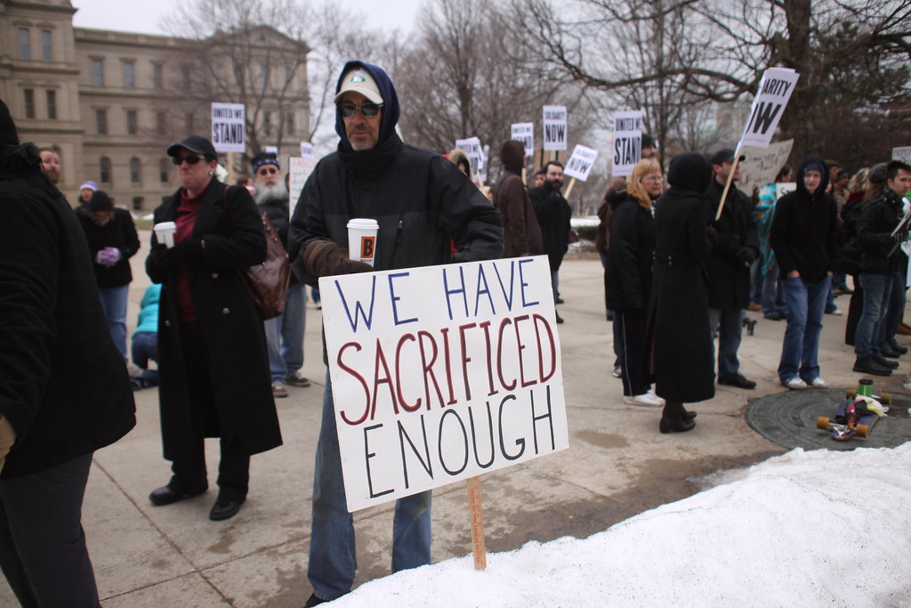
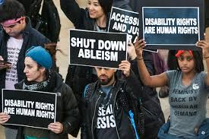
Speak out
Speech and More Speech
Artistic expression
Events
Protests
Bystander intervention (direct or indirect)
Voting
Constructive conversations
This Photo by Unknown Author is licensed under CC BY-NC-ND
This Photo by Unknown Author is licensed under CC BY-NC
This Photo by Unknown Author is licensed under CC BY
Notes:
Express your views

Slide 8
When speech becomes harassing conduct
Focus is objective impact of speech rather than content
Legal standard:
A member of a protected class must be targeted because of membership in that protected class;
The conduct is unwelcome;
The conduct deprives a person of employment or access to education.
Severe or Pervasive
Report to the Office of Institutional Equity
Notes:
As a general matter, if you are speaking
as a private citizen,
about a matter of public concern, and
your speech does not interfere with your job,
your speech is protected.

Slide 9
Workplace Examples May Include:
Protected Free Speech
Not Protected
Personal Tweet that a school is violating tax laws
Personal social media post expressing an opinion about systemic racism
HR personnel's reply on local newspaper Facebook page expressing opinion of same sex marriage
Professor's lecture on language, which explored the social and political impact of certain words
Unwanted daily broadcast of prayers over an employer's public address system
Posting naked people cartoons of all genders in the breakroom
Displaying music videos depicting sexually provocative conduct
Police officer who sold a video on the adults-only section of eBay that showed him stripping off a police uniform

Slide 10
Get support: Faculty, staff, and student resources at MSU
Academic Advancement Network (AAN)
Affinity groups (student, faculty, and staff)
Council of Racial and Ethnic Minorities (CoREM)
Council of Racial and Ethnic Students (CORES)
Council of Progressive Students (COPS)
Counseling and Psychiatric Services (CAPS)
Individual counseling
Group conversations
Employee Assistance Program (EAP)
Faculty Grievance and Dispute Resolution Office
LBGT Resource Center
Office of Inclusion and Intercultural Initiatives (I3)
MSU Dialogues program
Implicit bias training
Trained facilitators
Office of Cultural & Academic Transitions
Prevention, Outreach, and Education (POE)
University ombudsperson
Undergraduate advisors
Work Life Office
And many more…

Slide 11
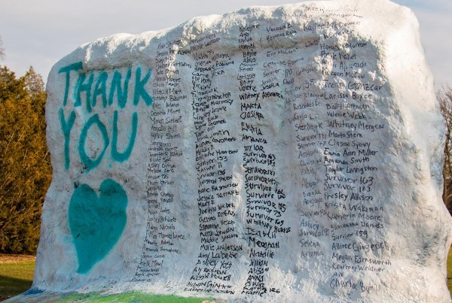
What comes next
Freedom of Speech on Campus: Part Two
Facilitated small-group case studies exploring free speech and inclusion
November 6, 9-10:30 am
Registration information
Use the same link you did for today’s session
https://msu.co1.qualtrics.com/jfe/form/SV_1ZjUb7vC65BdgEZ
This Photo by Unknown Author is licensed under CC BY

