Slide 1
Michigan State University
Budget & Finance Basics
September 10, 2020
Brent Johnston University Budget Officer
Office of Budget, Planning, and Analysis
Notes:
JAMES

Slide 2
Table of Contents
Summary and Overview
Financial Structure
Budget Planning
Endowment & Endowment Spending
Resources & Contacts
Introduction
Notes:
JAMES

Slide 3
Introduction
Purpose & Agenda
To provide an overview of the financial structure, policies, processes, and language as you assume financial responsibility for your unit
Fund and account structure
Sub-funds/object codes
Some specifics on the general fund
Object codes
Budget and planning
Endowment spending
Resources and contacts
Administrative
and
Finance Functions
Budget & Finance Basics
Notes:
Eric

Slide 4
Who Can Help?
Introduction
David Byelich
Associate Vice President and Director
Office of Planning and Budgets
517-355-9271
Byelich@msu.edu
Brent Johnston
University Budget Officer
Budget Planning and Analysis
Office of Planning and Budgets
517-353-5519
john1096@msu.edu
Barbara Kranz
Director
Facilities Planning and Space Management
Office of Planning and Budgets
517-355-9271
kranzb@opb.msu.edu
Bethan Cantwell
Director
Institutional Studies
Office of Planning and Budgets
517-355-9273
cantwellb@msu.edu
Greg Deppong
University Controller
Office of the Controller
517-355-5020
deppong@msu.edu
John Thelen
Assistant Controller
Financial Analysis
517-884-4197
thelen43@ctlr.msu.edu
Lee Hunter
Chief Accountant & Manager of Financial Reporting
Office of the Controller
517-355-9271
hunerti@msu.edu
Katie Cook
Director
Office of Sponsored Programs
517-884-4237
farrkat1@osp.msu.edu
Debbie Gulliver
University Travel Manager
Officer of the Controller
517-355-5000
gullive5@cltr.msu.edu
Kara Yermak
Assistant Director
AP/AVP for Academic Human Resources
517-884-0185
burtkara@provost.msu.edu
Evo Pedawi
Director
Contracts and Grants Post Award
517-884-4234
pedawi@cga.msu.edu
Rebecca Yauch
Assistant Director
Human Resources
517-884-0115
ryauch@hr.msu.edu
Valerie Noel
Assistant Budget Officer
PA, OCCI, RBI, RFA
517-432-0219
thebeau@msu.edu
Bill Buddle
Assistant Budget Officer
Planning Analytics Operations
517-432-5319
buddlewi@msu.edu
Charmaine Shellman
Assistant Budget Officer
Allocations & Resource Management
517-355-4503
cshellma@msu.edu
Rati Walther
Financial Analyst
Budget, Planning, and Analysis
517-353-0864
walthe19@msu.edu
Budget & Finance Basics

Slide 5
Introduction
The value of MSU academic programs continues to appreciate at the state, national and international levels. Our reputation grows as a top-100 global university, committed to student success, advancing Michigan communities, and research with global impact.
Ongoing monitoring of MSU financial health; assets increased by approximately $150M in FY19, current bond rating at/exceeds Big Ten median, challenged by impact of legal settlement
Fall 2019 entering class amongst largest in history, included record level of domestic non-residents, monitoring national demographic trends and international enrollment
OPEB liability reduced by over $350M, approximately 20% of FY18 total due to changes in actuarial formula; additional reduction possible due to Medicare Advantage
Priorities in MSU’s long-term financial framework support transformational efforts in academic quality, financial aid, teaching and laboratory facilities
Auxiliary units, including Athletics, Residential & Hospitality Services, and the MSU Health Team monitor emerging local, regional, and national issues to inform long-range strategic planning efforts
Flat-rate tuition structure introduced for 2019-20 academic year, anticipated to reduce time-to-degree, limit student debt
MSU sponsored awards and expenditures at record levels, MSU’s three-year rate of change best in the Big Ten
MSU formed private insurance captive for majority of insurance needs, sexual assault and traumatic brain injury risks outside of captive
Budget & Finance Basics
Notes:
Eric

Slide 6
Table of Contents
Introduction
Financial Structure
Budget Planning
Endowment & Endowment Spending
Resources & Contacts
Financial Structure
Notes:
JAMES

Slide 7
Financial Structure
Fund Accounting Concepts
Follows Governmental Accounting Standards Board (GASB)
Separates funds by source and restriction
Helps ensure funds are used for intended/defined purposes
Maintains separation of restricted (endowments, gifts, grants) from unrestricted (auxiliary services, general fund, fee-for-service) funds
Budget & Finance Basics
Notes:
Eric

Slide 8
Financial Structure
Fund Structure Overview
Major activities:
Instructional activity
Departmental research activity
Academic, student, institutional support
Maintenance and utilities
General fund financial aid
Startup, other initiatives, and support activities
Current Funds
General Fund: Unrestricted operating funds; budgeted and allocated for general operations
Designated Fund: Unrestricted self-supporting mission related activities – fee for service
Auxiliary Fund: Unrestricted self-supporting non-mission activities – fee for service
Expendable Restricted: Restricted funding for sponsored projects or current gift/endowment revenue
Major activities:
Sponsored programs
Gifts
Endowment spending
Major activities:
Non-credit instruction
Study abroad
MSP/Clinical operations
DCPAH
Major activities:
RHS
Athletics
Parking
Budget & Finance Basics
Notes:
Eric

Slide 9
Financial Structure
Fund Structure Overview
Fund Group Code | Fund Group Name | Restricted Status
AF | AGENCY FUND | Restricted (arm’s length)
GF | GENERAL FUND | Unrestricted
DF | DESIGNATED FUND | Unrestricted
XF | AUXILIARY FUND | Unrestricted
RF | EXPENDABLE RESTRICTED FUND | Restricted
NF | ENDOWMENT FUND | Unrestricted or Restricted
LF | STUDENT LOAN FUND | Unrestricted or Restricted
TF | RETIREMENT AND INSURANCE | Unrestricted
PF | PLANT FUND | Unrestricted or Restricted
Budget & Finance Basics
Notes:
Eric

Slide 10
Significant All Funds Activities
Financial Structure
Amount
Review
General Fund
$1.50B
BOT approved each June
Includes major instructional and administrative activities of the university
BOT approved grant-by-grant as received, endowment by spending policy – MSUE/AgBio each June
Expendable Restricted
$0.80B
Includes sponsored activities and restricted endowment and gift accounts
Auxiliary Activities
$0.45B
Athletics BOT approved each June, RHS each April
Comprised primarily of Residential & Hospitality services and Athletics
Designated
$0.30B
Clinical and fee-for-service operations differentially
Comprised primarily of clinical operations and other activities
All funds activities also include the student loan, endowment (principal), plant fund, and retirement and insurance funds
Budget & Finance Basics

Slide 11
Financial Structure
Fund Structure Overview
Current Funds:
General Fund – unrestricted operating funds that are budgeted and allocated for the general operations of a unit/department.
Designated Fund – unrestricted self-supporting activities (activities generally include an instructional, research, or public service component) that furnish goods or services to the campus community and/or the general public for a fee
Auxiliary Fund – unrestricted self-supporting activities (activities that generally lack an instruction, research, or public service component) that furnish goods or services to the campus community and/or the general public for a fee
Expendable Restricted Fund – restricted funding for sponsored projects/programs or current gift revenue and endowment income spending accounts restricted for specific use.
Non-current Funds:
Endowment Fund – unrestricted or restricted funds invested "in perpetuity" of which only a portion of the market value is distributed each year for spending (i.e. spending policy distributions).
Plant Fund – unrestricted or restricted funds used for purchasing, maintaining and recording of the University’s property, plant, and equipment.
Student Loan Fund – unrestricted or restricted funds used for the administration of student loan fund programs (For Central Use Only).
Retirement & Insurance Fund – unrestricted funds invested and used for various self-insured retirement and insurance programs (For Central Use Only).
Agency Fund – funds on deposit at MSU and managed by University employees, but to which MSU does not have any legal ownership.
Budget & Finance Basics
Notes:
Eric

Slide 12
Financial Structure
Fund-to-Fund Transactions
Auxiliary Fund:
yes, though uncommon
No
With approved project/reserve account
Plant fund
General Fund:
Rarely – with approval
Designated Fund:
Rarely, should project be complete and overfunded
Rarely – GF solution preferred
No
No
Expendable Restricted:
Budget & Finance Basics
12

Slide 13
Financial Structure
Sub-Fund Overview
Sub-funds delineate Funds to group accounts with similar activities.
Sub-funds begin with the first letter of the Fund.
Common sub-funds:
GA – General Fund Operations: Accounts for day-to-day operations of university departments.
GE – General Fund Startups – Faculty: Accounts for faculty startup agreements.
DS – Designated Operations (Self-Supporting): Accounts for activities generally having instruction, research, or public service components (conferences, seminars, medical services, etc.).
RC/RG – Expendable Restricted Contracts and Grants: Accounts for sponsored project/program activities where the university is granted funds.
RN – Expendable Restricted Gifts: Accounts for restricted gifts where the donor has specified how the funds must be spent.
XT – Auxiliary Other: Accounts for self-supporting and fee for services activities that provide goods or services to the campus community and general public, but lacks the instruction, research, or public service components.
Budget & Finance Basics
Notes:
Eric

Slide 14
Financial Structure
Account and Transaction Elements
Account Attributes
Centrally Controlled | Unit Controlled
Campus Code RC Code Organization Code Fund Group Code Sub-Fund Group Code Account Number Account Type Code Category Code Higher Ed Function Code Source of Funds Code Fiscal Officer Account Supervisor Account Manager Account Expiration Date | Mission Code Program/Initiative Code Use of Funds Code Sub-Account Number Financial Reporting Code
Transaction Attributes
Centrally Controlled | Unit Controlled
Document Number Chart Account Number Object Code Object Level Object Sub-Type Object Consolidation Reference Origin Code | Sub-Object Code Project Project Mgr principal name Org Ref ID (Text) Line Description (Text)
Budget & Finance Basics
Notes:
Eric

Slide 15
Financial Structure
General Fund Account Structure
General Fund
Operations (GA): For day-to-day operations of departments/ colleges
Startup (GE/GH): Used to account for ongoing startup activity for new faculty and long-term funding needs
Technology (GL): Used to support Teaching and Learning Environment funds (TLE)
Specials (GS): Used to account for projects/ initiatives – startups, retentions, other activities – sub fund being reviewed
Cash Management Programs (GC): Used to account for annual budget allocations/ carryforward – no expenditures
Contingency (GD): Used to account for carryforward, unencumbered programmatic resources, flex funds – Unit priorities
Manual of Business Procedures: https://ctlr.msu.edu/download/mbp/ex5GeneralFund.pdf
Budget & Finance Basics
Notes:
Eric

Slide 16
Financial Structure
General Fund Transactions
\To From | GA | GC | GD | GS | GE | GH | GR
GA | Yes | Yes* | Yes | Yes, for specific approved purposes | Yes | Yes | Yes, for research related activity
GC | Yes | Yes* | Yes | Yes, for specific approved purposes | Yes | Yes | Yes, for research related activity
GD | Yes | Yes* | Yes* | Yes, for specific approved purposes | Yes | Yes | Yes, for research related activity
GS | Yes | Yes* | Yes | Yes | Yes | Yes | Yes, for research related activity
GE | No | No | No | No | Yes | Yes | No
GH | No | No | No | No | Yes | Yes | No
GR | Yes | Yes* | Yes | Yes | Yes | Yes | Yes
Budget & Finance Basics
Notes:
Eric

Slide 17
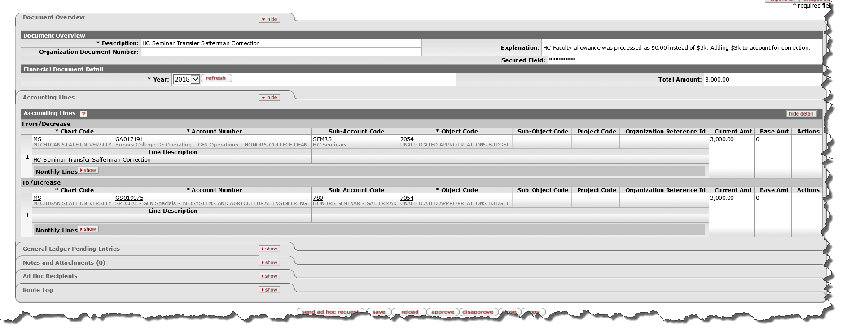
Financial Structure
Transaction Snapshot
Budget & Finance Basics
Notes:
Eric

Slide 18
Financial Structure
Object Code Ranges
Accounting Category | Object Name Type | Object Type | Numeric Ranges
Asset | Assets | AS | 1000-1999
Liability | Liabilities | LI | 2000-2999
Fund Balance | Fund Balance | FB | 3000-3999
Income | Income-Cash | IN | 4000-5999
 | Transfer In |  | 4100-4106
Expense | Expense Expenditure | EX | 6000-7999 (7000’s are expense budget)
 | Transfer Out
 |  |  | 6100-6106
Budget & Finance Basics
Notes:
Eric

Slide 19
Financial Structure
Object Code Hierarchy
Object
Consolidation
(6000’s or 7000’s)
Better align budgetary and expense object codes
Allow for more “generalized” budget decisions (i.e. travel)
Decrease budget reallocation needs
Improve reporting
Enhance flexibility for fiscal officers
Object
Sub-Type
(6000’s or 7000’s)
Object
Level
(6000’s or 7000’s)
Object Code
(6000’s)
Budget & Finance Basics
Notes:
Eric

Slide 20
Table of Contents
Introduction
Financial Structure
Budget Planning
Endowment & Endowment Spending
Resources & Contacts
Budget Planning
Notes:
JAMES

Slide 21
Budget Planning
Budget and Planning Timeline
Initiate strategic planning process
Budget allocation planning
MSU internal budget development
State Capital Outlay request due
Governor State of the State, Executive Budget recommendation
Legislative action on state budget
Legislative action on state budget
August
September
October
November
December
January
February
March
April
May
June
July
August
BOT September meeting – preliminary enrollment report
BOT October Meeting – financial statements
BOT December meeting – financial health
BOT February meeting – budget overview
BOT April meeting – budget detail
BOT June meeting – BOT action on budget
Budget & Finance Basics

Slide 22
MSU Budget and Planning Process
Budget Planning
Budget Reports, Data Metrics (PPS), Capital Outlay
Sept-Oct
State Reporting, State Budget Request, Functional Budgets
Oct-Nov
Budget and Raise Processing, Carry Forwards
July-Sept
Budget Profiles, Salary Studies, Planning Meetings
Nov-Jan
MSU
Planning and Budget Process
Budget Meetings, Budget Guidelines, Allocations
May-June
Budget Model, Budget and Raise Calendar, Executive Budget
Jan-Feb
Faculty Salaries (AAUP), RBI, OCCI, RFA, Tuition Policy
Mar-April
FPSM Requests, College Budget Materials, Program Fees
Feb-Mar
Budget & Finance Basics

Slide 23
Budget Planning
Financial Planning Context
Financial planning isolates selected resources including investment income, indirect cost recoveries, the MSU Foundation, and utilities reserves
MSU’s conservative financial approach restricts operational investment from these sources
2018 bond offering that provides funding from non general fund for several capital projects and MSU’s legal settlement
Note: Overall campus operations also include auxiliary units, research programs, and clinical activities
Budget & Finance Basics
Notes:
Eric

Slide 24
Budget Planning
General Fund Budget Model
Budget & Finance Basics
Notes:
Eric

Slide 25
Budget Planning
General Fund Budget Model
Incremental budget framework for most units
Utilizes an ongoing budget that includes both recurring and non-recurring components
Recurring elements include:
Programmatic investments
Annual reallocations
Salary increments
Supplies and services increments
Activity-based allocations provided for revenue generating activity and include:
Off-campus/online credit instruction
Indirect cost recovery
Significant institutional activities separately planned for, including:
Financial aid
Fringe benefits
Utilities
Differential programmatic investments
Financial framework provides a planning mechanism for leadership to identify priorities and estimate funding over a multi-year horizon
Budget & Finance Basics
Notes:
Eric

Slide 26
Budget Planning
General Fund Revenues
Revenue
State Appropriations
Tuition and Fees
Investment and Other Income
Research Facilitation Pass-Through
Revenue Based Initiative
Pass-Through
State Appropriations
Monitor state actions
Tuition
Size and composition of entering class
Core and professional college tuition rates
Monitor debt levels
Investment and Other Income
Monitor market performance for sustainability and adjustment
Research Facilitation Pass-Through
Federal budget impact on indirect cost realization
Ability to sustain 3% growth projection for research facilitation pass-through
Revenue-Based Initiatives Pass-Through
Review pass-through revenue projections
Budget & Finance Basics
Notes:
Eric

Slide 27
Budget Planning
General Fund Expense/Allocation
Employee Compensation
Fund faculty salary components – shifting balance salary to compensation
Monitor peer group – target median
Fund increases per bargaining agreements
Assess health care and salary increment trade-off
Supplies and Services
Approximate inflation
Financial Aid
Allocations to build/sustain non-resident student population
Assess aid needs as policy changes – need-based, merit-based, etc
Benefits
Transition of health care plan design, market and legislative environment
Allocation for Projected Expenditures
Employee Compensation
Supplies and Services
Utilities
Financial Aid
Benefits
Debt Service
General University Operations
Pass-Through Funds
(RBI and RFA)
1% Program Efficiency and Reinvestment Fund (PERF)
Budget & Finance Basics
Notes:
Eric

Slide 28
Budget Planning
General Fund Expense/Allocation
Allocation for Projected Expenditures
Employee Compensation
Supplies and Services
Utilities
Financial Aid
Benefits
Debt Service
General University Operations
Pass-Through Funds
(RBI and RFA)
1% Program Efficiency and Reinvestment Fund (PERF)
General University Operations
Analysis of planning profiles submissions
Strategic priorities
Critical space and capital projects
Revenue Based Initiatives and Research Facilitation Pass-Through
Monitor evolving policy changes
Fund annual performance amounts
One percent Program Efficiency and Reinvestment Funds (PERF)
Each unit is assessed a one-percent efficiency factor annually.
The funds generated through this process are reallocated across the university for initiatives identified through the planning process.
Budget & Finance Basics
Notes:
Eric

Slide 29
Budget Planning
Fringe Benefits
MSU recovers costs related to fringe benefits through Specific Identification
Covers four significant fringe cost categories
1) Retirement – 10% of salary (if participating, mandatory after five years, age 35)
2) FICA – 7.65% (portion capped at specific salary)
3) Healthcare, dental, prescription drugs - $15,480
4) Other/misc - 1.4% - life insurance, workers comp, other misc benefits
Graduate assistant fringe benefits charged where incurred
GA specific identification varies from above – assessed bi-weekly
https://www.cga.msu.edu/PL/Portal/95/20192020FringeBenefitsforSponsoredProjects
Budget & Finance Basics
Notes:
Eric

Slide 30
Budget Planning
OCCI/RBI Policy Update
For activity up to FY18 allocation amount:
Allocation parameters honor existing practice
FY18 allocation threshold modified for OCCI to RBI conversions
For activity beyond FY18 allocation amount:
Credit hour and revenue-share parameters unchanged for initial analysis
FY18 OCCI allocation totals modified for total growth in undergraduate credit hours
Revised FY18 totals create maximum allocation level for FY20
Allocations lesser of actual OCCI allocation or FY18 ceiling
https://opb.msu.edu/functions/budget/documents/OCCIpolicy.pdf
Budget & Finance Basics
Notes:
Eric

Slide 31
Budget Planning
Research Facilitation (IDC Pass-Through)
Indirect cost recoveries related to contract and grant overhead allocated to Colleges and Units on the following basis
10% at the college level:
Based solely on the relative commitment and academic appointment of the investigators
10% at the department level:
Allocates 25% of the departmental increment to the unit providing the post-award administration
Allocates 75% of the departmental increment based upon relative commitment and academic appointment of the investigators
Modified allocation formula for instances when space assignment varies from PI academic appointment
https://opb.msu.edu/functions/budget/documents/IDCpolicy.pdf
Budget & Finance Basics
Notes:
Eric

Slide 32
Budget Planning
General Fund Carryforward
University policy for assessing year-end balances
Pertinent to the GF only, other funds roll-forward automatically
Most GF sub-funds now carryforward automatically
GF operational funds (GA, GC, GD sub-funds) assessed against a percentage of GF budget (10% in FY20)
Operational balances in excess of threshold require written memo to OPB/CFO for carryforward
Most requests approved as submitted
Budget & Finance Basics
Notes:
Eric

Slide 33
Budget Planning
“Typical” Planning Priorities
Programmatic stability and prominence – 32 programs in the top-25 nationally, top-100 in the world, AAU membership -- Increasing prominence and cost of active learning and STEM disciplines
Growing accountability for student success, student safety, and Title IX objectives
Intensifying focus on competitive tuition rates, financial hardship and related student debt and completion
Threats to non-resident enrollment targets and composition – falling State and regional demographics, increasing institutional competition – offset by rising college-going rates
Opportunities to reach different student markets – online education, Kaplan, etc
Increased competition to recruit and retain top faculty including salary as well as start-up requirements
Need to prioritize programmatic and capital improvements
MSU increasingly competitive for federal support. However, federal R&D spending lags inflation, longer term Federal outlook unclear
Insurance and other operational cost pressures – focus on productivity and efficiency
Budget & Finance Basics
Notes:
Eric

Slide 34
Budget Planning
Toward FY 2021
COVID-19 Realities and Remaining Uncertainties
Michigan, national picture
Testing options and opportunities
Vaccine prospects and timing
Implications to Fall on campus
Continuing Uncertainties
Return to campus planning continues
Hybrid instructional model announced for Fall
2020-21 tuition and fee rates frozen at 2019-20 levels; increase to financial aid planned
State appropriations – possible 15% reduction
Auxiliary duration and depth – furloughs, reductions, reserves
Intense focus on enrollment – level and mix (knowns and unknowns)
Budget & Finance Basics

Slide 35
Budget Planning
Our Approach FY21 Planning
Preserve academic program quality; maintain instructional and research efforts; minimize disruption to campus students, faculty and staff where possible
Include university-wide and unit reductions to align with revenue disruptions
Planned use of $90M in deferred projects and reserves to mitigate near-term disruptions and provide additional lead-time for further planning
Proposed FY21 budget represents best known assumptions after considering multiple cases
Identified contingencies for responding to budget assumption variances
Recognize continuing uncertainties – return with updates
Budget & Finance Basics

Slide 36
Budget Planning
FY21 Revenue Assumptions
 | FY20 | FY21 Proposal | Change | Notes
Appropriations | $292M | $246M | -$46M | Reflects a 15% ($46M) reduction to operating appropriations, corrects FY20 appropriation
Tuition and Fees | $1,082M | $1,019M | -$63M | Includes additional resident undergraduates ($9M), fewer domestic non-resident students ($14M), significant international enrollment displacement ($53M), and adjustment to summer budget based on current year ($4M)
Investment Income Allocation | $30M | $12M | -$18M | Loss of annual GF component due to reserves spend-down/balancing for debt service needs
Indirect Cost Recovery & Other | $76M | $78M | $2M | Includes funding from several institutional sources
One Time Resources | Na | $90M | $90M | Includes funding from several institutional sources
Indirect Cost Recovery and Pass-Through Additions | Na | $2M | $2M | Increments for online/distance education programming and indirect cost recoveries
Total Revenues | $1,479M | $1,446M | -$33M
Budget & Finance Basics
Notes:
Included in the Resolution package

Slide 37
Budget Planning
Expense Assumptions
 | FY20 | FY21 Proposal | Change | Notes
Financial Aid | $185M | $192M | $7M | Includes a 4% ($6.7M) increase to financial aid budgets
Salary and Benefits | $909M | $943M | $34M | Includes market funding ($3M), UNTF contractual raise increment ($0.5M), FY20 annualization amounts ($3.5M), support staff contractual increases ($6M), increments for health ($3) and other fringe benefits ($6M); incorporates PY framework and pass-through additions into FY21 base ($12M)
Graduate Assts./Students | $65M | $68M | $3M | Reflects funding for stipend increases, change to healthcare, hourly rate increase for student employees
Utilities | $52M | $48M | -$4M | Reflects a 9% operating reduction (-$4.8M) and $0.8M in funding for new space requirements
Supplies & Services/Operations | $256M | $255M | -$1M | 1% ($2M) across-the-board SS&E adjustment; $1M in library collections funding; 2% ($3M) operations increase, change to budgeted auxiliary abatement (-$7M)
Unit Reductions | 0% | -3% | -$20M | Reflects $20M in unit reductions
Expenditure offsets | Na | -$45M | -$45M | Above-the-match retirement ($30M), 2.3% salary reduction ($15M)
Framework/Pass-Through Additions | $10M/$2M | $4M/$2M | Na | Framework includes $3M recurring for technology, $1M for Academic Competitiveness; Pass-through allocations Increment for online/distance education and indirect cost recoveries
Total Expenditures | $1,479M | $1,446M | -$33M
Budget & Finance Basics
Notes:
Included in the Resolution package

Slide 38
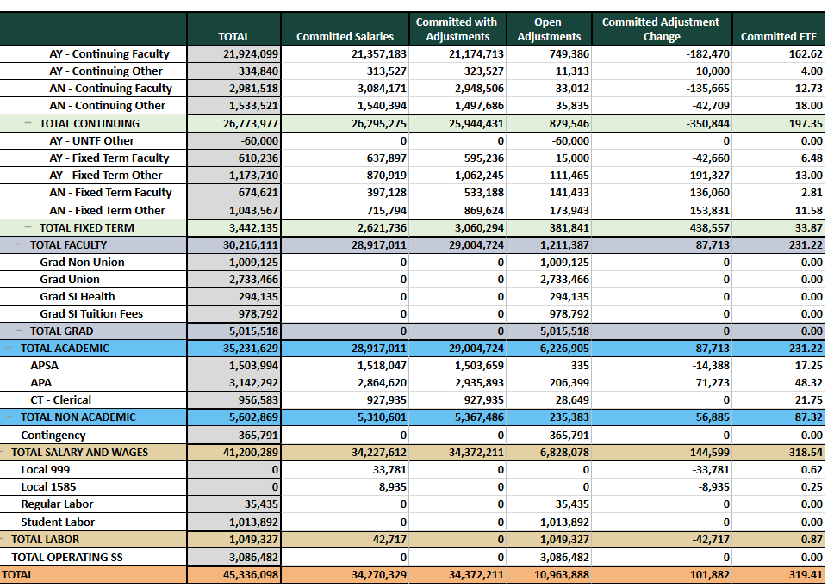
Planning Analytics: Budget System of Record
Budget Planning
System of record for annual budget, planning, allocations, and most raise information
Includes applications for:
Base budget reconciliation
Salary distribution & annual increments
Off-Campus Credit Initiative Allocation
Revenue Based Initiatives
Research Facilitation Allocation
Recurring and non-recurring programmatic allocations (in & after budget)
Budget control & distribution
Unit budget planning
Carryforward
Unrestricted fund balance review
Faculty merit and market raise processes
Professional raise process
Allocation processing
Sponsored activity reporting
Special program fees
More information:
https://opb.msu.edu/functions/budget/planning-analytics-resources.html
Budget & Finance Basics

Slide 39
Budget Planning
Building New Tools for Units
Improving planning and reporting capabilities across Cognos platform
Leveraging emerging analytics environment correlated with disciplined approach to account and transaction structure
Planning Analytics replaced Enterprise Planning application, replacing many manual processes with value-added approaches
Increasing departmental need to develop long-term budget plans across fund types
Improved ability to review departmental metrics conveniently across contexts
Leverage available data to inform long-range plans
Allow high level scenario development to quickly assess order of magnitude
Budget & Finance Basics

Slide 40
Table of Contents
Introduction
Financial Structure
Budget Planning
Endowment and Endowment Spending
Resources & Contacts
Endowment & Endowment Spending
Notes:
JAMES

Slide 41
Endowment & Endowment Spending
Investment Returns
The old “Normal”
CIF 6.25% Long-Term Return Assumption²
The new “Normal”
Budget & Finance Basics
Notes:
Eric

Slide 42
Endowment & Endowment Planning
Investment Returns
Budget & Finance Basics
Notes:
Eric

Slide 43
Endowment & Endowment Spending
Spending Policy History
Budget & Finance Basics
Notes:
Eric

Slide 44
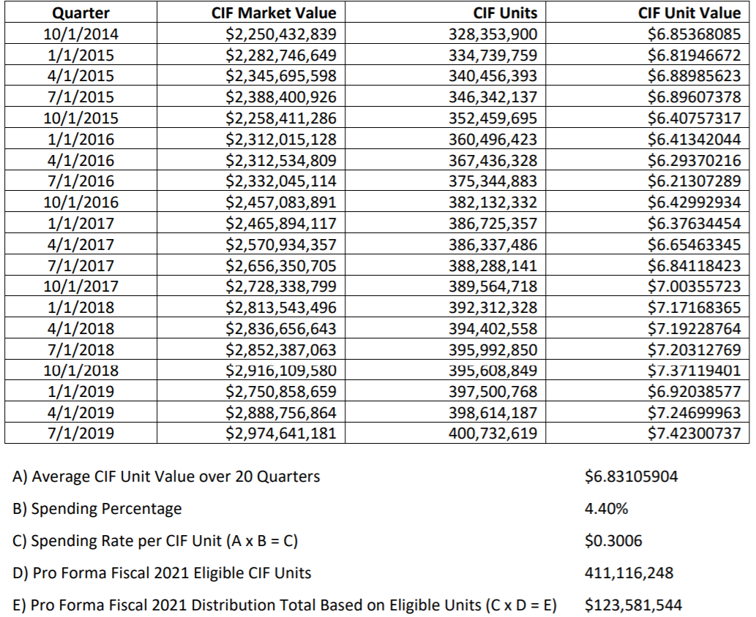
Endowment & Endowment Spending
Spending Policy Calculation
http://tfm.msu.edu/_files/docs/Spending_Policy_History_2021.pdf
Budget & Finance Basics
Notes:
Eric

Slide 45
Table of Contents
Introduction
Financial Structure
Budget Planning
Endowment & Endowment Spending
Resources & Contacts
Resources & Contacts
Notes:
JAMES

Slide 46
Resources & Contacts
Policies and Procedures
Manual of Business Procedures: http://ctlr.msu.edu/combp/
Planning Process & Budget Policy: https://opb.msu.edu/functions/budget/planning-process-and-policies.html
Planning Analytics Resources: https://opb.msu.edu/functions/budget/planning-analytics-resources.html
Planning Profile Summary: https://opb.msu.edu/functions/institution/pps.html
Budget & Finance Basics
Notes:
Eric

Slide 47
Sources of Information
Resources & Contacts
EBS resources (ebs.msu.edu):
Kuali Financial System (KFS)
Kuali Coeus (KC)
Business Intelligence (BI)
Planning Analytics (PA)
HR/Payroll (SAP)
Applicant Tracking (Page-Up)
Travel (Concur)
Spartan Marketplace
Other Sources:
Institutional Research (Tableau)
https://opb.msu.edu/functions/institution/index.html
Planning Profile Summary
https://opb.msu.edu/functions/institution/pps.html
Sponsored Programs Account Explorer
https://cga.msu.edu/PL/Accounting/AE2/AE2.aspx#Detail
Manual of Business Procedures
https://ctlr.msu.edu/combp/
Human Resources
https://hr.msu.edu/ua/index.asp
Budget & Planning
https://opb.msu.edu/functions/budget/index.html
Budget & Finance Basics

Slide 48
Who Can Help?
Resources & Contacts
David Byelich
Associate Vice President and Director
Office of Planning and Budgets
517-355-9271
Byelich@msu.edu
Brent Johnston
University Budget Officer
Budget Planning and Analysis
Office of Planning and Budgets
517-353-5519
john1096@msu.edu
Barbara Kranz
Director
Facilities Planning and Space Management
Office of Planning and Budgets
517-355-9271
kranzb@opb.msu.edu
Bethan Cantwell
Director
Institutional Studies
Office of Planning and Budgets
517-355-9273
cantwellb@msu.edu
Greg Deppong
University Controller
Office of the Controller
517-355-5020
deppong@msu.edu
John Thelen
Assistant Controller
Financial Analysis
517-884-4197
thelen43@ctlr.msu.edu
Lee Hunter
Chief Accountant & Manager of Financial Reporting
Office of the Controller
517-355-9271
hunerti@msu.edu
Katie Cook
Director
Office of Sponsored Programs
517-884-4237
farrkat1@osp.msu.edu
Debbie Gulliver
University Travel Manager
Officer of the Controller
517-355-5000
gullive5@cltr.msu.edu
Kara Yermak
Assistant Director
AP/AVP for Academic Human Resources
517-884-0185
burtkara@provost.msu.edu
Evo Pedawi
Director
Contracts and Grants Post Award
517-884-4234
pedawi@cga.msu.edu
Rebecca Yauch
Assistant Director
Human Resources
517-884-0115
ryauch@hr.msu.edu
Valerie Noel
Assistant Budget Officer
PA, OCCI, RBI, RFA
517-432-0219
thebeau@msu.edu
Bill Buddle
Assistant Budget Officer
Planning Analytics Operations
517-432-5319
buddlewi@msu.edu
Charmaine Shellman
Assistant Budget Officer
Allocations & Resource Management
517-355-4503
cshellma@msu.edu
Rati Walther
Financial Analyst
Budget, Planning, and Analysis
517-353-0864
walthe19@msu.edu
Budget & Finance Basics

Slide 49
Thank You
Good luck
Feel free to be in touch
Notes:
JAMES

