Slide 1
On September 28, 2019, the membership of the National Association for College Admissions Counselors (NACAC) voted to remove provisions from its Code of Ethics and Professional Practices (CEPP) that the Department of Justice
Antitrust Division had raised concerns about.
The provisions removed included current rules that:
Prohibit offering incentives to Early Decision students: Incentives that were prohibited included offering special housing options or unique scholarships that regular applicants may not have access to.
Prohibit recruitment of students who have committed to a college
Prohibit recruitment of students currently enrolled in a 4-year college
Restrict certain types of transfer recruitment: Colleges must not solicit transfer applications from a previous year’s applicant or prospect pool unless the students have themselves initiated a transfer inquiry.

Slide 2
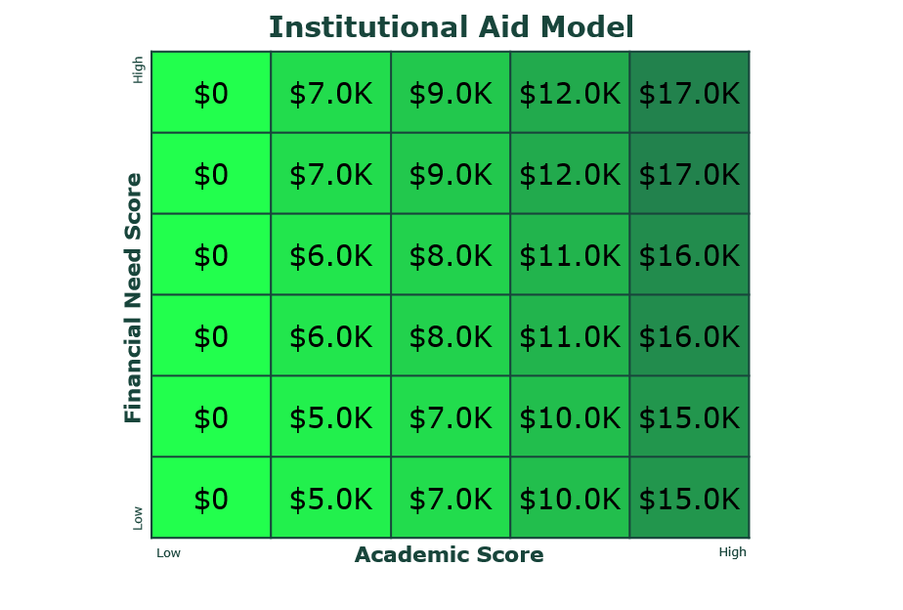
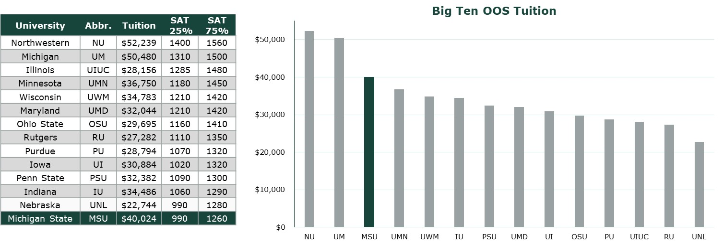
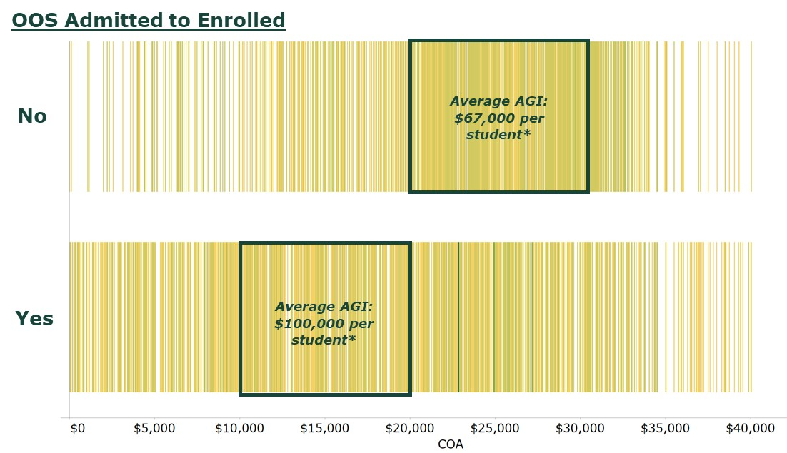
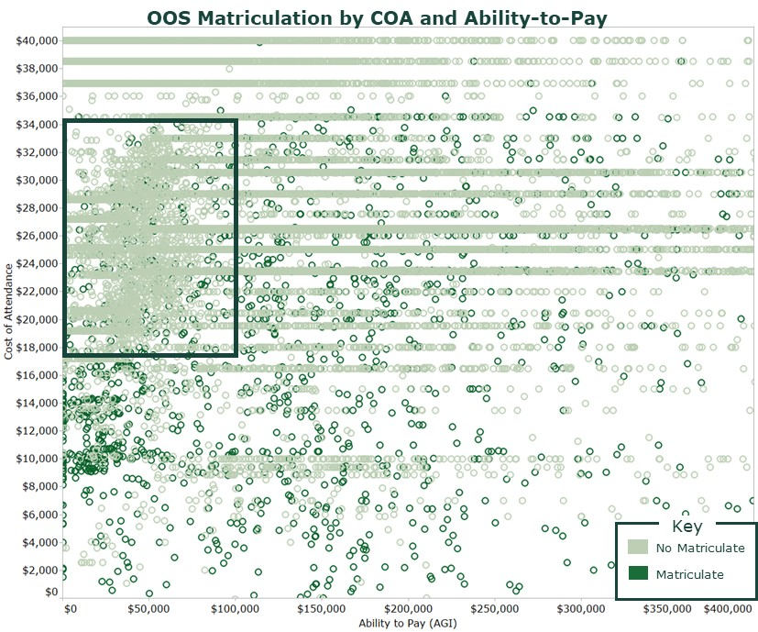
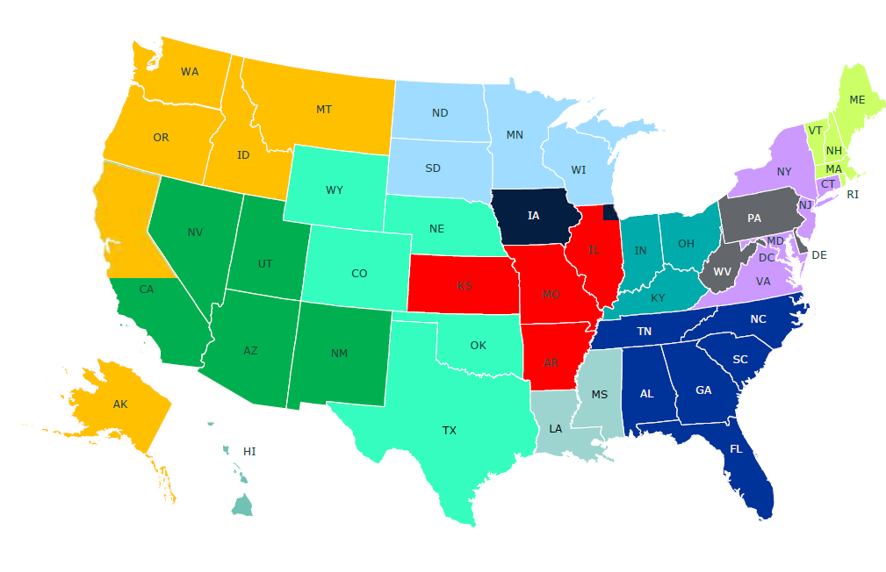
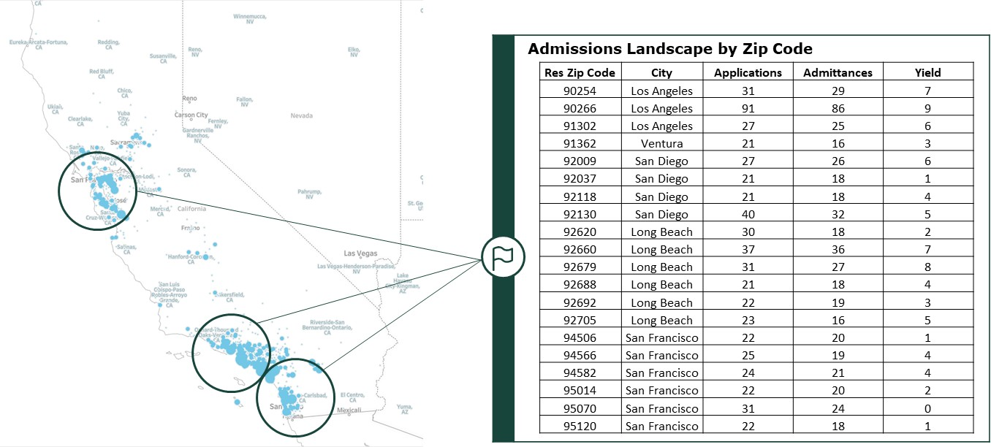
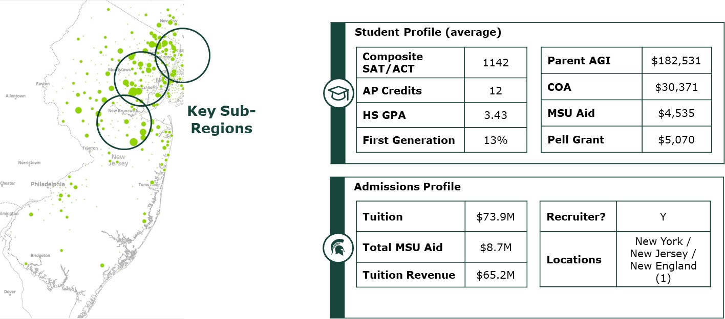
Domestic Out-of-State (DOS) Strategy
Deloitte consultants worked with MSU Admissions to analyze aid-yield outcomes and existing recruiter territories to construct a more effective scholarship/grant regimen and focus recruiter efforts on the highest-value geographies.
Pricing & Financial Aid Analysis
Clear, equitable, and easily communicated out-of-state scholarship and need grant strategy designed to increase yield and aggregate NTR while maintaining academic quality of incoming cohort
Zip Code-Level Geographic Market Analysis
Focused geographic territories and enrollment targets for dedicated out-of-state recruiting team, supported by detailed priority zip codes and high schools

Slide 3
Map Overview

Slide 4
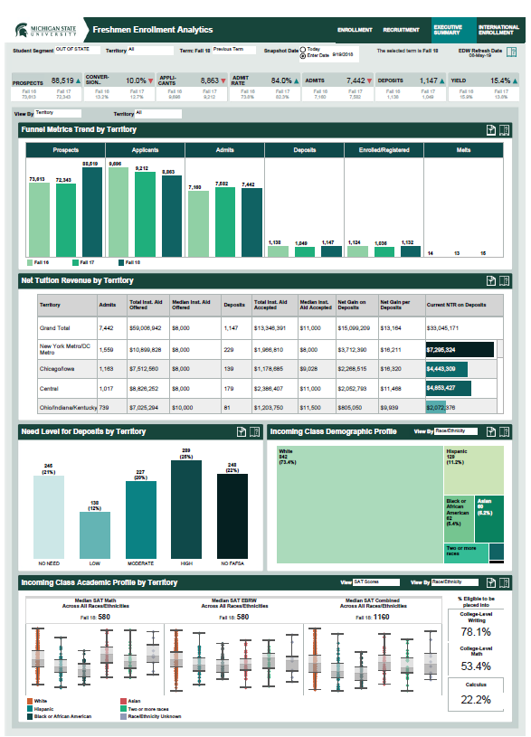



Real-time Enrollment Analytics
Deloitte consultants have initially developed dashboards for recruiters, admissions leadership, and executives to track progress against targets and are developing predictive and prescriptive analytics tools which leverage artificial intelligence and advanced modeling to better inform recruitment and enrollment strategies.
“Stage One” Descriptive Enrollment Analytics Dashboards
Predictive & Prescriptive Advanced Enrollment Analytics
Currently in Progress
Prospect
Identifier
Yield
Predictor
Aid
Optimizer
Outreach
Recommender
Ability to identify target new prospect pools to recruit | Ability to predict yield of admitted students | Ability to discern institutional aid “sweet spot” for admissible students | Ability to identify optimal outreach activities
Once the models are complete, data will be shared on a real-time basis via dashboards designed for three types of end users:
Executive Leadership
Admissions Leadership
Recruiters

Slide 5
