Slide 1
Welcome to Michigan State University Research Office of the Senior Vice President for Research & Innovation New Administrator Orientation August 6, 2019

Slide 2
Speakers Today
Jim Pivarnik, Research Integrity
Doug Gage, MSU Research Overview
Paul Hunt, Research Compliance
Charles Hasemann, MSU Innovation Center

Slide 3
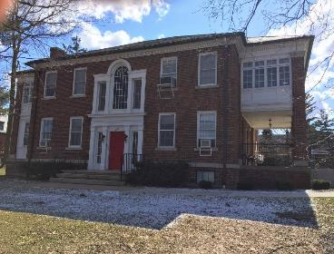
What Every MSU Community Member Should Know About Research Misconduct James M. Pivarnik, PhD Research Integrity Officer (RIO) Michigan State University www.rio.msu.edu RIO@msu.edu 106 Wills House 517-432-6698

Slide 4
Our website URL
www.rio.msu.edu

Slide 5
What the RIO does
The RIO is responsible for seeing to it that the MSU Procedures Concerning Allegations of Misconduct in Research and Creative Activities are carried out in an unbiased, confidential, and professional manner.
Required for any institution seeking and accepting federal funding (42 CFR 93)

Slide 6
The role of the RIO
The RIO shall coordinate implementation of these Procedures and shall be responsible for their fair and impartial administration. The RIO shall not be an advocate for the Complainant or the Respondent.

Slide 7
What exactly is “Research Misconduct”?

Slide 8
Research Misconduct
Fabrication, Falsification, Plagiarism, or any other practice, that Seriously Deviates from practices commonly accepted in the discipline or in the academic and research communities generally in proposing, performing, reviewing, or reporting Research and Creative Activities.
Misconduct does not include appropriative practices in the Creative Arts insofar as they accord with accepted standards in the relevant discipline. Misconduct does not include honest error or honest differences in the interpretation or judgment of Research data.

Slide 9
Disclosure: Report Potential Conflicts of Interest

Slide 10
Compliance: Understand and follow the rules

Slide 11
Protections: Respect research participants

Slide 12
Unacceptable Research Practices
“Unacceptable Research Practices” means practices that do not constitute Misconduct but that violate applicable laws, regulations, or other governmental requirements, or University rules or policies, of which the Respondent had received notice or of which the Respondent reasonably should have been aware, for proposing, performing, reviewing, or reporting Research or Creative Activities.

Slide 13
What about individuals who are always on the edge?

Slide 14
Questionable Research Practices
“Questionable Research Practices” means practices that do not constitute Misconduct or Unacceptable Research Practices but that require attention because they could erode confidence in the integrity of Research or Creative Activities.

Slide 15
Collegiality: Work well with others

Slide 16
Question:
What percentage of potential allegations coming to our office is associated with some sort of previous conflict between/among the parties involved?
~ 90%!!

Slide 17
Is Research Misconduct an Issue at MSU?

Slide 18
What about prevention?
Advice
We encourage students, faculty and administrators to ask us about any research issues

Slide 19
Prevention cont.
Dispute Resolution
We encourage students and faculty to seek our help with settling disputes

Slide 20
Please do one thing for me:

Slide 21
Questions on Research Integrity?

Slide 22
Research: The Foundation for Success
Research is the basis for education and outreach
Dynamic research programs—based on a forward-thinking research agenda—address problems of today and tomorrow
Furthering research – advancing knowledge – gives MSU international prominence
Notes:
Importance of encouraging faculty to remain research active
22

Slide 23
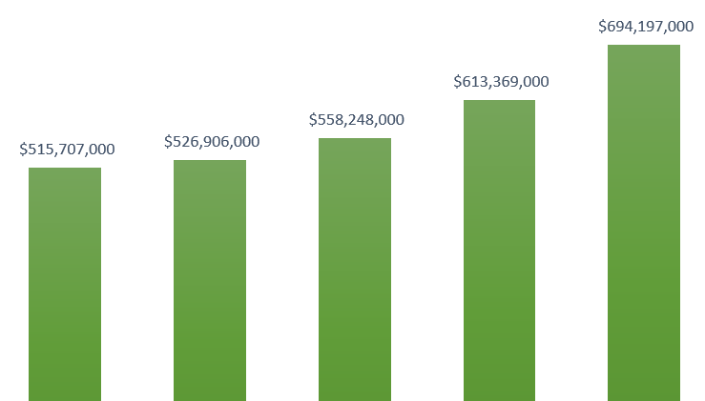
Total MSU Research Expenditures
Increased from just over $500M to nearly $700M in past five years.
MSU’s NSF HERD ranking is now in the top half of the Big Ten for the first time.
MSU’s overall US rank jumped from 36 to 32 -- growth rate top in B1G.
MSU is now #1 in DOE and combined DOE and NSF expenditures.
2013 2014 2015 2016 2017
Source: NSF HERD Data for 2017

Slide 24
Research Expenditure Rankings
MSU is now ahead of Rutgers, UT Austin, Illinois (UIUC), Purdue, Arizona, Maryland, Indiana, Iowa, ASU, Colorado (Boulder), and UVA.
Almost all of the schools ranked above us (and many below) have major medical research hospitals. In those cases, the medical research number often exceeds that of the rest of campus combined. At MSU, less than ~$100M of our total comes from medical research. We still have significant room to advance.
No medical complex: UC Berkeley $771M (top public university in the US; home of Lawrence Berkeley National Lab) and MIT $952M (home of Lincoln Laboratory, a major defense research lab).
Note: for more information about our rankings and current strategic initiatives, visit this page for a video presentation https://vp.research.msu.edu/lead-meeting-research-update-february-28-2019
Source: NSF HERD Data for 2017

Slide 25
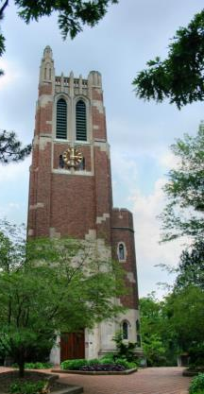
Mission of OSVPRI
Create the institutional vision for research
Advocate for research and creative activities within MSU and beyond
Increase the excellence of research and creative endeavors at MSU - both quality and quantity
Assure the integrity of the research process in all its diverse dimensions
Notes:
OVPRGS policy framework: focus on integrity
25

Slide 26
Why Enhance Research?
MSU is a research-extensive university (member of AAU)
Research and scholarly activity is closely linked to graduate and undergraduate education
Research – especially federal funding – determines national and international reputation
Facilities and administrative (F&A) rates reduce university's subsidy for research, leverages central funds
Research grants enable procurement of major equipment and sustain core research facilities
Research contributes to the state’s economy
Notes:
Importance of encouraging faculty to remain research active
26

Slide 27
How Will We Grow Research?
Take intelligent risks
No mistakes means too risk-averse
Fail early, correct fast
Incentives must allow for occasional mistakes: Silicon Valley
Exponential returns for successful risks – we forego these returns if we are too risk-averse

Slide 28
Growing Research, Cont.
Leadership: rational and smart
“No brainer” decisions must be predictable
Transparency in decision making (metrics, criteria) reduces second-guessing (wasted effort within organization)
Staff and team should be able to (largely) predict decisions in advance, in order to plan

Slide 29
Growing Research Cont.
Pursue larger share of federal research funds
Faculty in areas where external support is available must compete successfully for it
Faculty must submit large multi-investigator proposals (linked to cluster hires)
Enhance corporate research activity
MSU Business-CONNECT
MSU Technologies
MSU Spartan Innovations
MSU Innovation Center
Notes:
Importance of encouraging faculty to remain research active
29

Slide 30
Institutionally Limited Proposals
Limited submission opportunities, including faculty scholar and fellowship programs, available at http://vprgs.msu.edu/funding-opportunities/institutionally-limited
OSVPRI conducts an internal selection process to determine which proposals will be submitted.
-Where possible, internal deadlines are 8 weeks prior to submission.
Notes:
30

Slide 31
Internal Funding Sources
Competitive, university-wide, peer-reviewed internal grants programs support scholarly activities and provide seed funding for future proposals.
Humanities and Arts Research Program (HARP)
Scholarship Development proposal (deadline in October)
Scholarship Production proposals (semiannually)
Strategic Partnership Grant
Multidisciplinary and/or multi-investigator projects
Have potential to generate significant external funds
Proposals solicited in the fall
Discretionary Funding Initiative
Provides bridge funds for studies needed to resubmit a grant.
Notes:
Scholarship Development for research, creative, and performance projects that help faculty achieve career milestones; deadline in October.
Scholarship Completion, a subvention program for expenses associated with producing the results of a completed research or creative project; proposals accepted quarterly.
Scholarship Development for research, creative, and performance projects that help faculty achieve career milestones; deadline in October.
Scholarship Completion, a subvention program for expenses associated with producing the results of a completed research or creative project; proposals accepted quarterly.
for new projects, bridging grants, and seed funding needed for proposal resubmissions; proposals accepted quarterly.
31

Slide 32
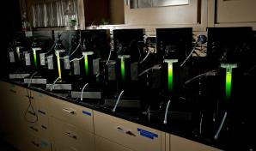
Arranging for Matching Funds and Space
When funding agencies require matching funds
Research associate dean
Negotiate a split among department, college, OVPRGS, provost
Space concerns
Dean/research associate dean/ department chair/director
Notes:
32

Slide 33
Sponsored Programs Administration
The Office of Sponsored Programs (OSP): unit within the Office of the Vice President for Research and Graduate Studies (organizational affiliation to chief financial officer and controller) that provides pre-award processing
Contract and Grant Administration (CGA): post-award administration, assisting with the financial and contractual administration of grants, cooperative agreements, and contracts https://osp.msu.edu/Default.aspx

Slide 34
Proposal Development Assistance
Office of Research Facilitation and Dissemination (ORFD)
Offers writing support on large, multi-author proposals. Call 432-4499 or https://vp.research.msu.edu/proposal-services
Presents seminars and workshops, including monthly coffee break discussions. Check the events calendar for details https://vp.research.msu.edu/events
OSVPRI additional offerings including:
Special consulting and grant editing
Peer review assistance
Note: Your college or department may also offer proposal assistance.
Notes:
34

Slide 35
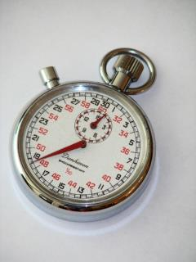
Review and Promotion
Clearly stated expectations for faculty performance
Thorough annual evaluation of performance
Role of OSVPRI in the P&T process
Strong mentoring programs
Internal to the department
External to the department
Research integrity—RIO and RCR
Faculty conflict of interest
Notes:
35

Slide 36
More Information…
https://vp.research.msu.edu/

Slide 37
Questions ?

Slide 38
Regulatory Affairs - Who are we?
Human Research Protection Program
Animal Care Program
Environmental Health and Safety
Institutional Stem Cell Research Committee
Conflict of Interest
Responsible Conduct of Research (shared)

Slide 39
The Committees
Institutional Animal Care & Use Committee - Sue Barman, Chair
Sally Light, IACUC Administrator
Phone: 517-432-3154 E-mail: barman@msu.edu
Campus Animal Resources
Claire Hankenson, University Attending Veterinarian
Phone: 517-353-5064
E-mail: fclaire@msu.edu
Biological Safety Office – John Gerlach, Chair
Jamie Willard, Biological Safety Officer
Phone: 517-353-1877
E-mail: cherryme@msu.edu
Faculty Conflict of Interest Office
Brian Mattes, Director
Phone: 517-884-7000
Email: mattesbr@msu.edu
Radiation Safety Office – Chris Waters, Chair
Bryan Harris, Radiation Safety Officer
Phone: 517-884-3309
E-mail: harris@ehs.msu.edu
Human Research Protection Program (HRPP)
Kristen Burt, Director
Ashir Kumar, Chair BIRB - Harry McGee, Chair SIRB Phone: 517-884-6020 E-mail: irb@.msu.edu
Chemical Safety Office – Christine DiFonzo, Chair
Genevieve Cottrell, Chemical Safety Officer
Phone: 517-432-8715
E-mail: cottre36@ehs.msu.edu
Stem Cell Oversight – Katheryn Meek, Chair
Kristen Burt , Director
Phone: 517-884-6020 E-mail: burtkris@msu.edu

Slide 40
What do we do?
Facilitate research
Protect the research subject and the investigator
Maintain compliance with state and federal laws, regulations and policies
Training
Accreditation

Slide 41
How can we help investigators?
Assist faculty in working through protocol approval process
Help stay in compliance through post-approval monitoring
Provide online and hands-on training
Work with your faculty to ensure a safe work environment

Slide 42
Questions
www.ora.msu.edu
It is always best to directly contact the regulatory office with questions!

Slide 43
Export Control – Definition
A group of laws and regulations that restrict ability to freely send or share certain goods, technology or information outside the U.S. or with non-U.S. nationals inside the U.S. – “deemed exports”
These laws are intended to promote U.S. national security and other policy goals and they have broad extra-territorial reach
ITAR controlled technology is restricted to U.S. citizens and permanent residents. EAR technology varies by specific citizenship.
Violations carry significant penalties, fines, and both University and individual liability

Slide 44
Export Control – Fundamental Research
“Fundamental research” on a U.S. university campus is excluded from export controls under ITAR (military) and EAR (dual use) provisions. Publication is key.
The “Fundamental Research Exclusion” is lost for:
Encryption;
If publication or citizenship restrictions apply;
If in-bound controlled data or equipment;
For contracted prototypes or defense services.

Slide 45
Export Control – The Entity List
05.03.2013
University Charged with Export Violations
BY: THOMAS B. MCVEY & JAHNA M. HARTWIG
http://www.williamsmullen.com/news/university-charged-export-violations
The University of Massachusetts at Lowell was charged by the Bureau of Industry and Security (“BIS”) for violating export control laws in connection with the export of an atmospheric testing device and related equipment. Specifically, the University was charged with…exporting items classified as EAR99 to a party on the BIS Entity List. This case reinforces the important point that even universities engaged in fundamental research are required to comply with export control laws. It also reinforces the importance of prohibited party list screening as a mandatory part of export compliance…

Slide 46
Trade Sanctions
E.g., U.S. Treasury’s “Specially Designated Nationals” list and Trade Sanctions imply:
MSU USAID researchers – participants must be careful in Afghanistan project.
MSU Dubai – avoid Bank Melli (Iran gov’t link).
MSU Alumni Association – participants must be careful during upcoming Cuba tourism.

Slide 47
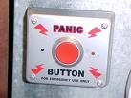
Issue Escalation
When in doubt, ask – OSVPRI staff can help. (517) 432-4499
Failure to escalate some issues can be a “career crash landing.”
Health and safety concerns
Criminality, discrimination, harassment
Research or fiscal misconduct
Regulatory compliance
New administrators frequently overlook the Office of the General Counsel as a resource.
Notes:
47

Slide 48
Contact us
Contact Export Control and Trade Sanctions at:
Phone: (517) 432-4499
Email: export@msu.edu
Website: http://exportcontrols.msu.edu
Address: 249 Administration Building

Slide 49
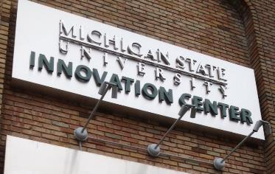
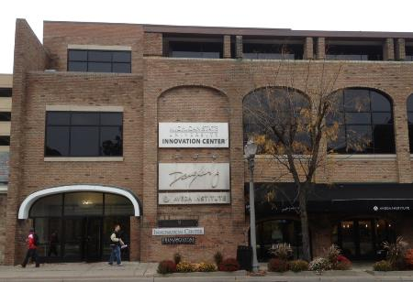
MSU’s place for connecting to the private sector

Slide 50
Innovation Center
Connecting MSU research to companies that are interested in what we do.
Company perspectives enrich faculty research
$11 Million in grants last year
Taking faculty ideas to the marketplace – seeing research put to practice.
$4.2 million in royalty revenue last year
>$500,000 distributed to faculty
Creating companies from MSU-owned ideas.
Professional help to create the best chance for success.
Engaging students in alternative careers.
Creating companies from student’s ideas.
Experiential part of undergraduate entrepreneurship education
Preparing students for the real world.

Slide 51
Working with MSU Commercialization Offices
B-C:
Corporate
SPONSORED RESEARCH
MSUT:
Corporate
LICENSES
Advancement:
Corporate & Foundation Relations
GIFTS
Spartan Innovations:
Investors, Companies
START-UPs
WHO:
Works with whom?
DOING WHAT?
Don’t do grants from:
Federal
State
Non-profits

Slide 52
New Administrator Orientation Panel Discussion
Please welcome:
Rachel Croson, Dean – College of Social Science
Thomas Glasmacher, Director – Facility for Rare Isotope Beams
Francesca Dwamena, Chair – Department of Medicine

