Slide 1
Office of the
Associate Provost for
Undergraduate Education
Mark Largent
Interim Associate Provost for Undergraduate Education
and Dean of Undergraduate Studies

Slide 2
At Michigan State:
We believe that every student admitted to MSU has the capacity to learn, thrive, and graduate

Slide 3
At Michigan State:
We believe that every student admitted to MSU has the capacity to learn, thrive, and graduate
Our responsibility is to support students as they develop their purposes and passions and prepare them to have a positive impact on the world

Slide 4
Responsibilities of the Office of the APUE
Support and Advocate for Academic Affairs Broadly Understood Inside and Outside of the Classroom

Slide 5
Responsibilities of the Office of the APUE
Support and Advocate for Academic Affairs Broadly Understood Inside and Outside of the Classroom
Advising
Undergraduate Research
NSSC (aka The Neighborhoods)
College Prep and Federal College Access Programs
New Student Orientation
Integrative Studies
Learning Analytics

Slide 7
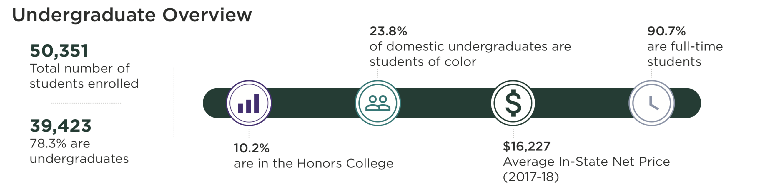


Slide 8
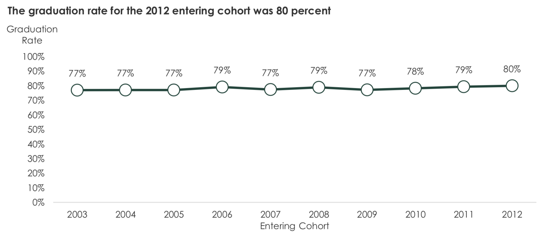

Slide 9
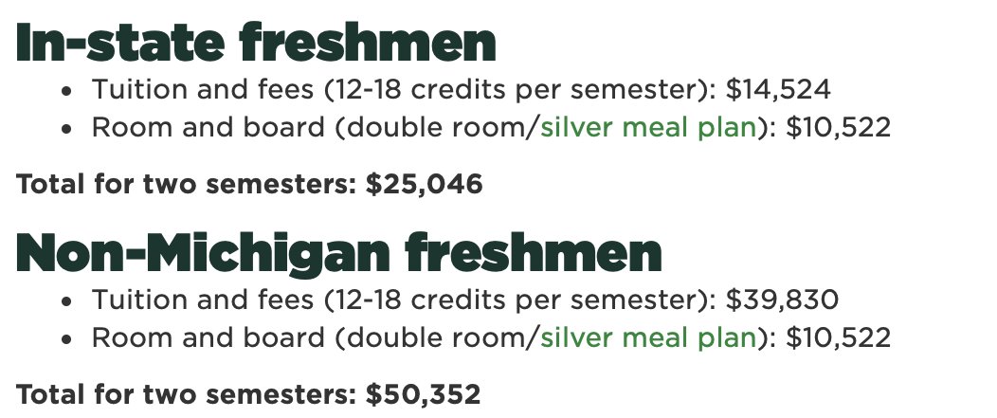
MSU’s Tuition, 2019-20

Slide 10
MSU’s Tuition, 2019-20
$100,000
$200,000

Slide 11
At Michigan State:
We believe that every student admitted to MSU has the capacity to learn, thrive, and graduate

Slide 12
At Michigan State:
We believe that every student admitted to MSU has the capacity to learn, thrive, and graduate
However, MSU does not graduate every student it matriculates

Slide 13
At Michigan State:
We believe that every student admitted to MSU has the capacity to learn, thrive, and graduate
However, MSU does not graduate every student it matriculates
The likelihood of a student leaving without a degree is not evenly distributed across the student body and does not directly correlate to “academic preparation”

Slide 14
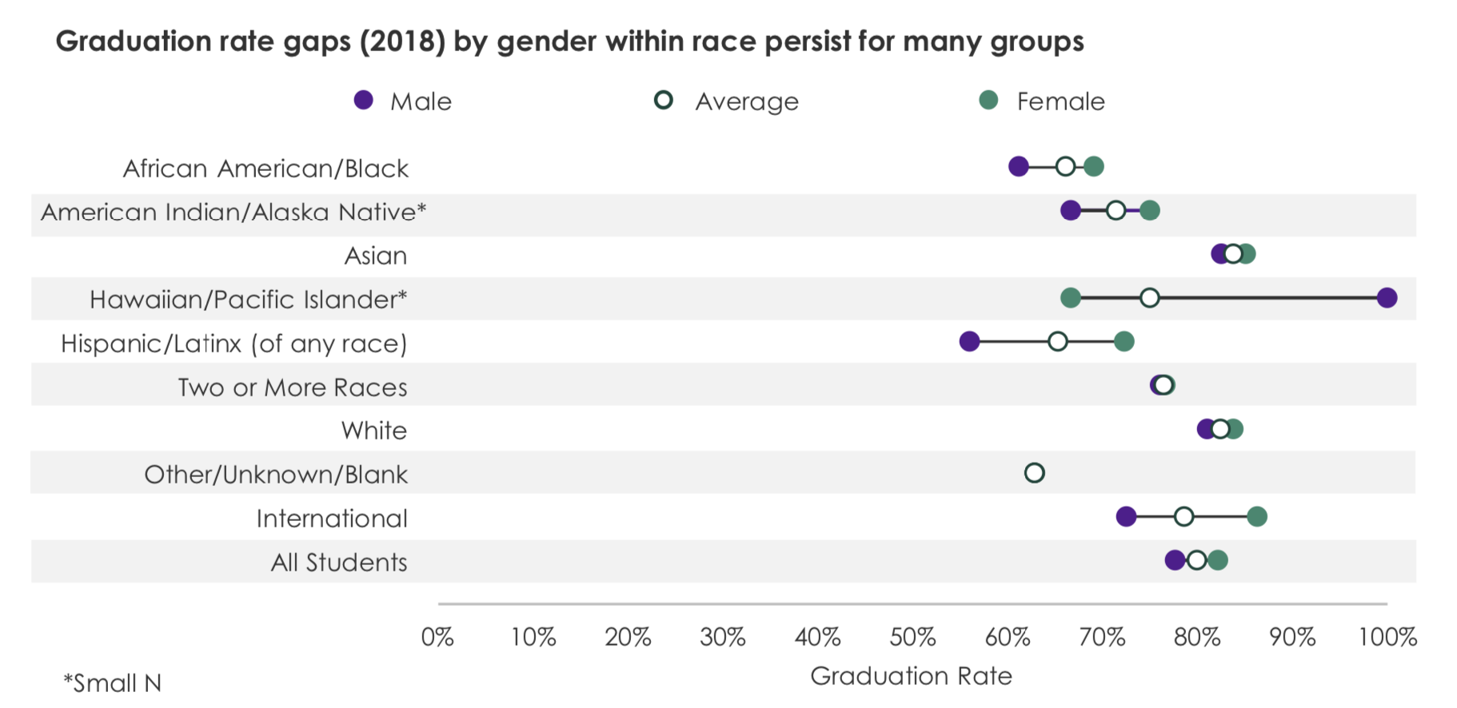

Slide 15
MSU’s Student Success Initiative
Mission: Michigan State University will create an accessible and equitable undergraduate student experience, both inside and outside the classroom, that empowers all students to learn, develop purpose and passion, and grow as individuals to achieve their goals.

Slide 16
MSU’s Student Success Initiative
Mission: Michigan State University will create an accessible and equitable undergraduate student experience, both inside and outside the classroom, that empowers all students to learn, develop purpose and passion, and grow as individuals to achieve their goals.
Our goal is to redesign MSU to make it capable of graduating every student it admits

Slide 17
MSU’s Student Success Initiative
Student Success Launch
University-Wide
Student Success Work
Student Success Summit & Spring Conference

Slide 18
MSU’s Student Success Initiative
Student Success Launch
University-Wide
Student Success Work
Student Success Summit & Spring Conference
Agenda Setting
Work
Report and Reflect

Slide 19
MSU’s Student Success Initiative
Student Success Launch
University-Wide
Student Success Work
Student Success Summit & Spring Conference
September 12,
Noon-3:00
Union Ballroom
College Student Success Group
Council of Undergrad Deans (CUED)
Dept & College-Level Project
Course & Curricular Reform
Student Academic and Social Support
Neighborhoods & and REHS
SIS Modernization
May 4-6,
Wells Hall

Slide 20
Questions or Comments?
largent@msu.edu
undergrad.msu.edu

