Slide 1
International @ MSU
DeAndra Beck
Associate Dean for Research, International Studies and Programs
August, 2019

Slide 2

From land-grant
to world-grant
Notes:
MSU is proud of and building on a long history of intentional international engagement.
Our first international student (from Denmark) came here in 1878.
In 1910, the Cosmopolitan Club was founded to help connect domestic and international students and help them learn from each other.
In 1960, MSU helped establish the University of Nigeria, Nsukka, the first land-grant university on the African continent—a partnership that exists today, six decades later.
We’re taking our land-grant values—to solve real-world problems—and applying it on every continent across the globe.
And why is international engagement so important?
Global problems are local problems.
Through international engagement, we’re connecting to new markets,
we’re expanding our recruitment footprint,
and we’re growing the Spartan network.

Slide 3
~$80 million external funding per year
~1,400 faculty engaged in international work
325 partnership agreements in 80 countries
30 internationally focused centers, units and offices at MSU
Notes:
International work at MSU is an important and critical part of MSU’s research and teaching.
Approximately $80 million in external funding for international work each year—that’s more than 10% of total external research funding annual
We have partnerships all across the globe—more than 325 agreements in 80 countries
Across campus, we have 30 internationally focused centers, units and office—from area studies to language learning to international business

Slide 4
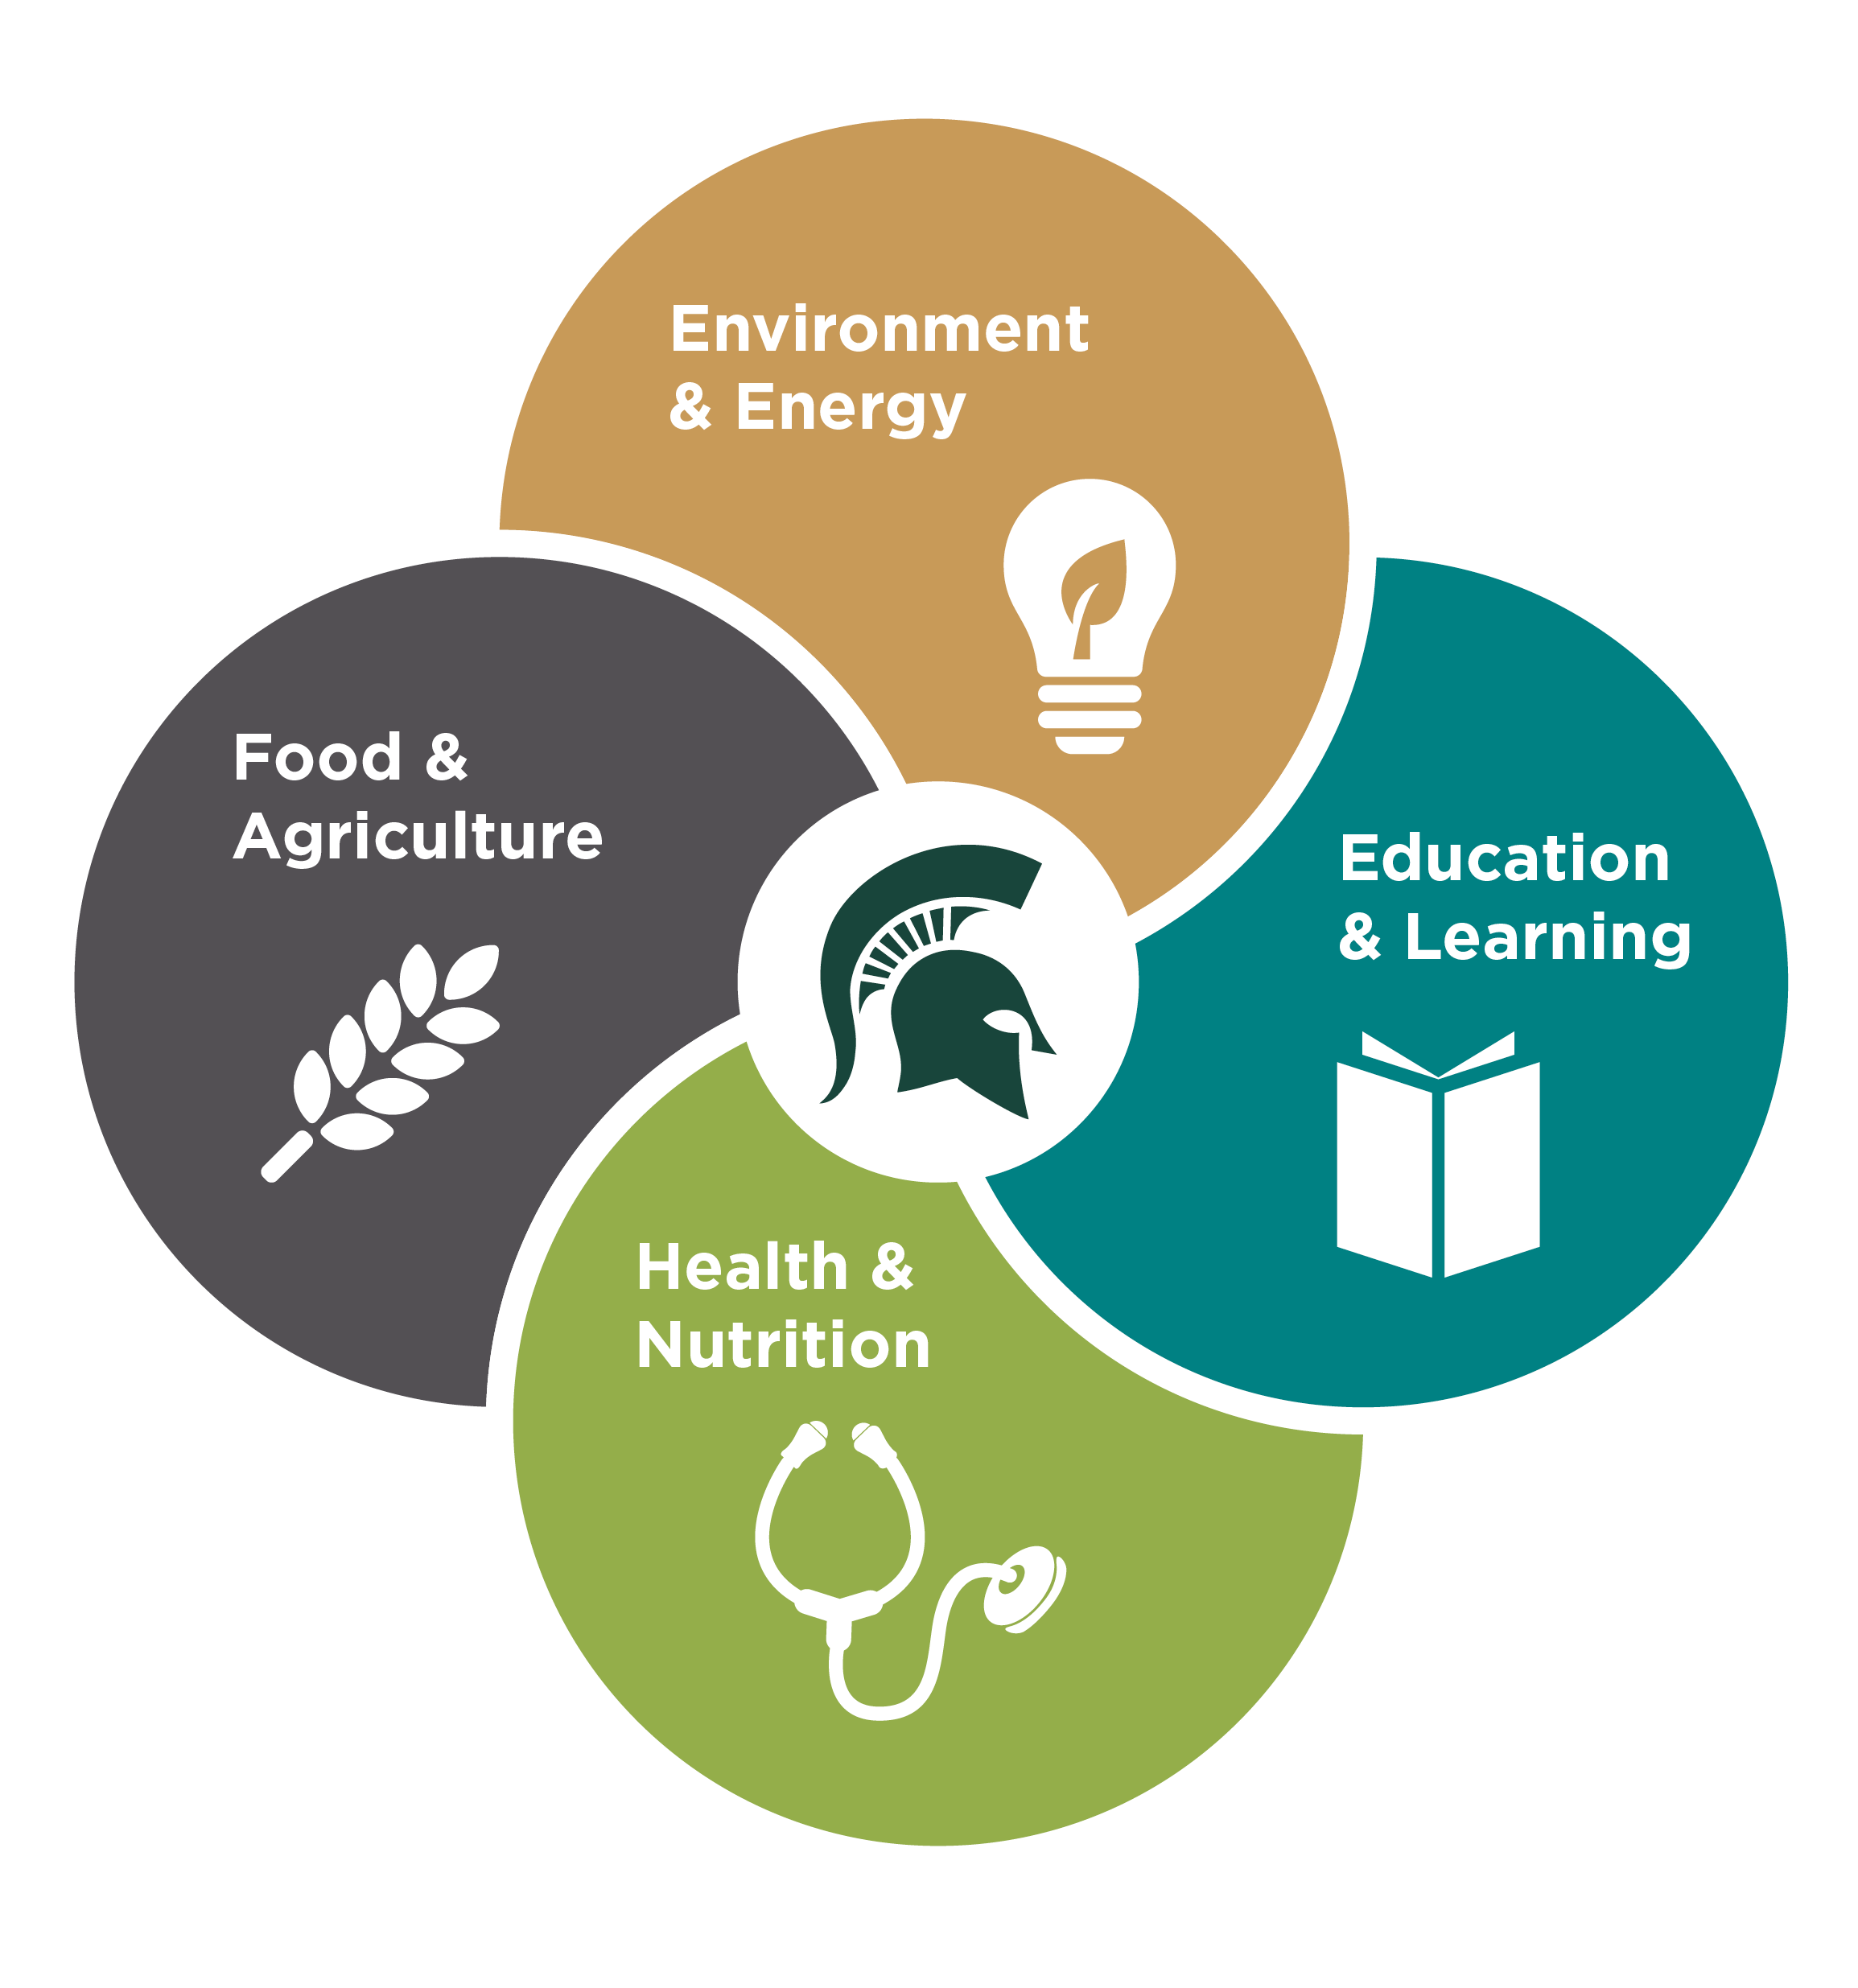
Scholarly Themes
7.6%
Europe & Eurasia
0.4%
US
1.4%
Near East
6.2%
East Asia & Pacific
2%
Global
31.2%
Multi-Regional
9.8%
South & Central Asia
4.2%
Western Hemisphere
37%
Sub-Saharan Africa
Notes:
Our international engagement reaches every corner of the world, largely focused on four broad thematic areas—
ag and food
health and nutrition
water energy and the environment, and
education and capacity-building
We have moved increasingly toward a data-driven approach to better understand how and where we work, and take advantage of new opportunities.
Majority of external funding is for research, education, and assistance projects in Africa—37%
Global projects include countries across the world without geographic primacy.
Multi-regional projects involve two or more geographic regions.
U.S. projects are based in the U.S. but have a strong international dimension (e.g., Title VI funding)

Slide 5
The World as a Classroom
76
275
Education Abroad
programs on all
7 continents
languages
taught
6,200+
50,000
~50%
International students from
International alumni
Spartan
students have an international experience
140
countries
Notes:
Spartan students have the world as their classroom.
They can choose to learn any one of 76 different languages, they can study abroad on all seven continents.
They’re from and taking classes alongside students from more than 140 countries.
Between participation in education abroad programs and our international student community, nearly half of Spartan students have an international experience by the time they graduate.
And when they graduate, they join a network of more than a half-million alumni, including 50,000 international Spartan alumni—a number that continues to grow each year.

Slide 6

Top 100
Global University
#8
Education Abroad
#16
International Students
Top producer of
Fulbright Scholars
and Peace Corps Volunteers
Notes:
International work has a significant impact on rankings and reputation.
It helps us to recruit top students and faculty from around the world.
It helps us to generate revenue and funding from international and internationally focused donors.
It positions MSU as a leader on a global stage—which is critical as the world continues to get smaller and more integrated.

Slide 7

MSU’s Internationalization Strategy

Slide 8


Internationalization
Strategy
Notes:
Overall philosophy: MSU is very intentional with international engagement, in line with MSU core values. We pursue ethical partnerships, diversity and inclusion.
We focus on research for impact.
ISP is a catalyst for international work at MSU—we facilitate, serve as a conduit, and collaborate across campus and the globe to strengthen MSU’s international engagement.
Our data shows where we excel—what thematic areas, regional expertise, and our global partnerships—and we focus on the intersection of those themes, regions and relationships to build our internationalization strategy.
We look at how those themes, regions and relationships relate to our various stakeholders—how our research and education is making an impact in communities around the world AND here at home.
Three pillars to how we’re operationalizing the strategy:
Innovating Global Solutions; We’re supporting faculty research to help global problems—developing and deepening sustainable, strategic international partnerships and supporting multi-disciplinary, cross-regional collaborations focused on research and scholarship.
Creating Global Citizens: We’re developing new education pathways, next-generation education programs and curriculum models—and aligning these programs with priority strategic partnerships.
Generating Global Investment: We are a resource hub for those pursuing international funding, helping faculty navigate an increasingly complex network of funding opportunities—individual donors, private foundations, governments.

Slide 9
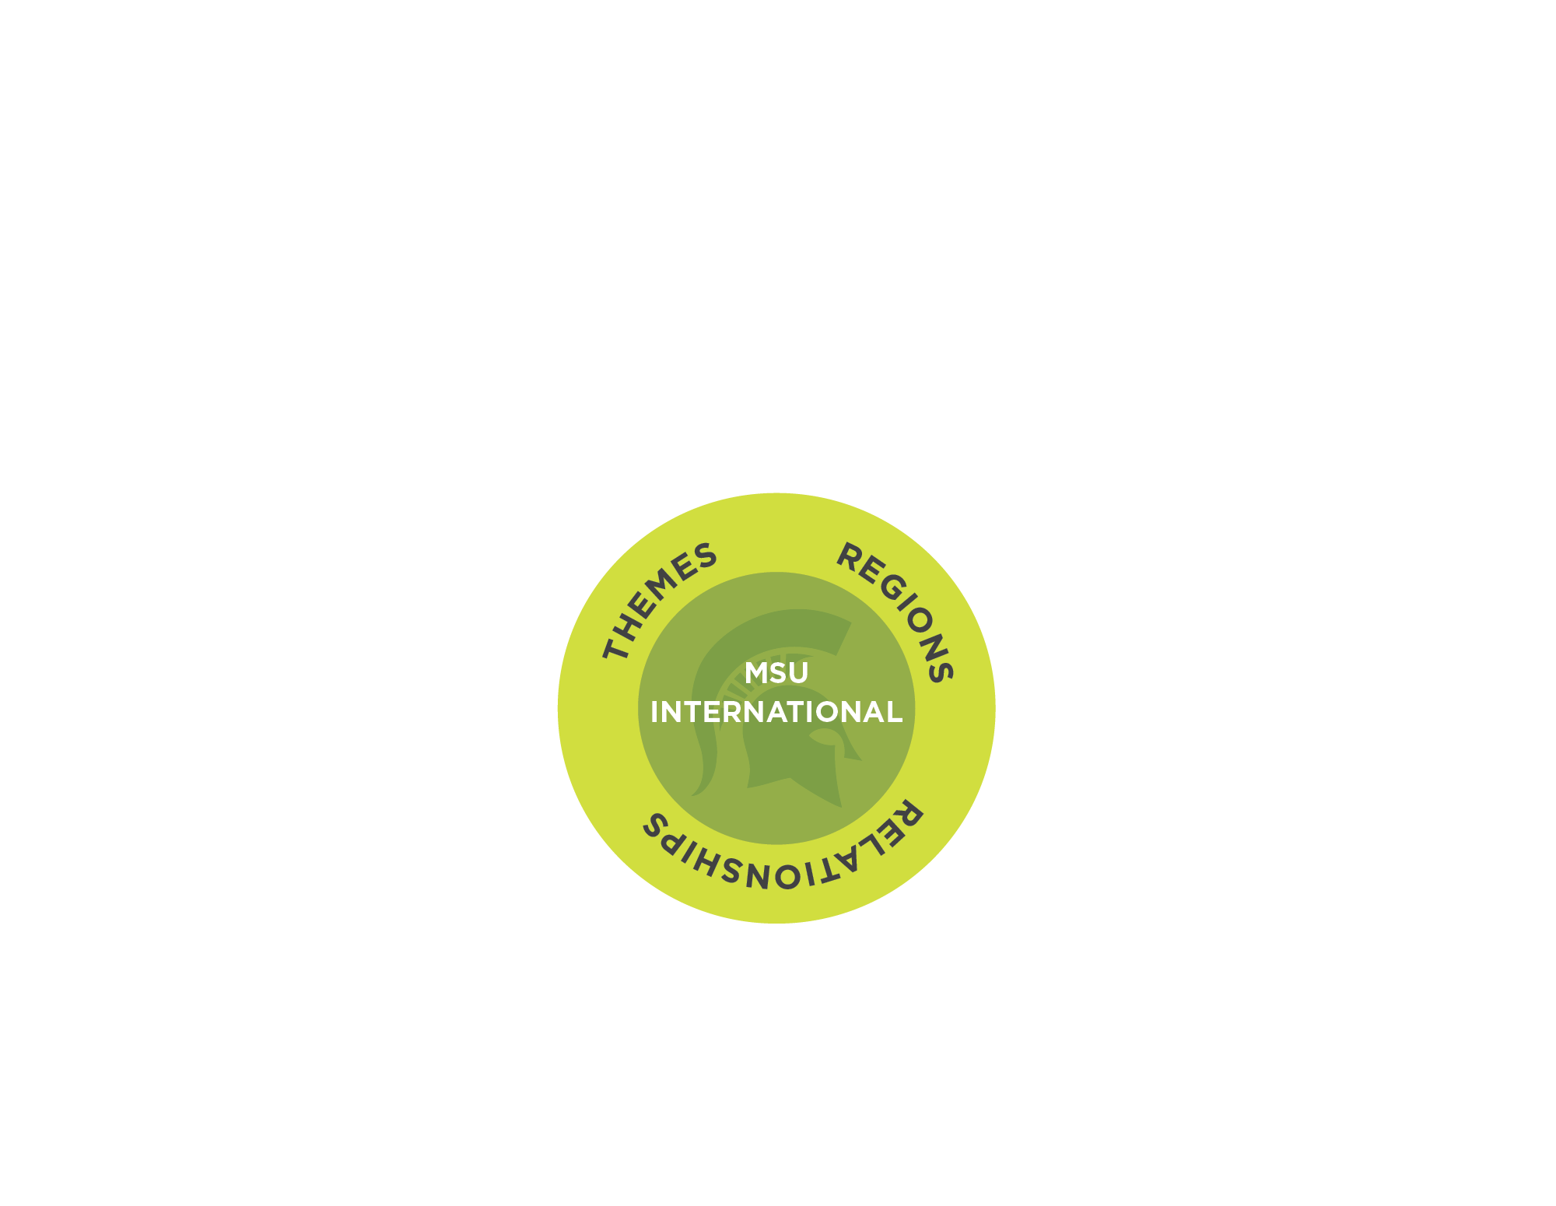
Internationalization
Strategy
Notes:
Overall philosophy: MSU is very intentional with international engagement, in line with MSU core values. We pursue ethical partnerships, diversity and inclusion.
We focus on research for impact.
ISP is a catalyst for international work at MSU—we facilitate, serve as a conduit, and collaborate across campus and the globe to strengthen MSU’s international engagement.
Our data shows where we excel—what thematic areas, regional expertise, and our global partnerships—and we focus on the intersection of those themes, regions and relationships to build our internationalization strategy.
We look at how those themes, regions and relationships relate to our various stakeholders—how our research and education is making an impact in communities around the world AND here at home.
Three pillars to how we’re operationalizing the strategy:
Innovating Global Solutions; We’re supporting faculty research to help global problems—developing and deepening sustainable, strategic international partnerships and supporting multi-disciplinary, cross-regional collaborations focused on research and scholarship.
Creating Global Citizens: We’re developing new education pathways, next-generation education programs and curriculum models—and aligning these programs with priority strategic partnerships.
Generating Global Investment: We are a resource hub for those pursuing international funding, helping faculty navigate an increasingly complex network of funding opportunities—individual donors, private foundations, governments.

Slide 10
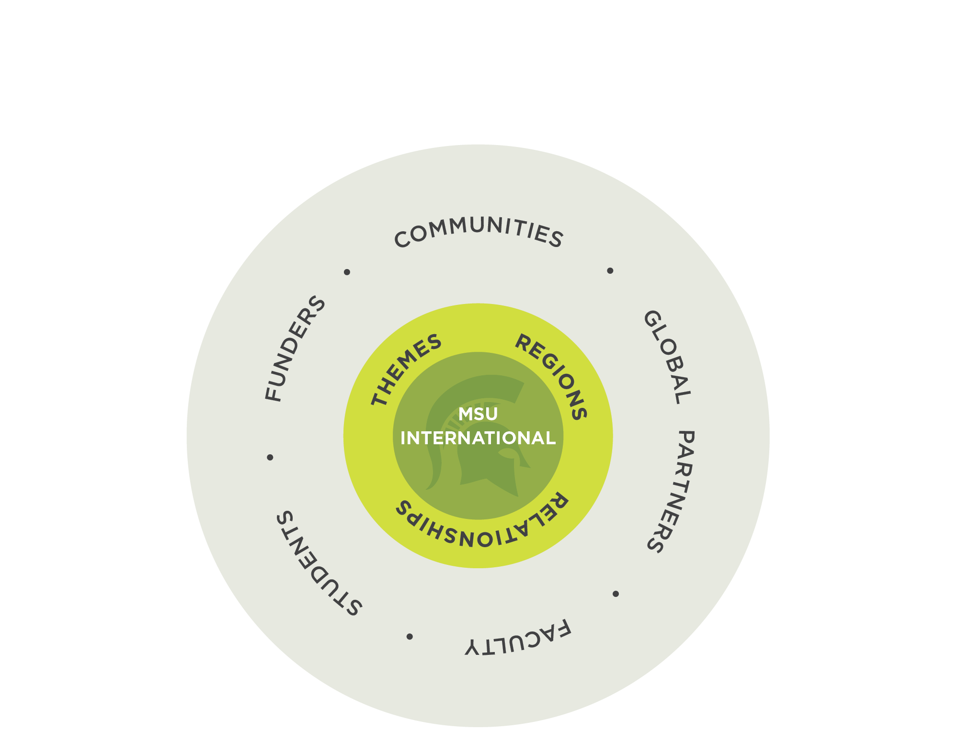
Internationalization
Strategy
Notes:
Overall philosophy: MSU is very intentional with international engagement, in line with MSU core values. We pursue ethical partnerships, diversity and inclusion.
We focus on research for impact.
ISP is a catalyst for international work at MSU—we facilitate, serve as a conduit, and collaborate across campus and the globe to strengthen MSU’s international engagement.
Our data shows where we excel—what thematic areas, regional expertise, and our global partnerships—and we focus on the intersection of those themes, regions and relationships to build our internationalization strategy.
We look at how those themes, regions and relationships relate to our various stakeholders—how our research and education is making an impact in communities around the world AND here at home.
Three pillars to how we’re operationalizing the strategy:
Innovating Global Solutions; We’re supporting faculty research to help global problems—developing and deepening sustainable, strategic international partnerships and supporting multi-disciplinary, cross-regional collaborations focused on research and scholarship.
Creating Global Citizens: We’re developing new education pathways, next-generation education programs and curriculum models—and aligning these programs with priority strategic partnerships.
Generating Global Investment: We are a resource hub for those pursuing international funding, helping faculty navigate an increasingly complex network of funding opportunities—individual donors, private foundations, governments.

Slide 11
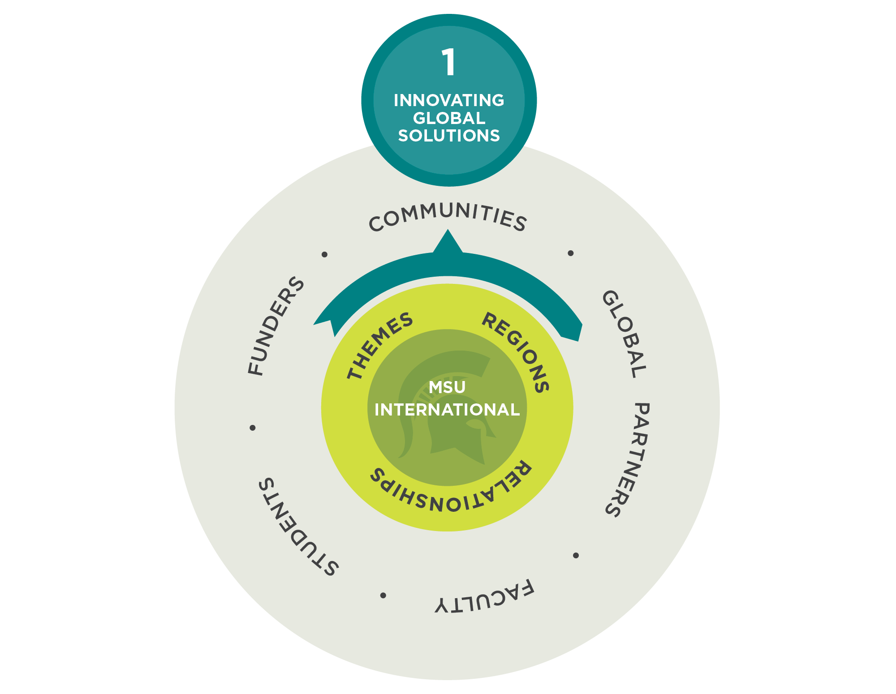
Internationalization
Strategy
Notes:
Overall philosophy: MSU is very intentional with international engagement, in line with MSU core values. We pursue ethical partnerships, diversity and inclusion.
We focus on research for impact.
ISP is a catalyst for international work at MSU—we facilitate, serve as a conduit, and collaborate across campus and the globe to strengthen MSU’s international engagement.
Our data shows where we excel—what thematic areas, regional expertise, and our global partnerships—and we focus on the intersection of those themes, regions and relationships to build our internationalization strategy.
We look at how those themes, regions and relationships relate to our various stakeholders—how our research and education is making an impact in communities around the world AND here at home.
Three pillars to how we’re operationalizing the strategy:
Innovating Global Solutions; We’re supporting faculty research to help global problems—developing and deepening sustainable, strategic international partnerships and supporting multi-disciplinary, cross-regional collaborations focused on research and scholarship.
Creating Global Citizens: We’re developing new education pathways, next-generation education programs and curriculum models—and aligning these programs with priority strategic partnerships.
Generating Global Investment: We are a resource hub for those pursuing international funding, helping faculty navigate an increasingly complex network of funding opportunities—individual donors, private foundations, governments.

Slide 12
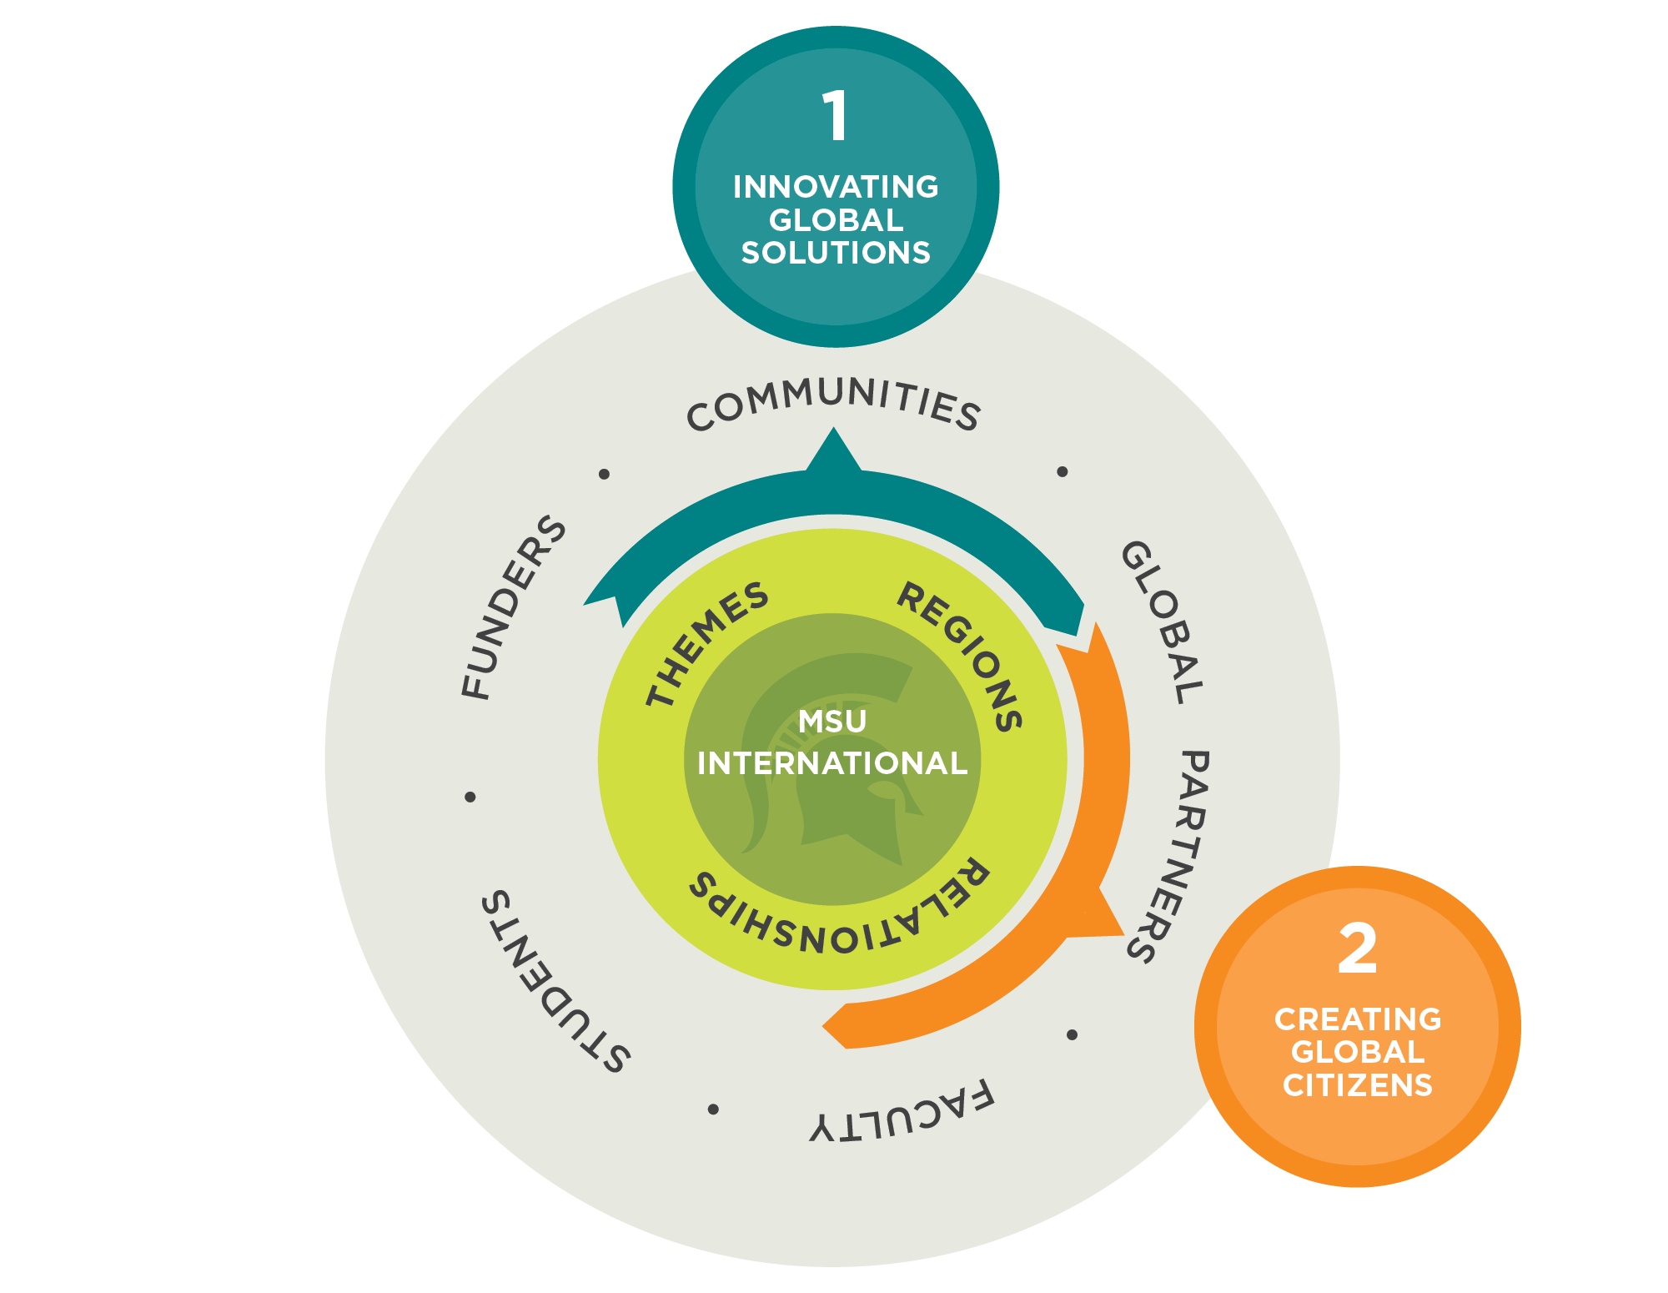
Internationalization
Strategy
Notes:
Overall philosophy: MSU is very intentional with international engagement, in line with MSU core values. We pursue ethical partnerships, diversity and inclusion.
We focus on research for impact.
ISP is a catalyst for international work at MSU—we facilitate, serve as a conduit, and collaborate across campus and the globe to strengthen MSU’s international engagement.
Our data shows where we excel—what thematic areas, regional expertise, and our global partnerships—and we focus on the intersection of those themes, regions and relationships to build our internationalization strategy.
We look at how those themes, regions and relationships relate to our various stakeholders—how our research and education is making an impact in communities around the world AND here at home.
Three pillars to how we’re operationalizing the strategy:
Innovating Global Solutions; We’re supporting faculty research to help global problems—developing and deepening sustainable, strategic international partnerships and supporting multi-disciplinary, cross-regional collaborations focused on research and scholarship.
Creating Global Citizens: We’re developing new education pathways, next-generation education programs and curriculum models—and aligning these programs with priority strategic partnerships.
Generating Global Investment: We are a resource hub for those pursuing international funding, helping faculty navigate an increasingly complex network of funding opportunities—individual donors, private foundations, governments.

Slide 13
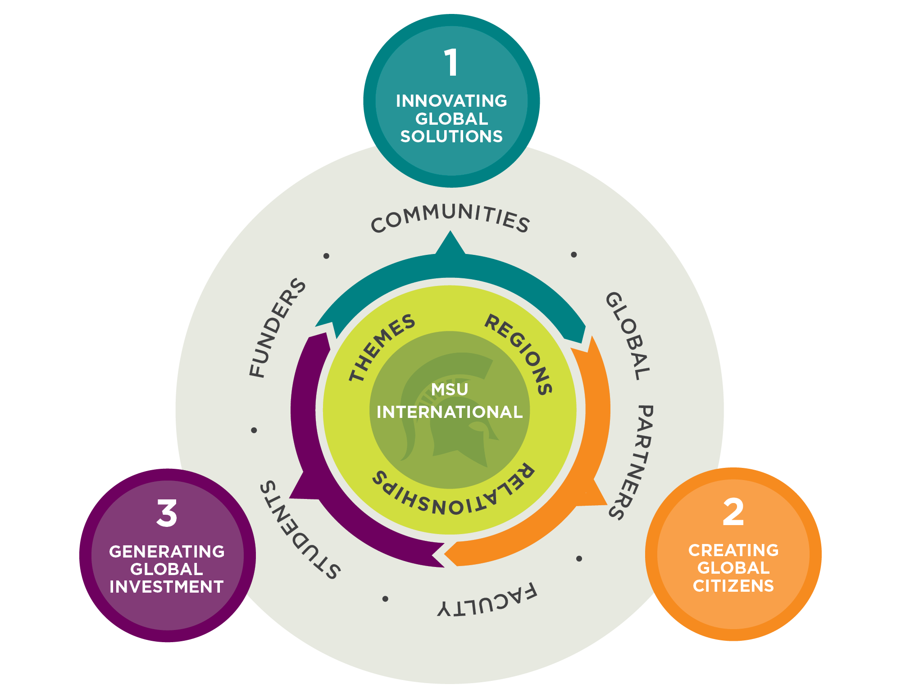
Internationalization
Strategy
Notes:
Overall philosophy: MSU is very intentional with international engagement, in line with MSU core values. We pursue ethical partnerships, diversity and inclusion.
We focus on research for impact.
ISP is a catalyst for international work at MSU—we facilitate, serve as a conduit, and collaborate across campus and the globe to strengthen MSU’s international engagement.
Our data shows where we excel—what thematic areas, regional expertise, and our global partnerships—and we focus on the intersection of those themes, regions and relationships to build our internationalization strategy.
We look at how those themes, regions and relationships relate to our various stakeholders—how our research and education is making an impact in communities around the world AND here at home.
Three pillars to how we’re operationalizing the strategy:
Innovating Global Solutions; We’re supporting faculty research to help global problems—developing and deepening sustainable, strategic international partnerships and supporting multi-disciplinary, cross-regional collaborations focused on research and scholarship.
Creating Global Citizens: We’re developing new education pathways, next-generation education programs and curriculum models—and aligning these programs with priority strategic partnerships.
Generating Global Investment: We are a resource hub for those pursuing international funding, helping faculty navigate an increasingly complex network of funding opportunities—individual donors, private foundations, governments.

Slide 14
MSU
International Studies and Programs

Slide 15
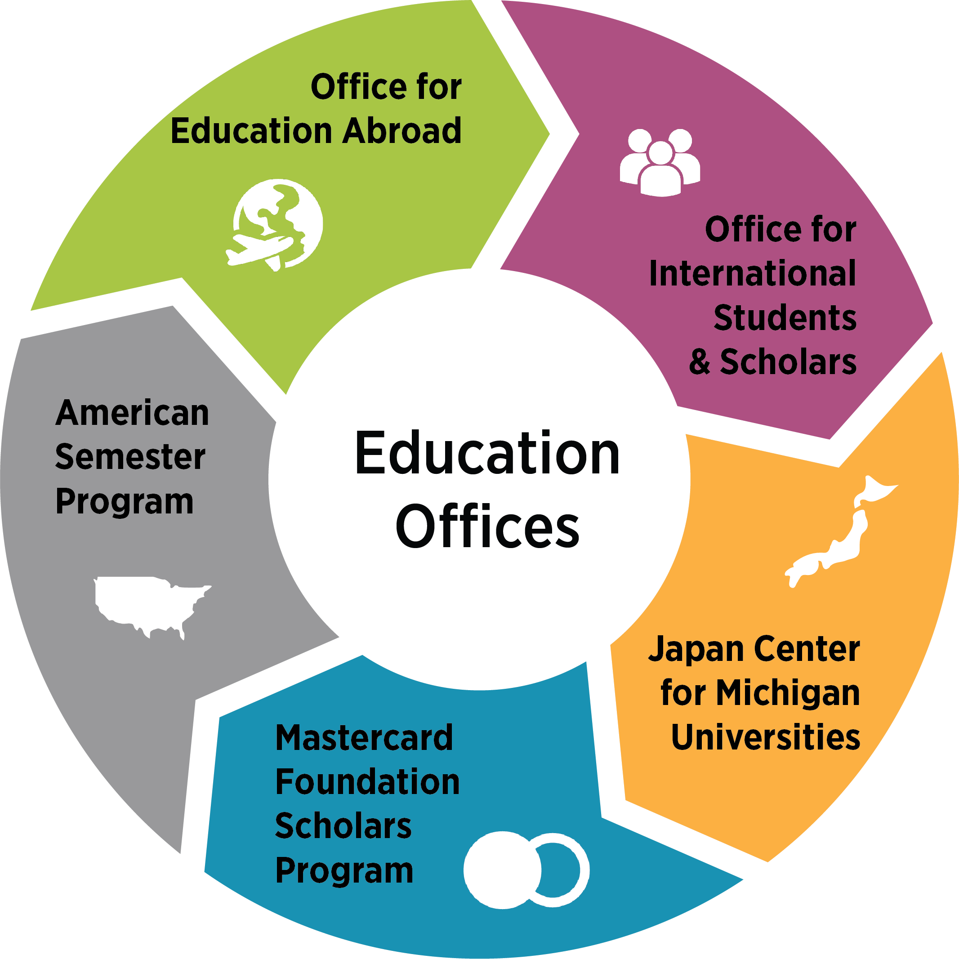
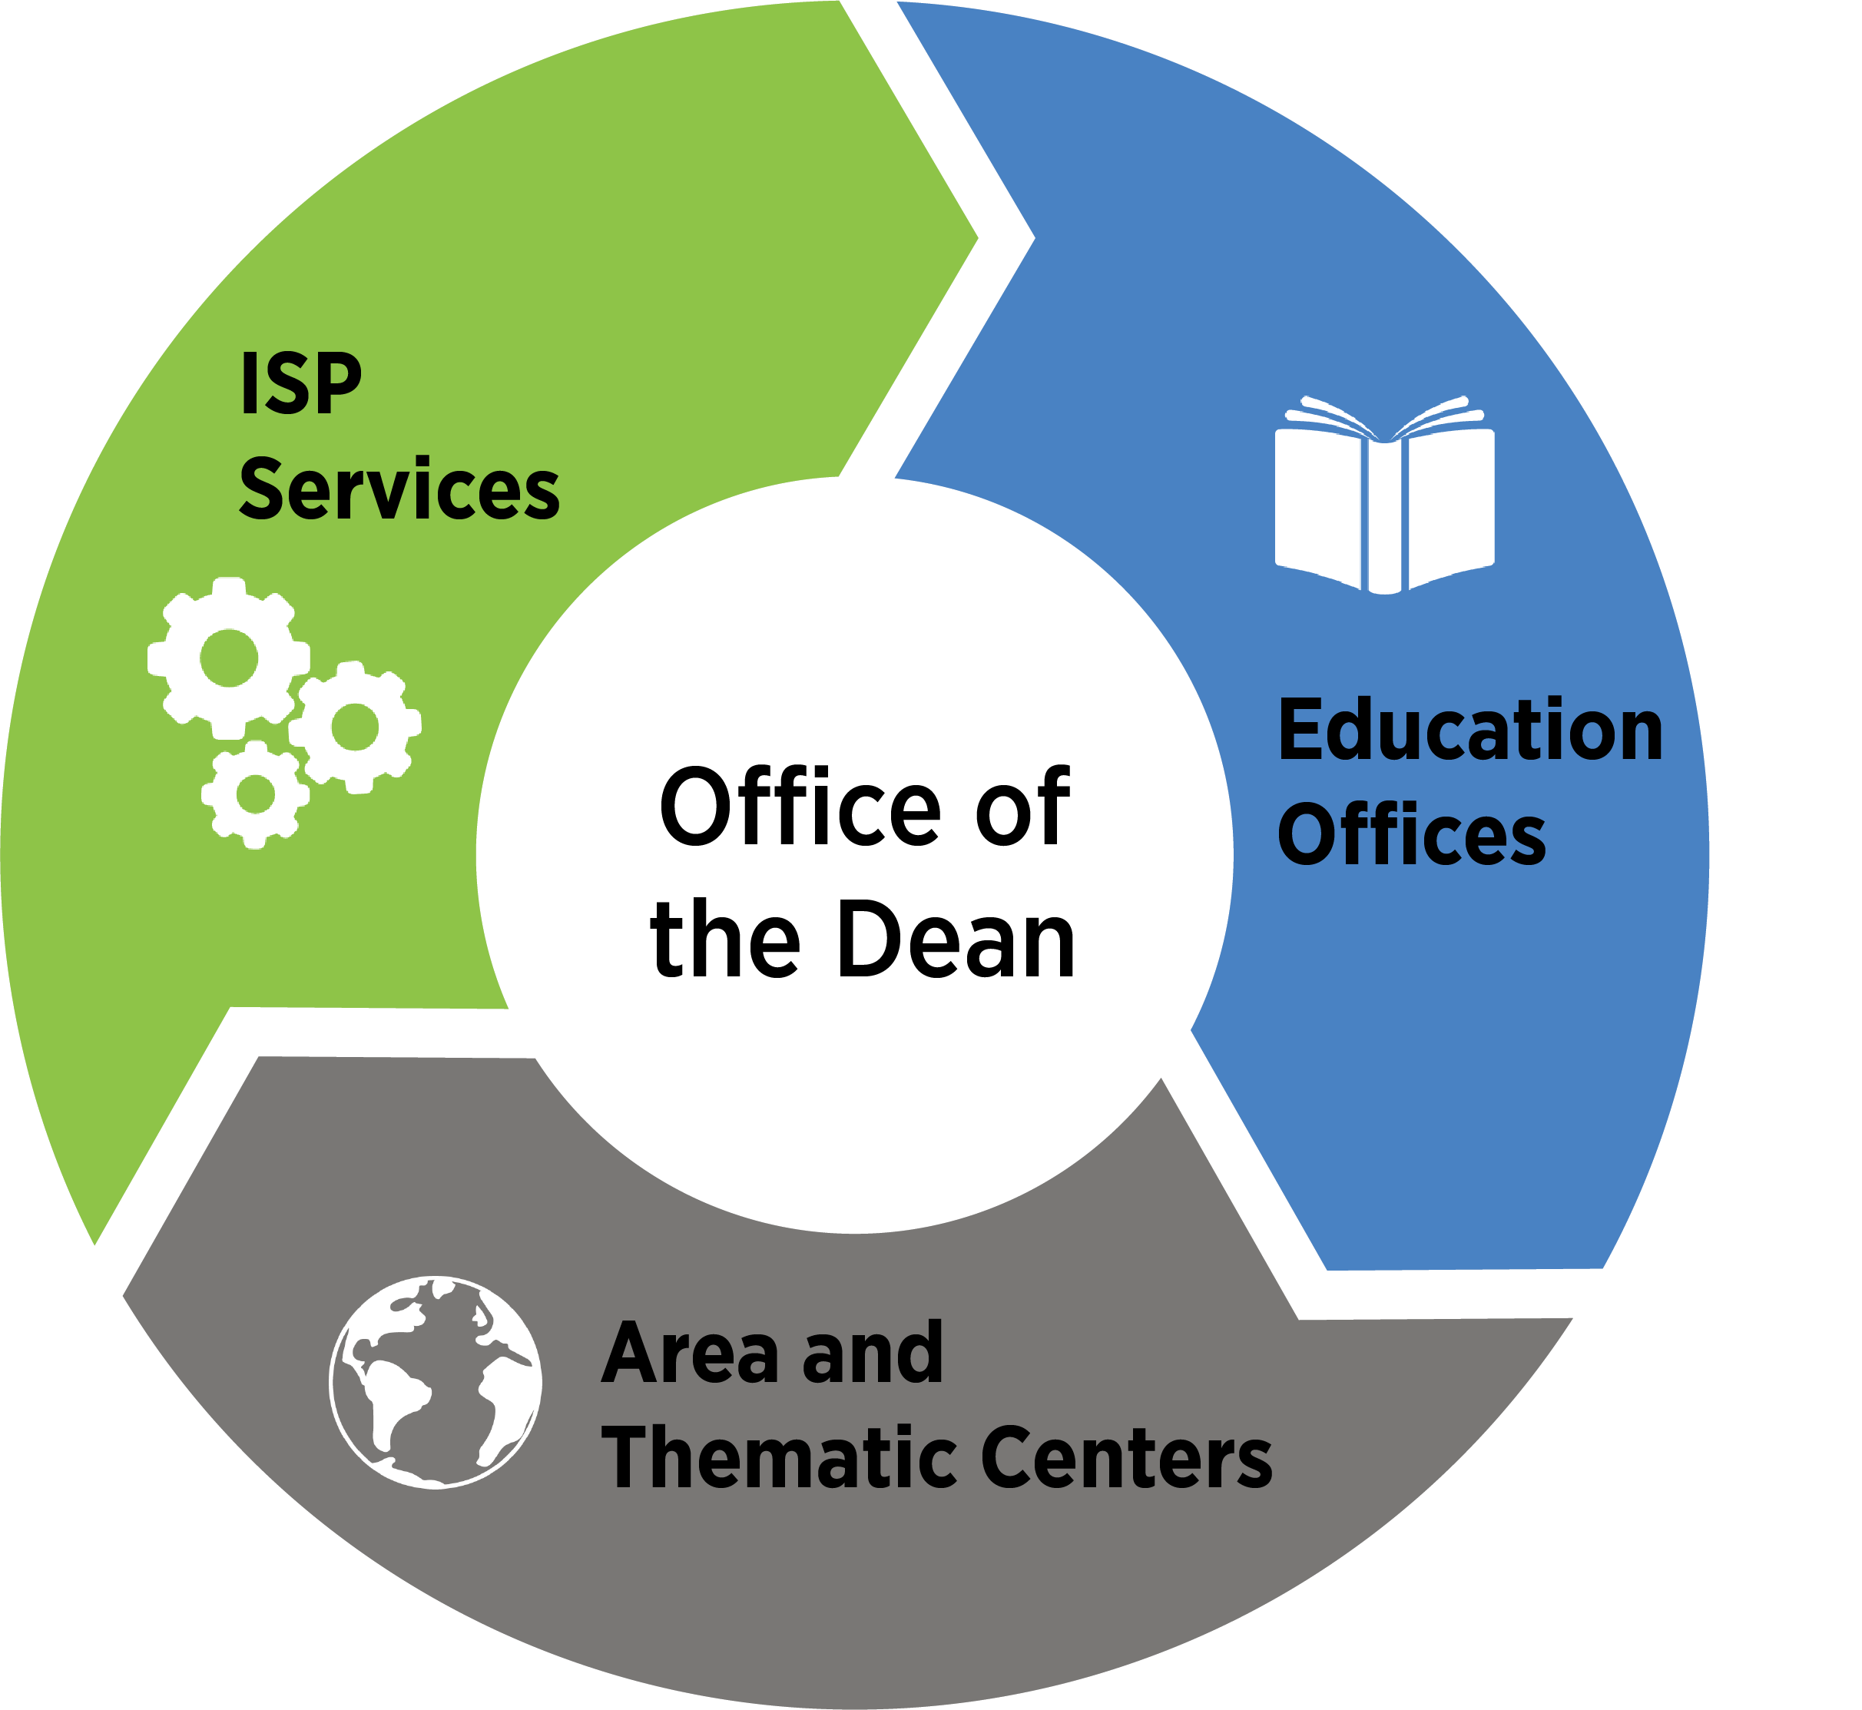
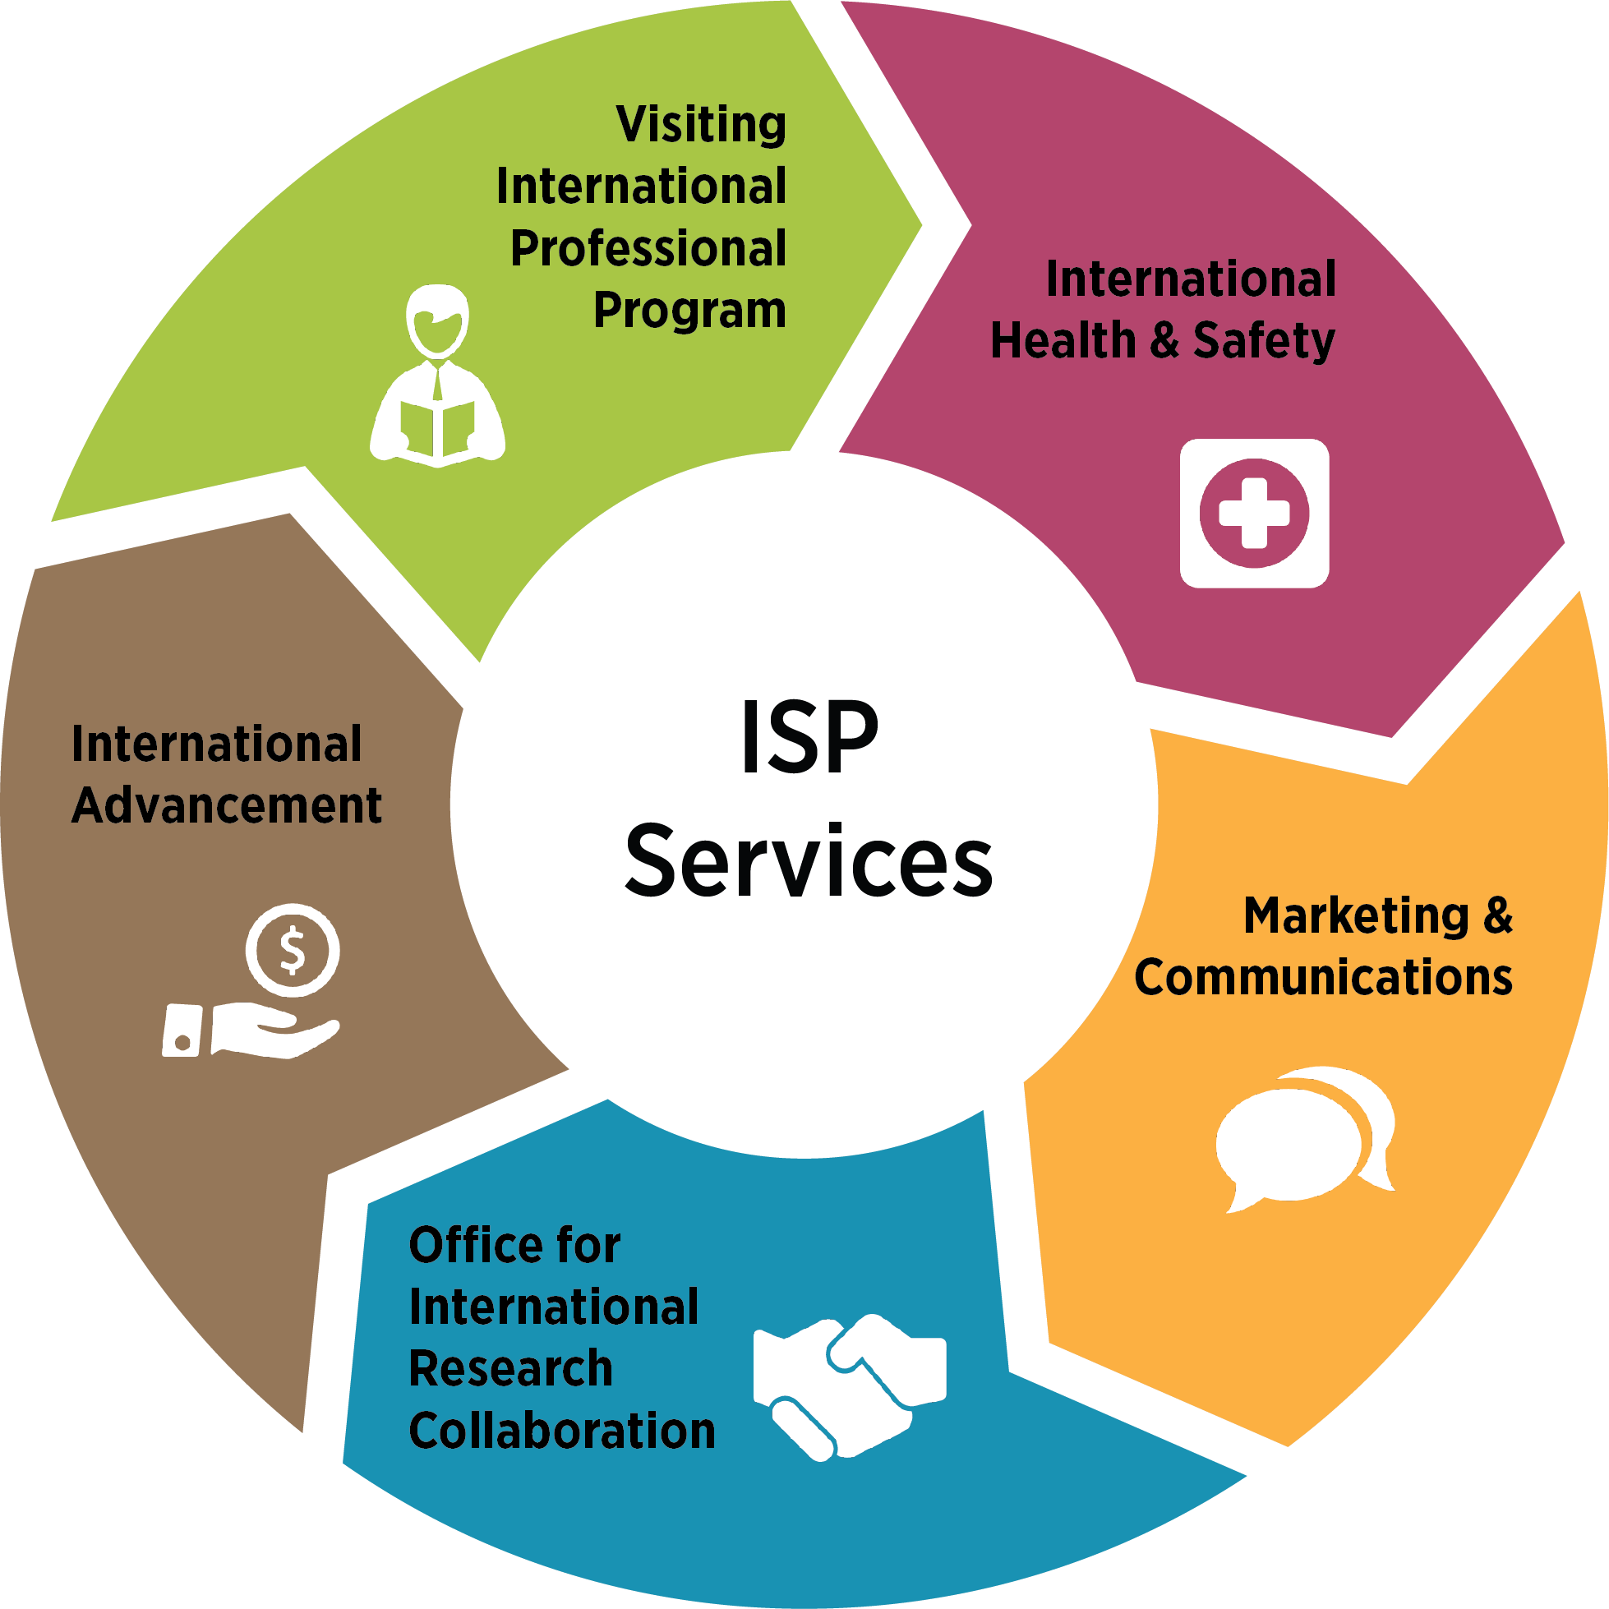
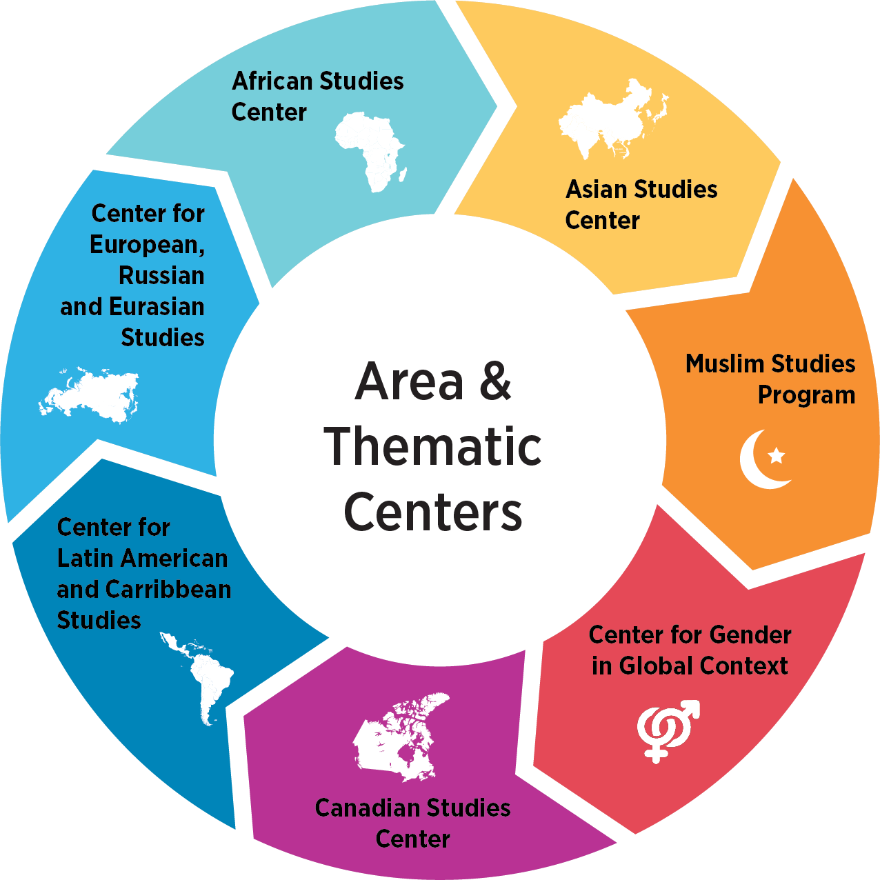
International Studies and Programs

Slide 16

MSU Global Travel Registry

Slide 17
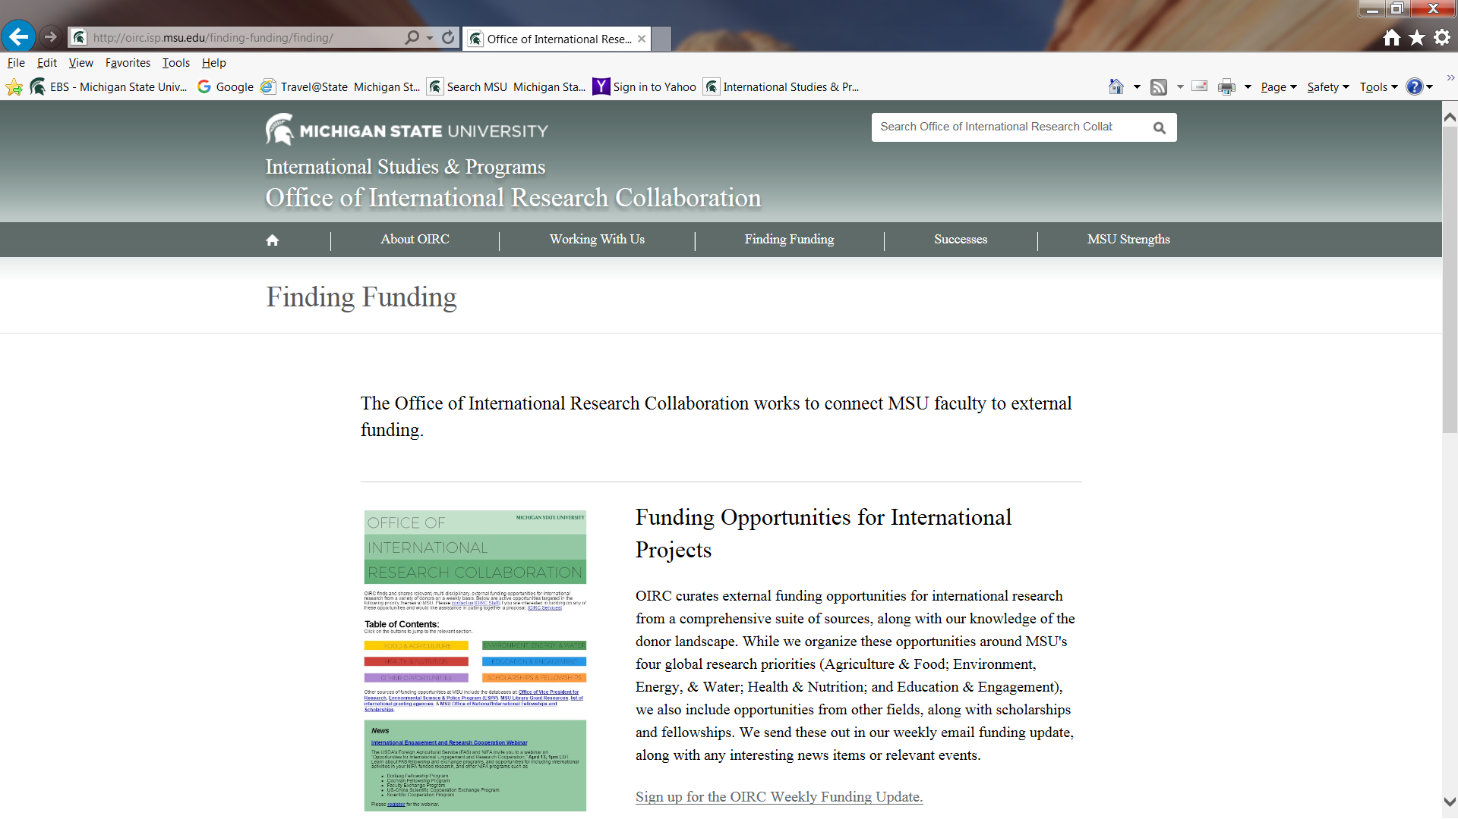
Funding for International Research – Sign Up!
Notes:
OIRC funding update sign up

Slide 18
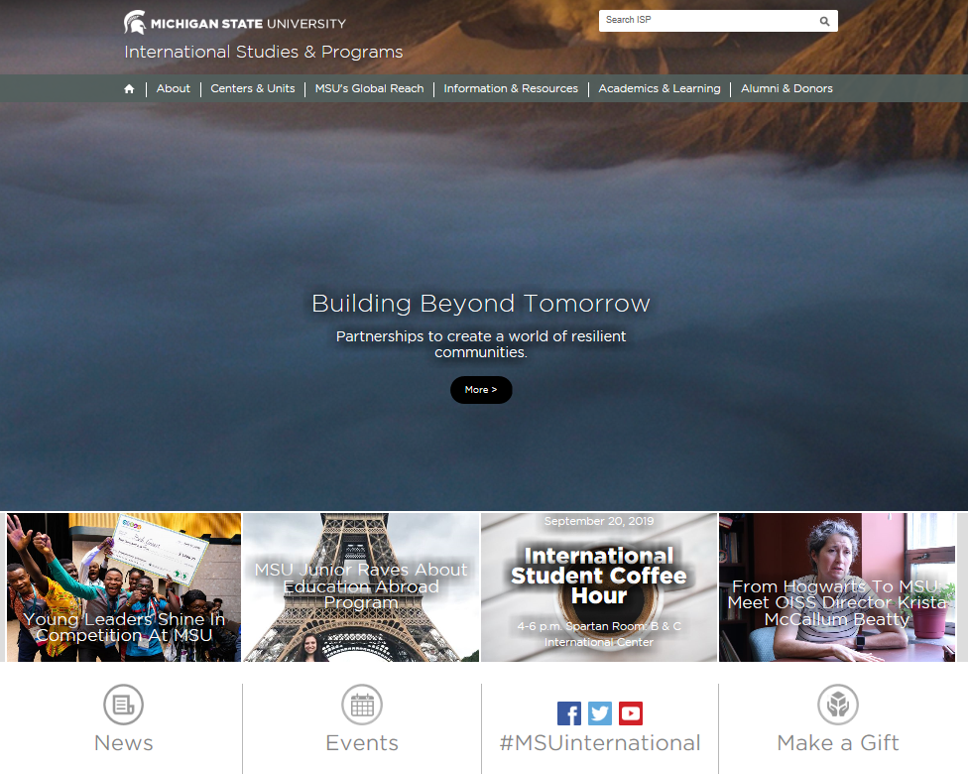
https://www.isp.msu.edu/

