Slide 1
University Communications New Administrator Orientation August 5, 2019
Merri Jo Bales
Emily Guerrant
Heather Swain

Slide 2
Agenda
Who We Are
What We Do
How We Can Help

Slide 3
Samuel L. Stanley Jr., M.D.
President
Michigan State University
Kathleen Wilbur, PhD
Executive Vice President
Government, Communications and Advancement
Merri Jo Bales
Vice President and
Strategic Director
University Communications
Heather Swain
Vice President Marketing, Public Relations and
Digital Strategy
Emily Guerrant
Vice President and
University Spokesperson
Media and Public Information

Slide 4
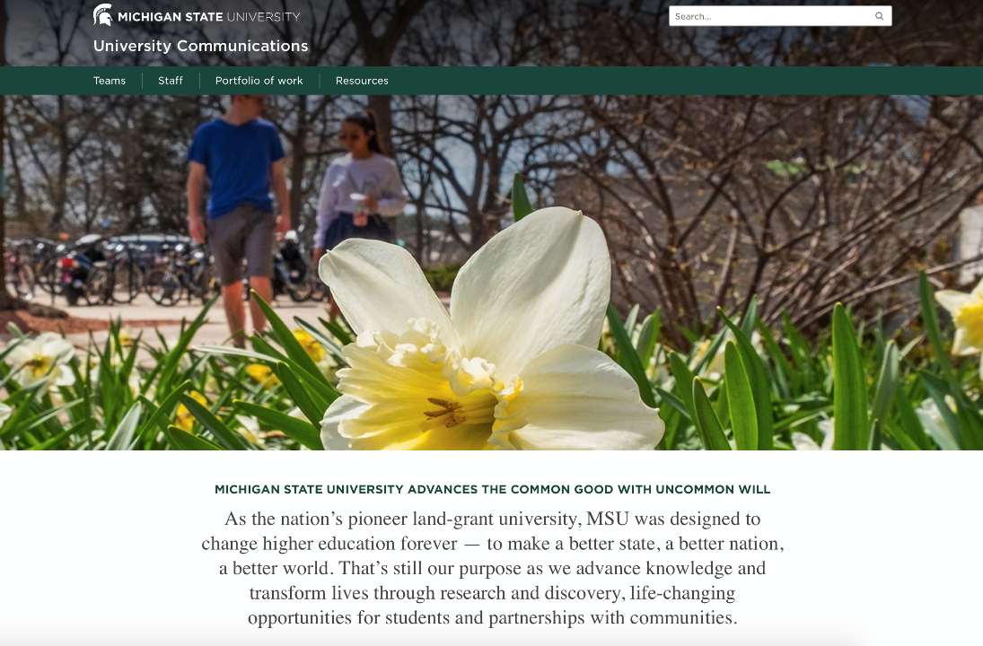

Slide 5
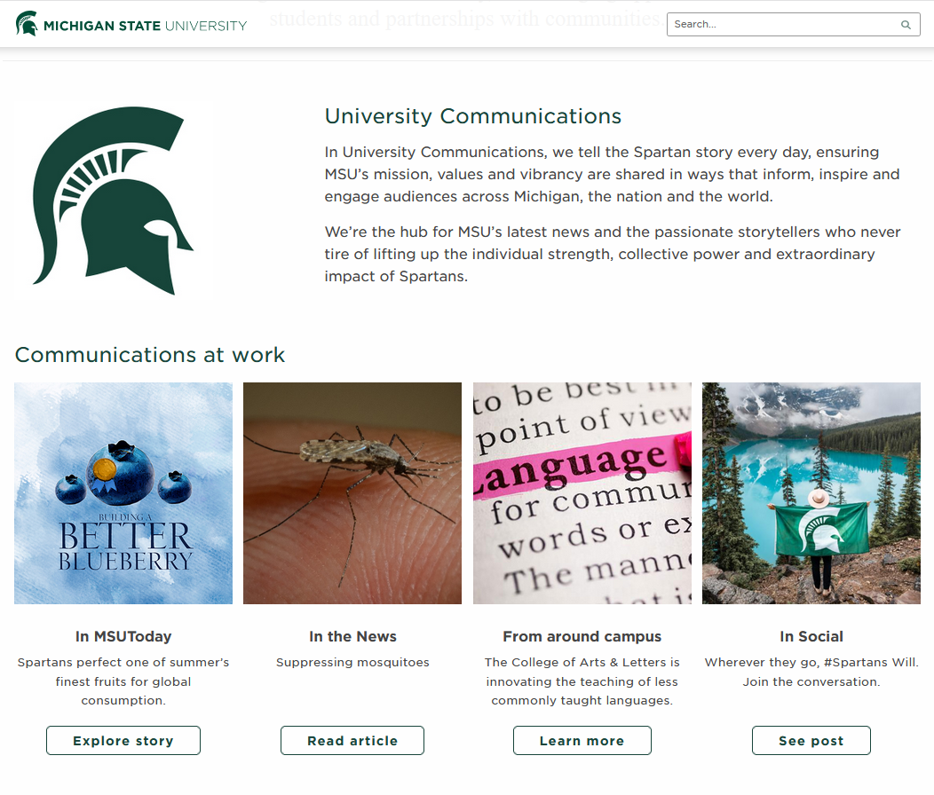

Slide 6
University Communications
Marketing, Public Relations and Digital Strategy
Media and Public Information
Heather Swain & Team
Emily Guerrant & Team
Marketing & Advertising
PR
Content & Channels
Media
Public Info
Internal Comms
Digital Social
Brand Guidelines
Analytics
Issues & Crisis Resp
Executive
Comms

Slide 7
University Communications Concept
Marketing, Public Relations and Digital Strategy
Strategic Partnerships
Media and Public Information
Communicators from
Colleges & Other Units
Heather Swain and Team
Todd Carter and Team
Emily Guerrant and Team

Slide 8
University Communications Concept
Colleges and Units
AG & NATURAL RESOURCES
ARTS AND LETTERS
RESIDENTIAL COLLEGE ARTS & HUMANITIES
ELI BROAD COLLEGE OF BUSINESS
COMMUNICATIONS ARTS & SCIENCES
EDUCATION
ENGINEERING
HUMAN MEDICINE
JAMES MADISON COLLEGE
COLLEGE OF LAW
LYMAN BRIGGS
MUSIC
NATURAL SCIENCE
NURSING
OSTEOPATHIC MEDICINE
PROVOST OFFICE
STUDENT AFFAIRS
SOCIAL SCIENCE
VETERINARY MEDICINE
OFFICE OF ADMISSIONS
RESIDENTIAL HOUSING SERVICES
Marketing, Public Relations and Digital Strategy
Strategic Partnerships
Media and Public Information
Communicators from
Colleges & Other Units
Heather Swain and Team
Todd Carter and Team
Emily Guerrant and Team
Notes:
MJ

Slide 9
What we’ll accomplish together…
Build a university communications infrastructure/network that’s
Timely
Informative
Transparent, and
Engaging

Slide 10
Marketing, PR & Digital Strategy Update
Advancing MSU’s distinctiveness and reputation
Content-driven strategy, strong channels
Collaborate on content with communicators across MSU
Integrated approach:
earned (PR),
owned (web, email),
shared (social) and
paid (advertising, sponsored) to drive content visibility and consumption

Slide 11
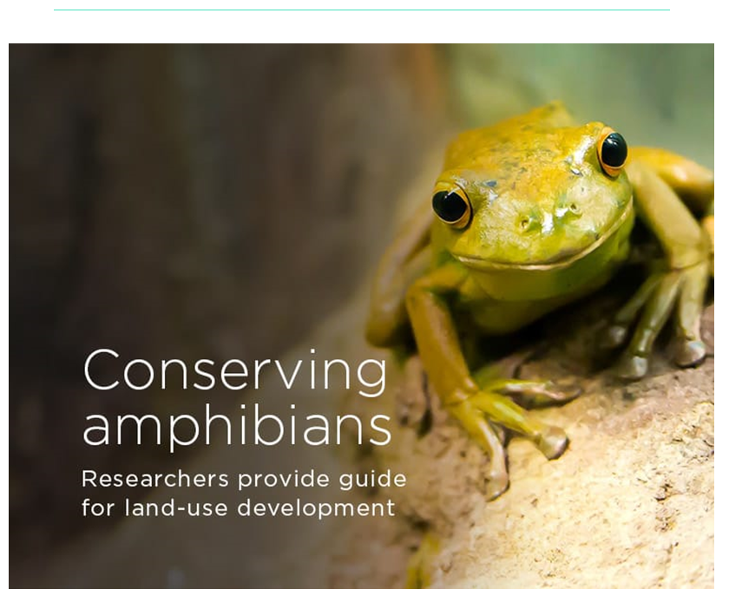
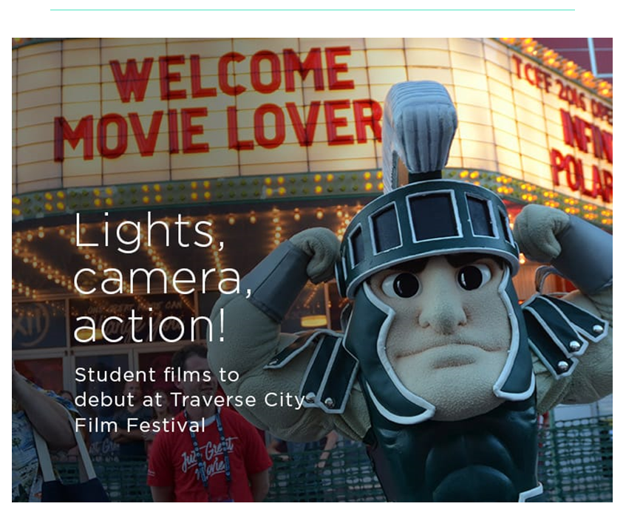
Subscribe: MSUToday Weekly Email https://msutoday.msu.edu

Slide 12
Read: INSIDE MSU

Slide 13
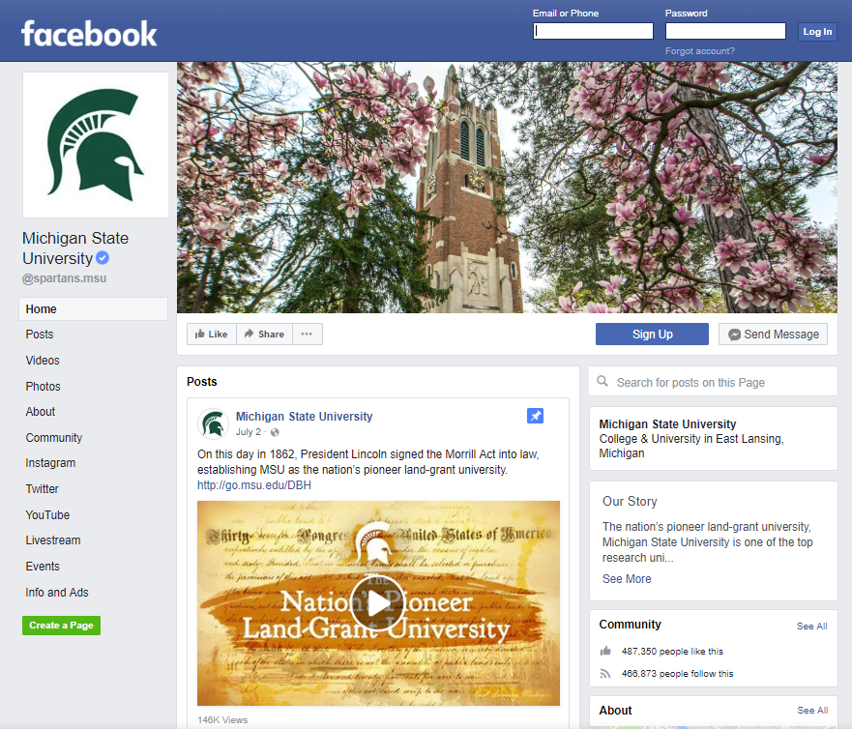
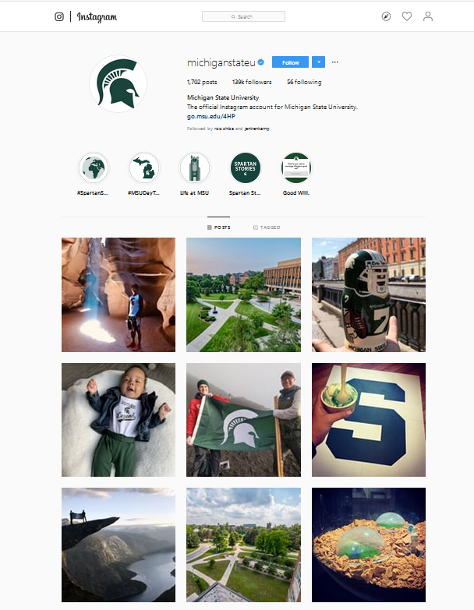
Follow MSU Social

Slide 14
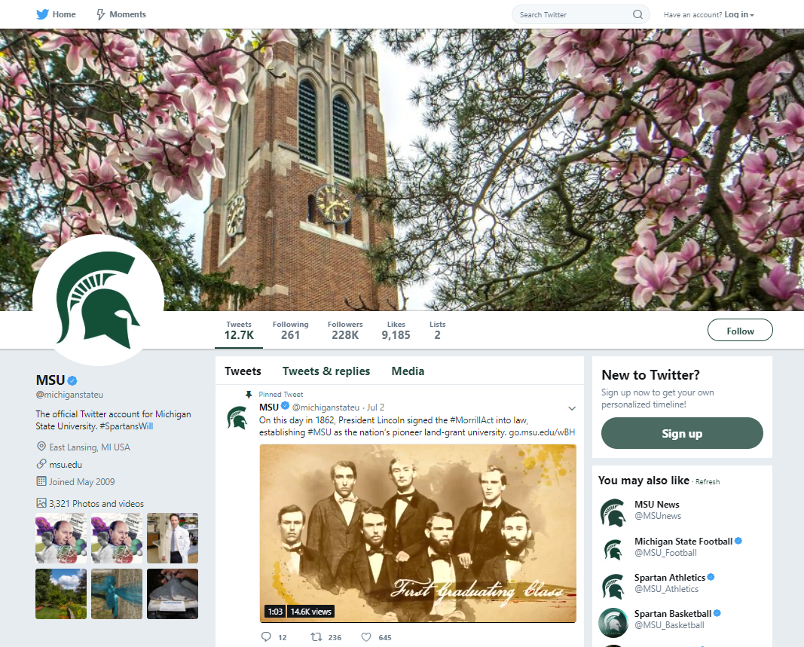
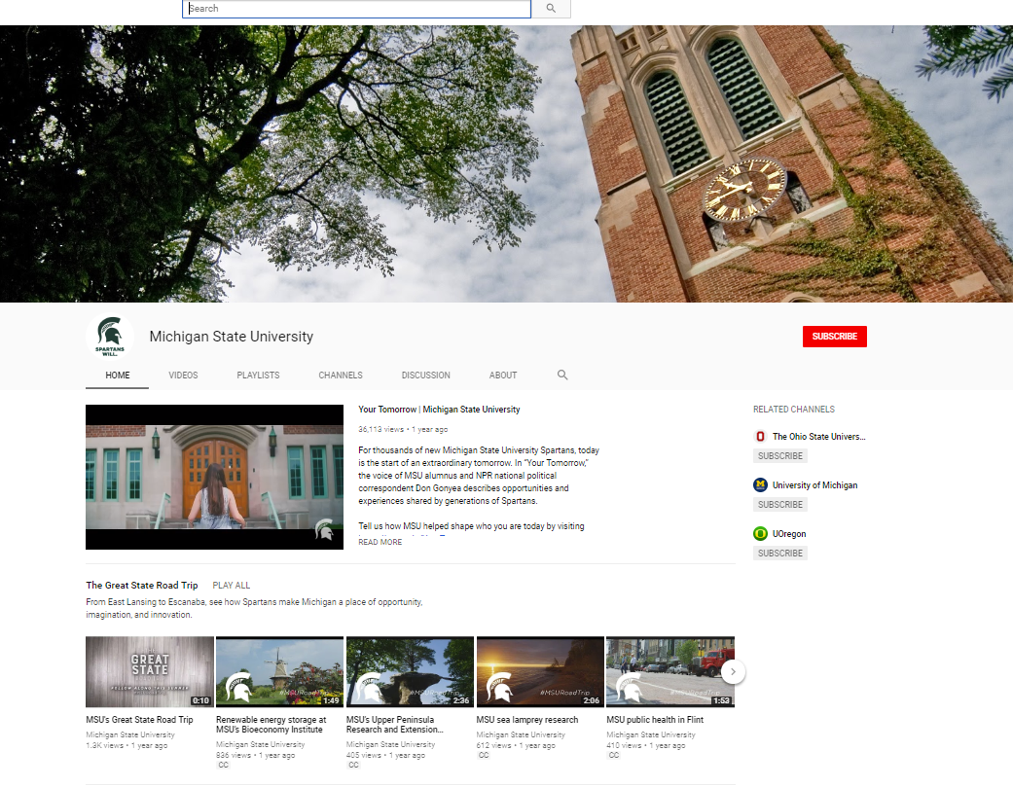
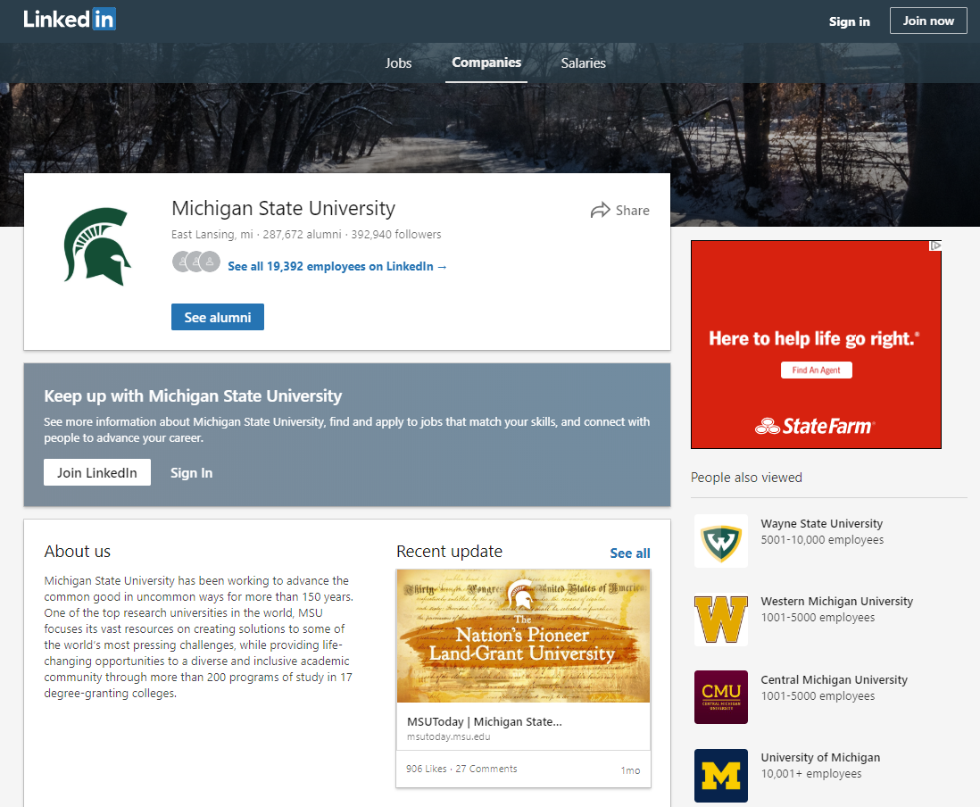
Follow MSU Social

Slide 15
Contribute….

Slide 16
Have something to share?
Tell your unit/college communicator!
Have something to say? Author a Faculty Voice or a piece for The Conversation
Offer content for InsideMSU, contact Jason Cody
Think it’s national news? Talk to your PR contact
Not national but still a cool story idea or tidbit? Send it to MSUToday Editor Lisa Mulcrone (Mulcron2@msu.edu)
It could become:
Feature
Pride point
Notable

Slide 17
Key PR Contacts
JEN DAVIS, Director of Public Relations
432-0304 | jend@msu.edu
LAYNE CAMERON – camer102.msu.edu
Biotech/Economic Development
College of Agriculture and Natural Resources*
College of Engineering*
College of Natural Science
SARINA GLEASON – sgleason.msu.edu
College of Osteopathic Medicine
College of Veterinary
College of Human Medicine
College of Nursing
Lyman Briggs
KIM WARD – kward@msu.edu
College of Education
College of Law
FRIB
Student Success
CAROLINE BROOKS – brooks78@msu.edu
College of Social Science*
College of Engineering*
College of Ag and Natural Resources*
The Eli Broad College of Business
MSU Foundation
KRISTEN PARKER – klparker@msu.edu
Broad Art Museum
College of Arts and Letters
College of Communication Arts and Sciences
College of Music
College of Social Science*
Honors College
International Studies and Programs
James Madison
Residential College in Arts and Humanities
JESSI ADLER – jadler@msu.edu
Academic Training Initiative
Other news*
* Shared Responsibility

Slide 18
VP & University Spokesperson
Serves as main media contact for the university
Resource for media-related questions and concerns
Advises the president on media strategies
Issues, crisis and emergency management

Slide 19
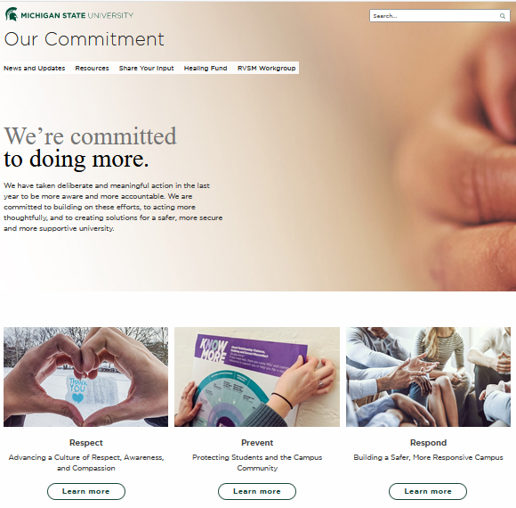
Media & Public Information
New Our Commitment webpage
Intermediate Healing Fund
New Issues and Statements webpage
Accessible from msu.edu
Board of Trustees
MSU President
Notes:
EG

Slide 20
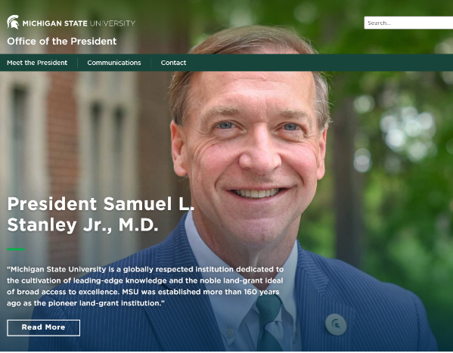
Media & Public Information
President Stanley
Admissions Release
Independent Investigation
Healing Fund
Next Board of Trustees Meeting
September 6
Notes:
EG

Slide 21
Get a media call?
Think it’s about the university?
Contact Emily or the general media line
Think it is about your college?
Tell your unit/college communicator
Speak as an expert or a leader in your area
Not sure? Both?
Tell your unit/college communicator
FYI Emily
General Media Contact
Email: Media@msu.edu | Phone: 517-353-7077

Slide 22
Need to talk through an issue?
Contact
Emily Guerrant
Email: emilyg@msu.edu | 517-355-3853
-or-
Melody Kindraka
Email: kindrak1@msu.edu | 517-355-2282

Slide 23
Other Key Contacts
MSUToday Editor – 432-0922
Lisa Mulcrone | Mulcron2@msu.edu
University Trademarks and Licensing – 353-8998
Samantha Stevens | Sstevens@msu.edu
MSU Logo Standards and Usage – 353-2956
Tony Frewen | Frewen@msu.edu
Photo/Video – 432-0909
Kevin Epling | Epling@msu.edu
Filming on Campus (filming must be coordinated and approved) Kevin Epling | Epling@msu.edu | 432-0909

Slide 24
Q&A

Slide 25
THANK YOU!
Emily Guerrant
Vice President and
University Spokesperson
emilyg@msu.edu 517-355-3853
Heather Swain
Vice President for Marketing,
PR and Digital Strategy
heather.swain@cabs.msu.edu 517-355-2262
Merri Jo Bales
Vice President and Strategic Director
University Communications
mjbales@msu.edu 517-884-8883

