Slide 1
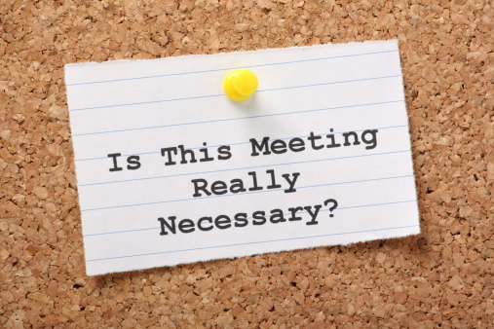
Leading Groups: Efficient and Productive Meetings

Slide 2
Basic Principles: Structure
If the answer to the question on the last slide is NO, then don’t hold the meeting.
Countless websites, guides, books exist on running efficient meetings. Some common themes that I have found useful:
Distribute an agenda ahead of time
Be sure the goals for the meeting are clear – a list of specific, actionable items
Keep the conversation focused on those goals; use a ‘parking lot’ for off-topic conversations
Take notes yourself (even if someone else is)
Distribute minutes shortly after the meeting; clearly identify any action items, along with due and who is responsible. *FOLLOW UP!
Start on time and end on time

Slide 3
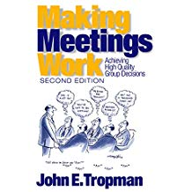
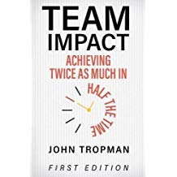
John Tropman
Henry J. Meyer Collegiate Professor of Social Work Emeritus, University of Michigan
2012
2017

Slide 4
Rule of Thirds
Three parts to each meeting:
Start-up period in which less difficult items are covered, latecomers arrive. Instructional items.
Heavy work period in which the most difficult items are considered. Decisions, action items.
Decompression period in which the meeting begins to wind down. Discussion items.

Slide 5
Agenda Bell
 | Urgency
Importance | Low | High
Low | 3 | 4 & 6
High | 4 | 5
Greatest Resources for Toughest Topic
Energy
Creativity/Brainstorming @each meeting around future topics
Modest Decision Item(s)
Moderate Decision Item(s)
Most Difficult Item(s)
Announce- ment(s)
Brainstorm Item(s)
Small Trivial Item(s)
Minutes
1
2
3
4
5
6
7
Time
Notes:
The Agenda Bell Rule This rule is a more specific rule about when certain types of agenda items should be covered. Agenda items should be considered in order of ascending controversiality, then attention should be turned to discussion and decompression items. Figure C.2 shows a typical agenda bell for a meeting. URGENCY = time sensitivity.

